Slide 1
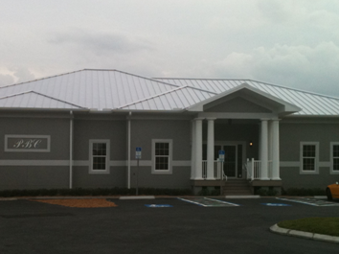
Vision Building Systems, L.L.C.
Permanent Buildings with Modular Construction

Slide 2
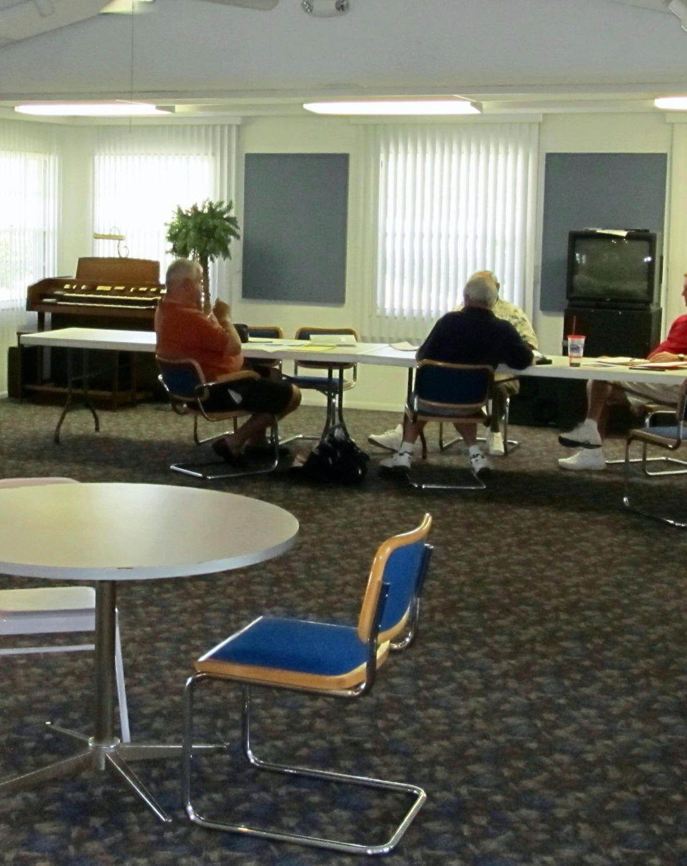
All successful projects begin with proper preparation and planning with designers and engineers.
These meetings are key to producing all the necessary plans for the project.

Slide 3
Conceptual Plan

Slide 4
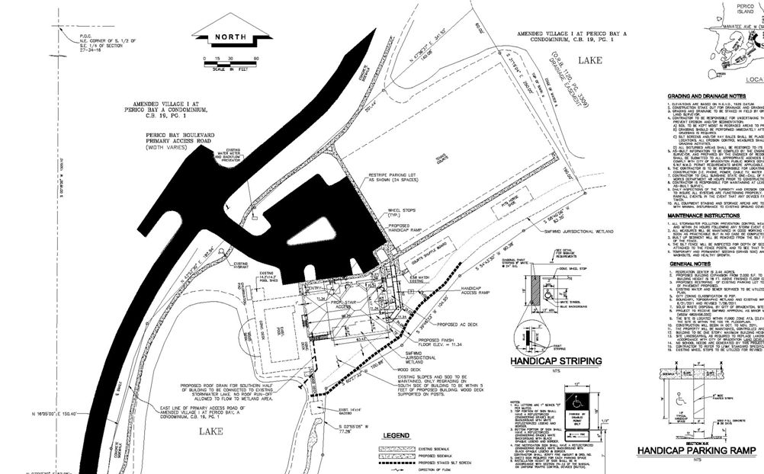
Site Plan

Slide 5
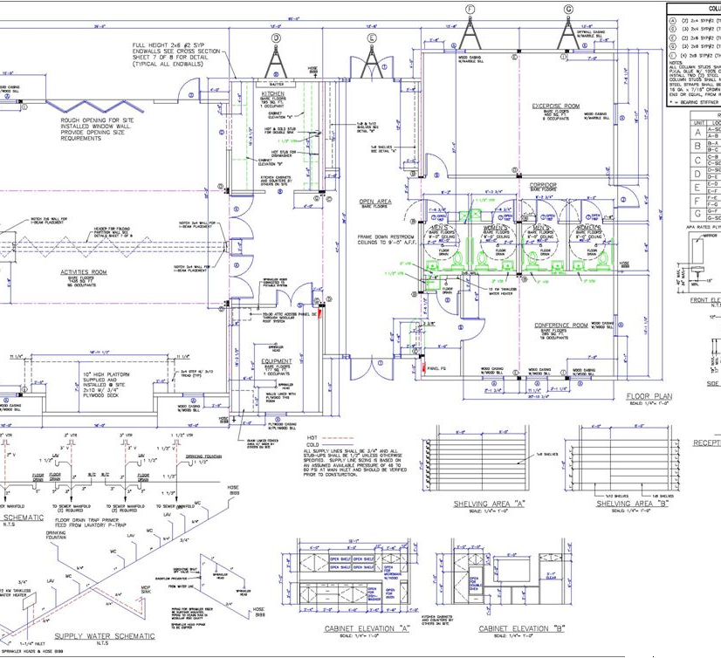
Engineered Building Plan

Slide 6
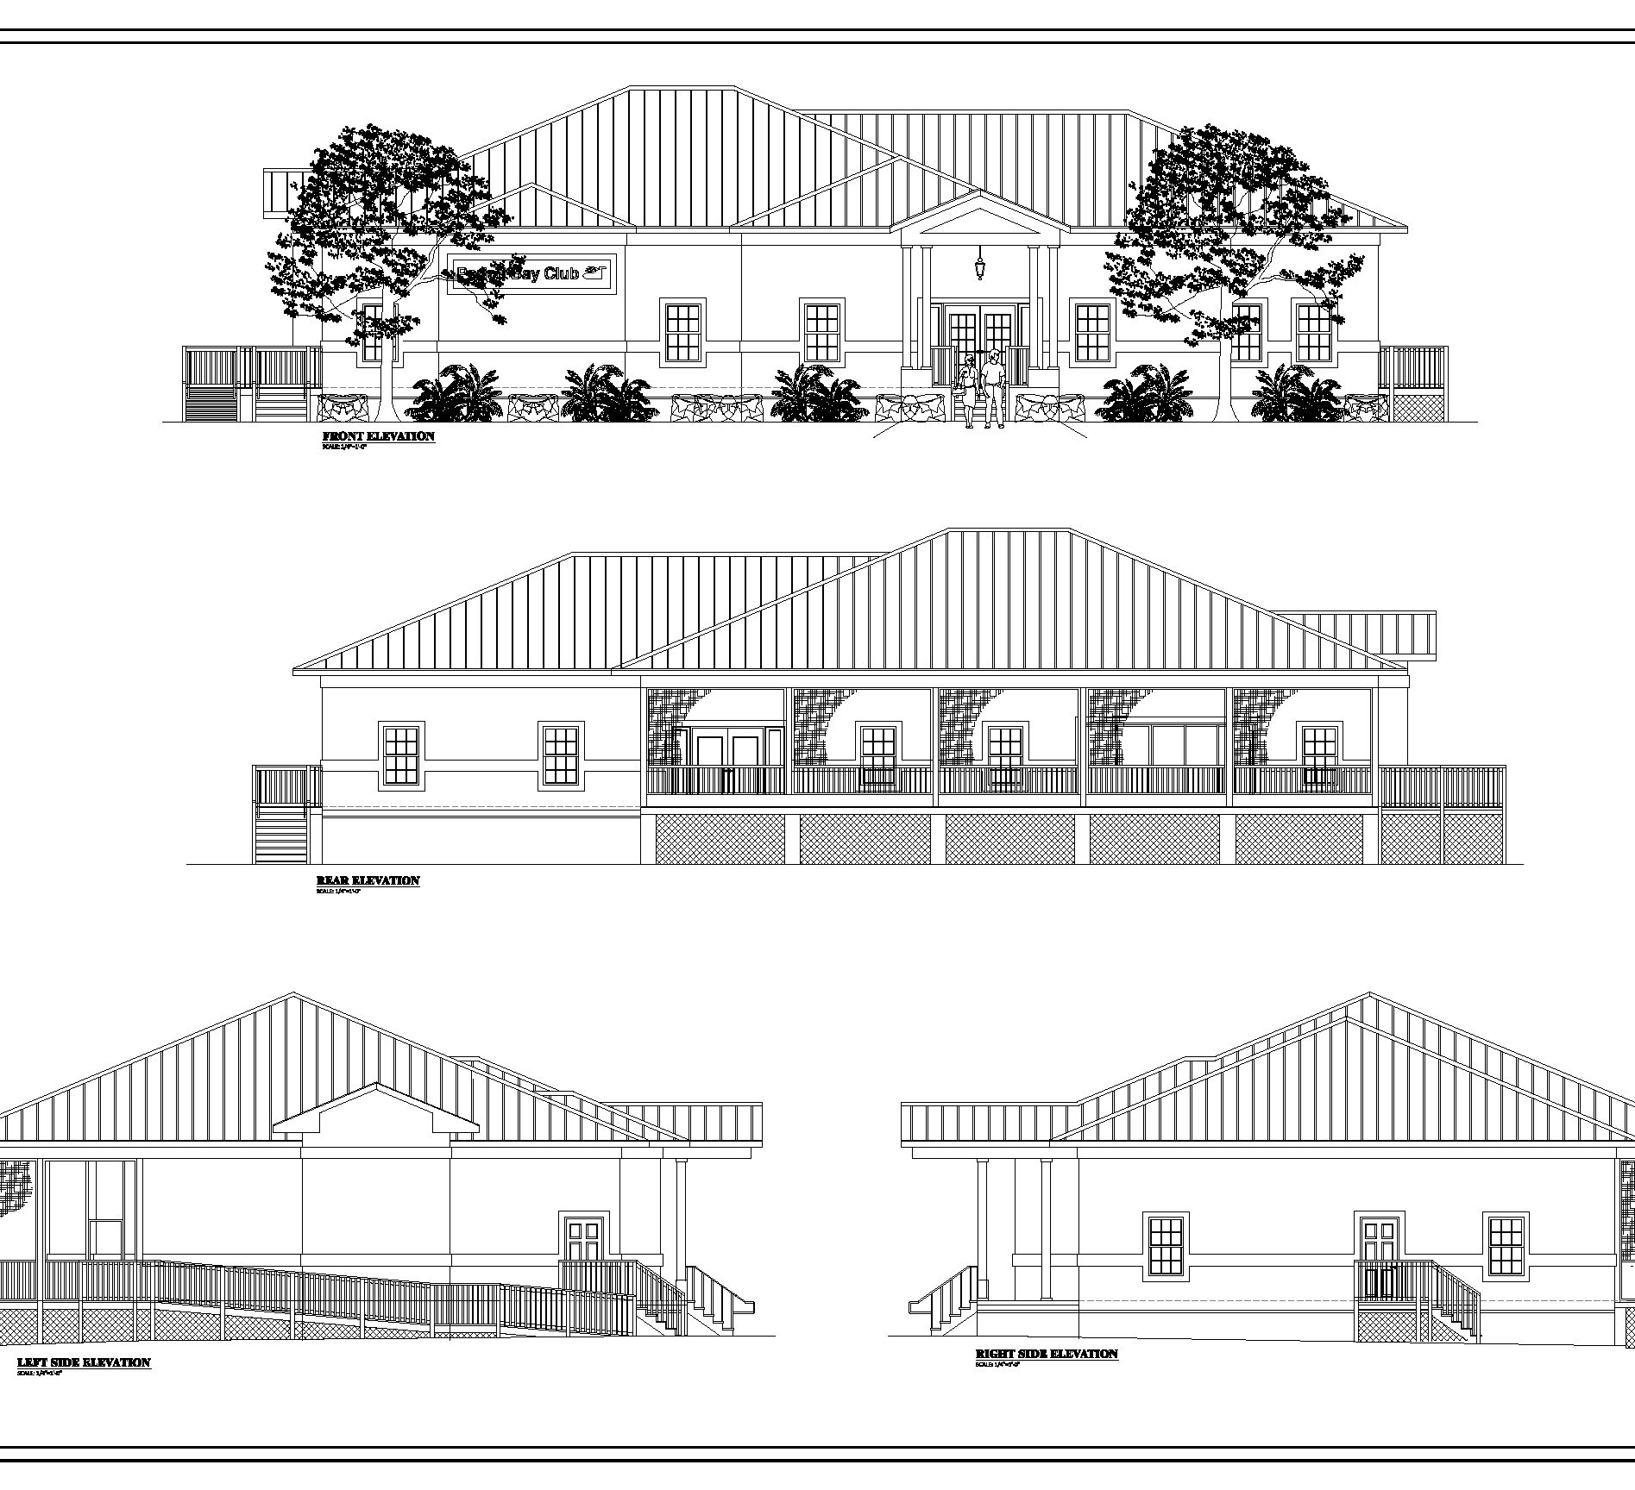
Building Elevations

Slide 7
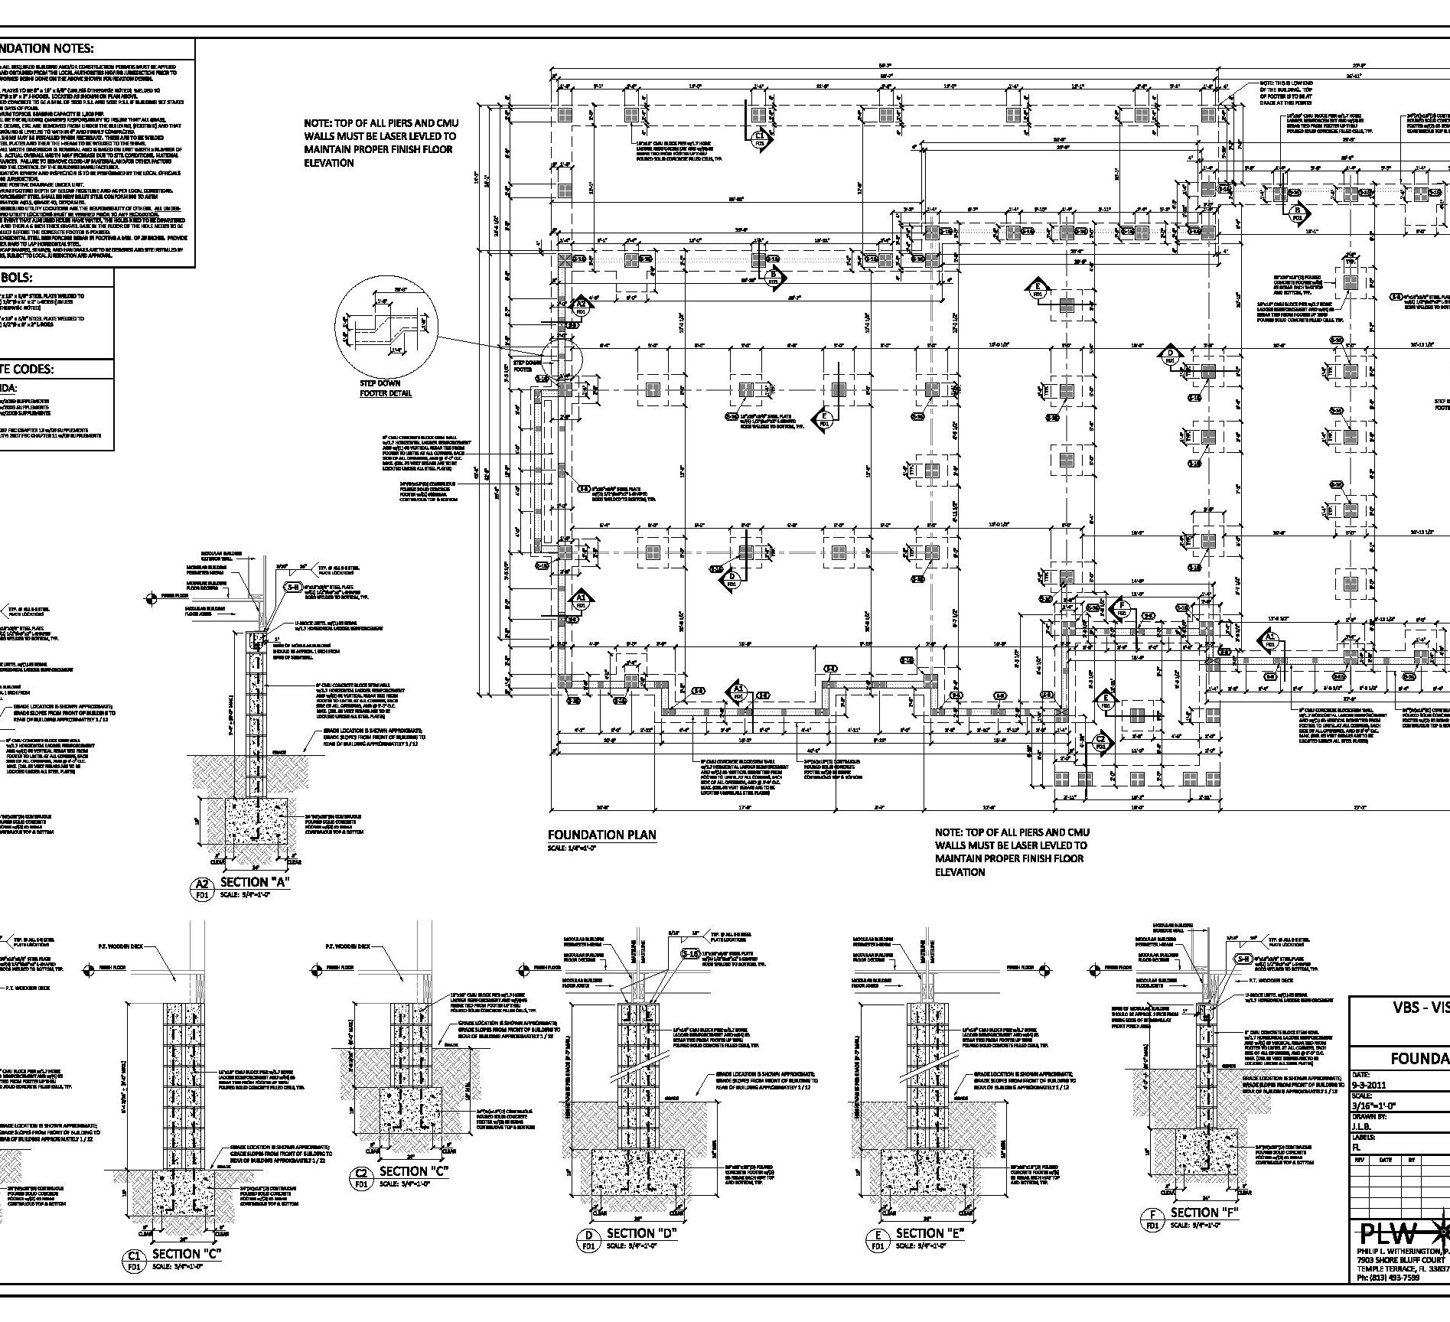
Foundation Plan

Slide 8
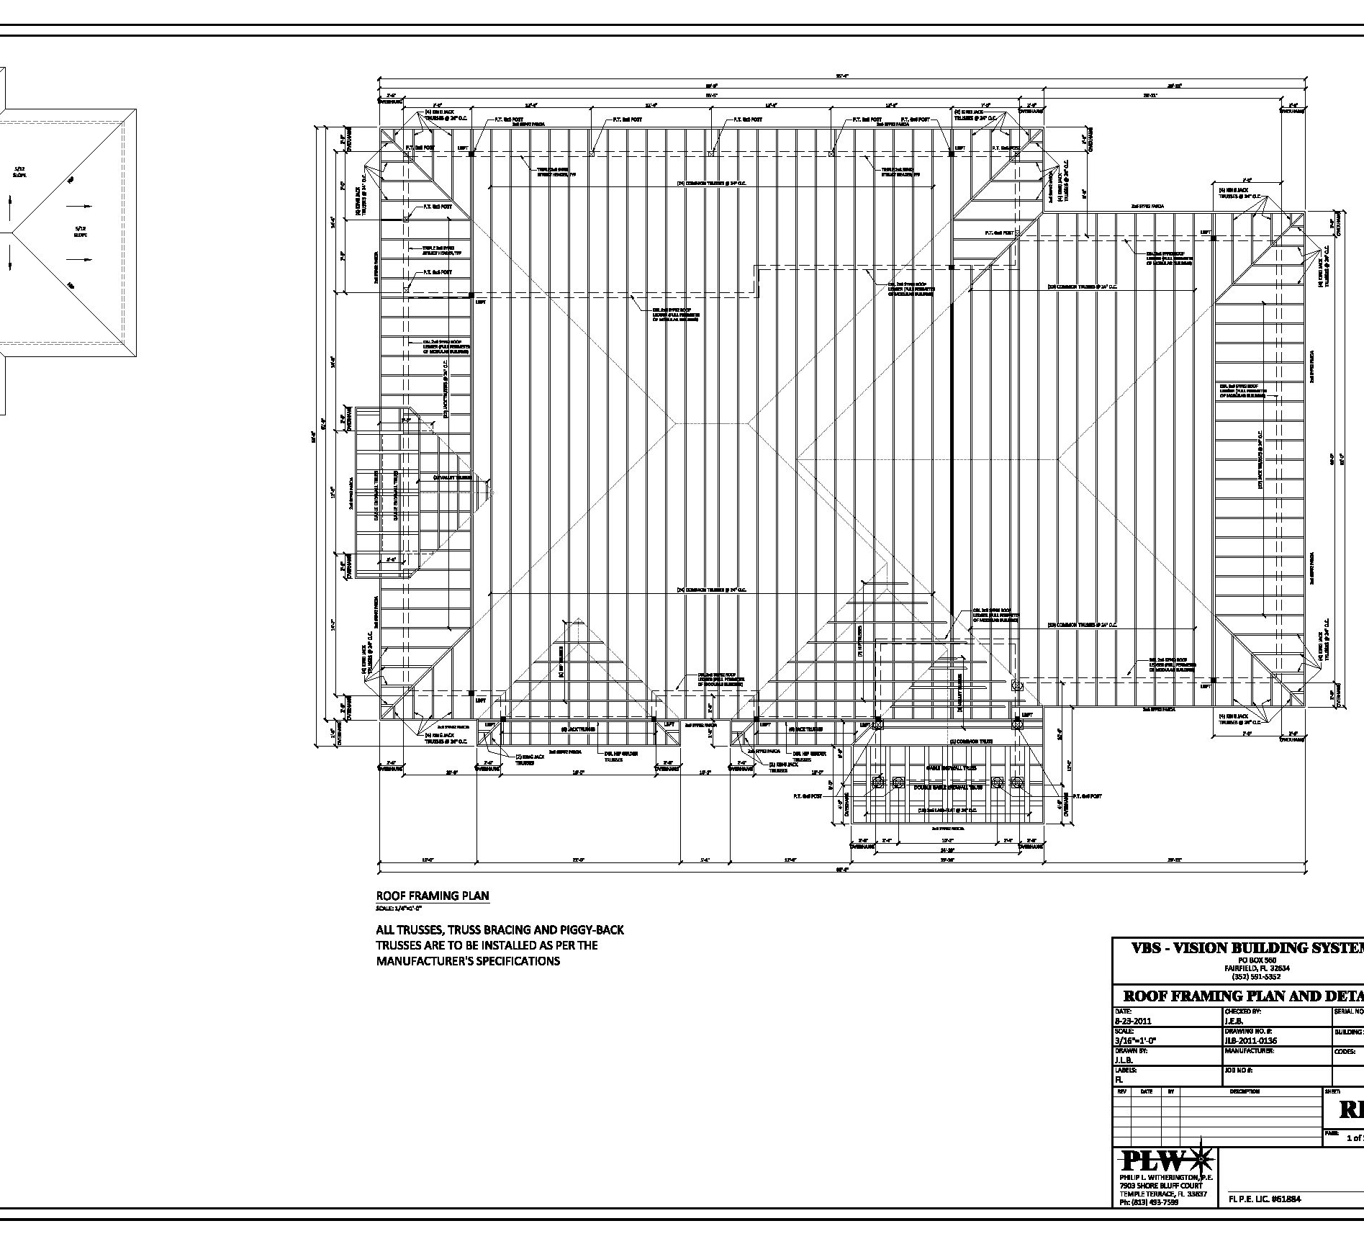
Roof Truss Plan

Slide 9
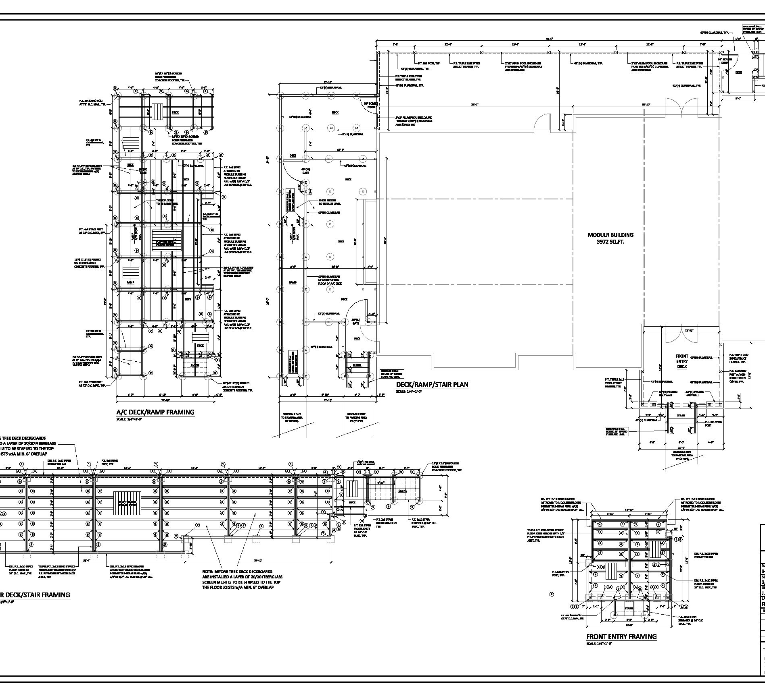
Deck and Ramp Plan

Slide 10
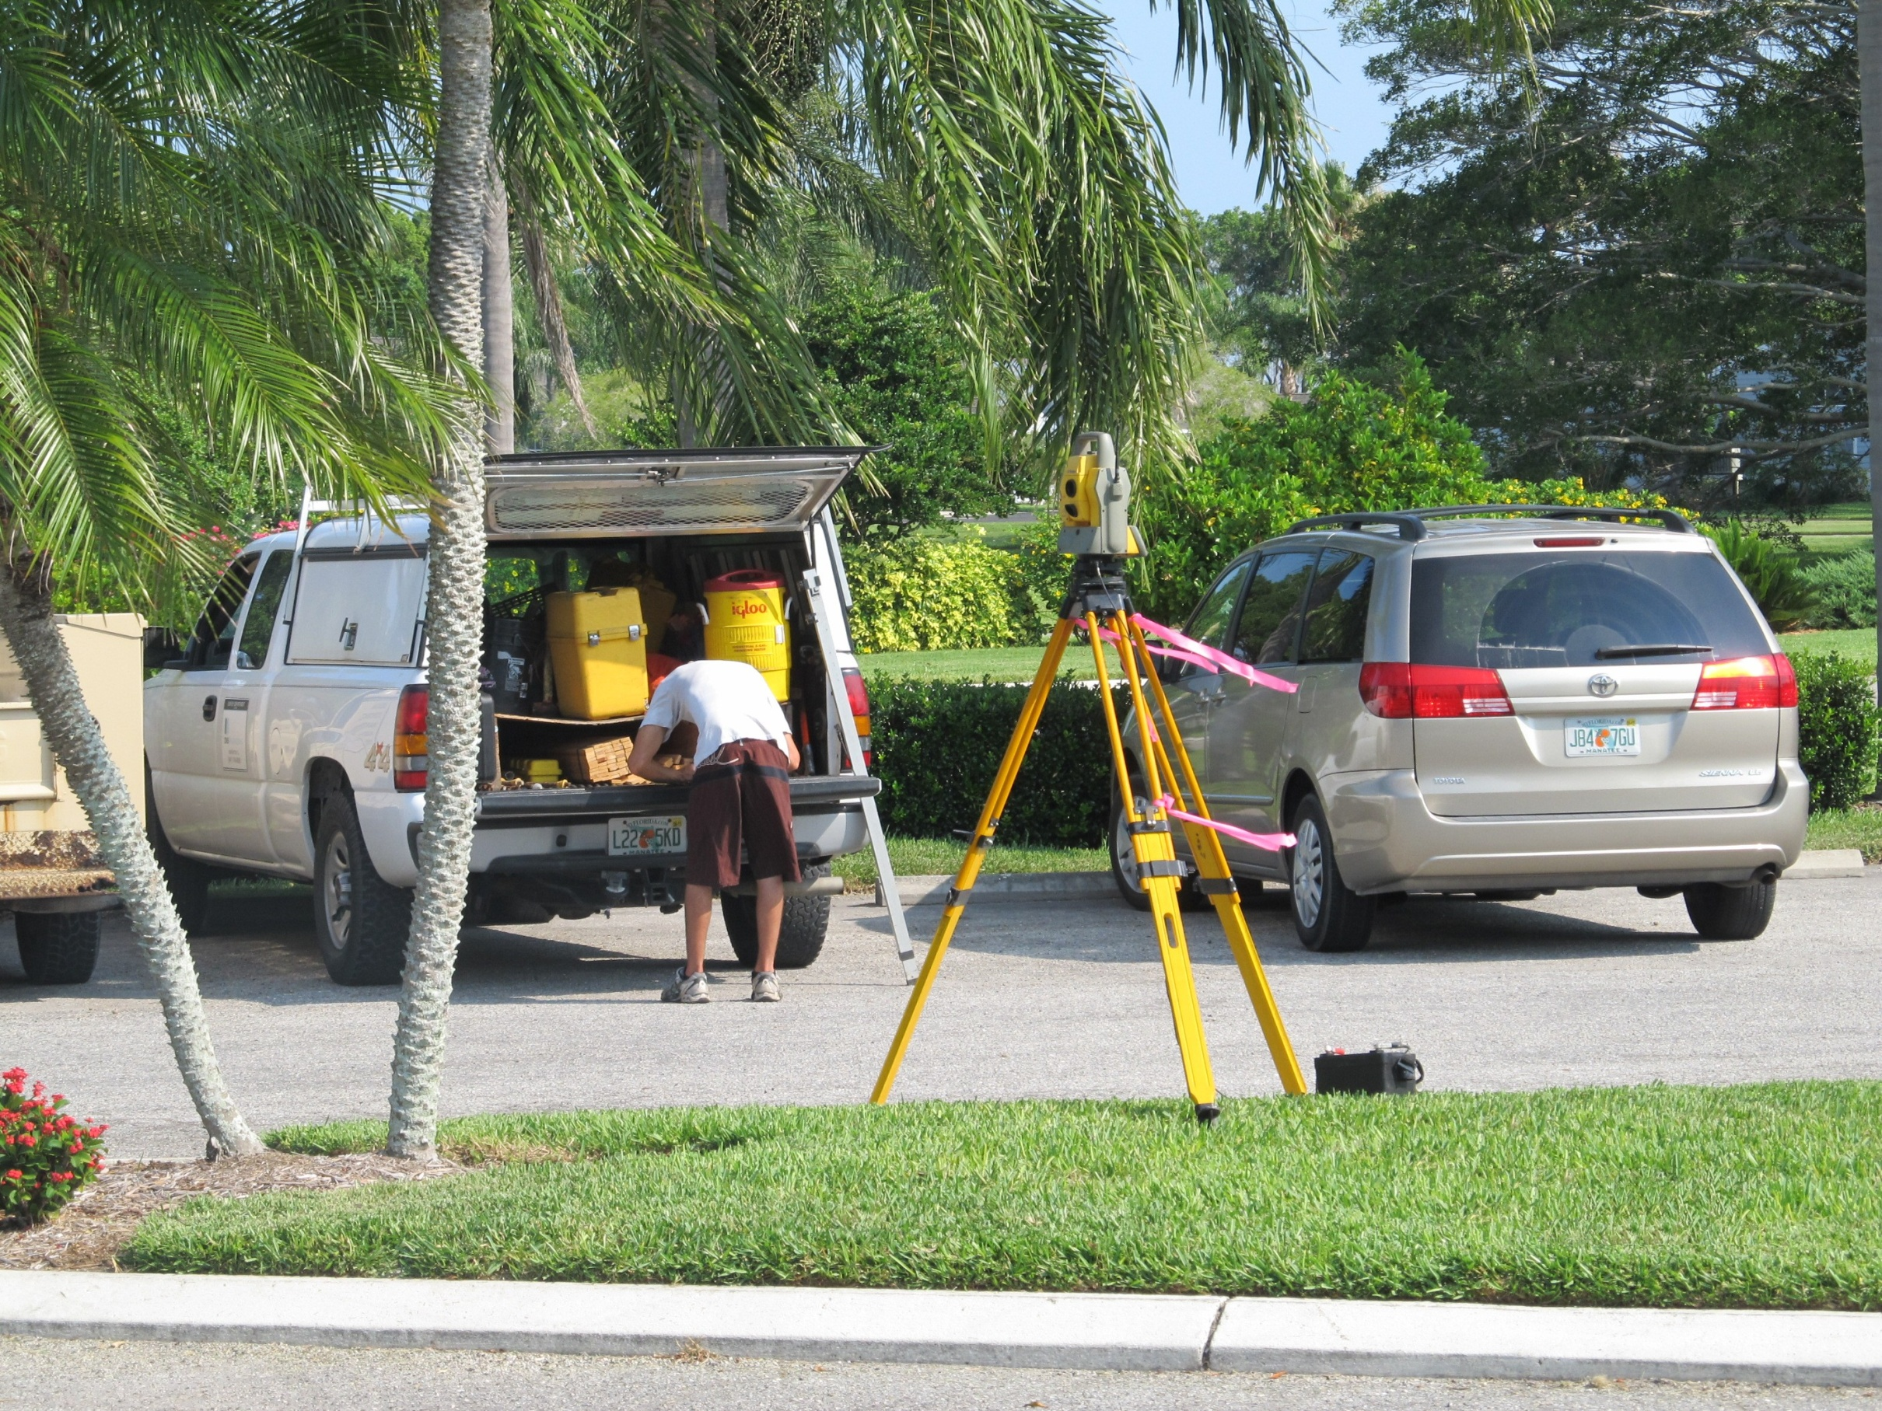
A good survey is essential to a good start

Slide 11
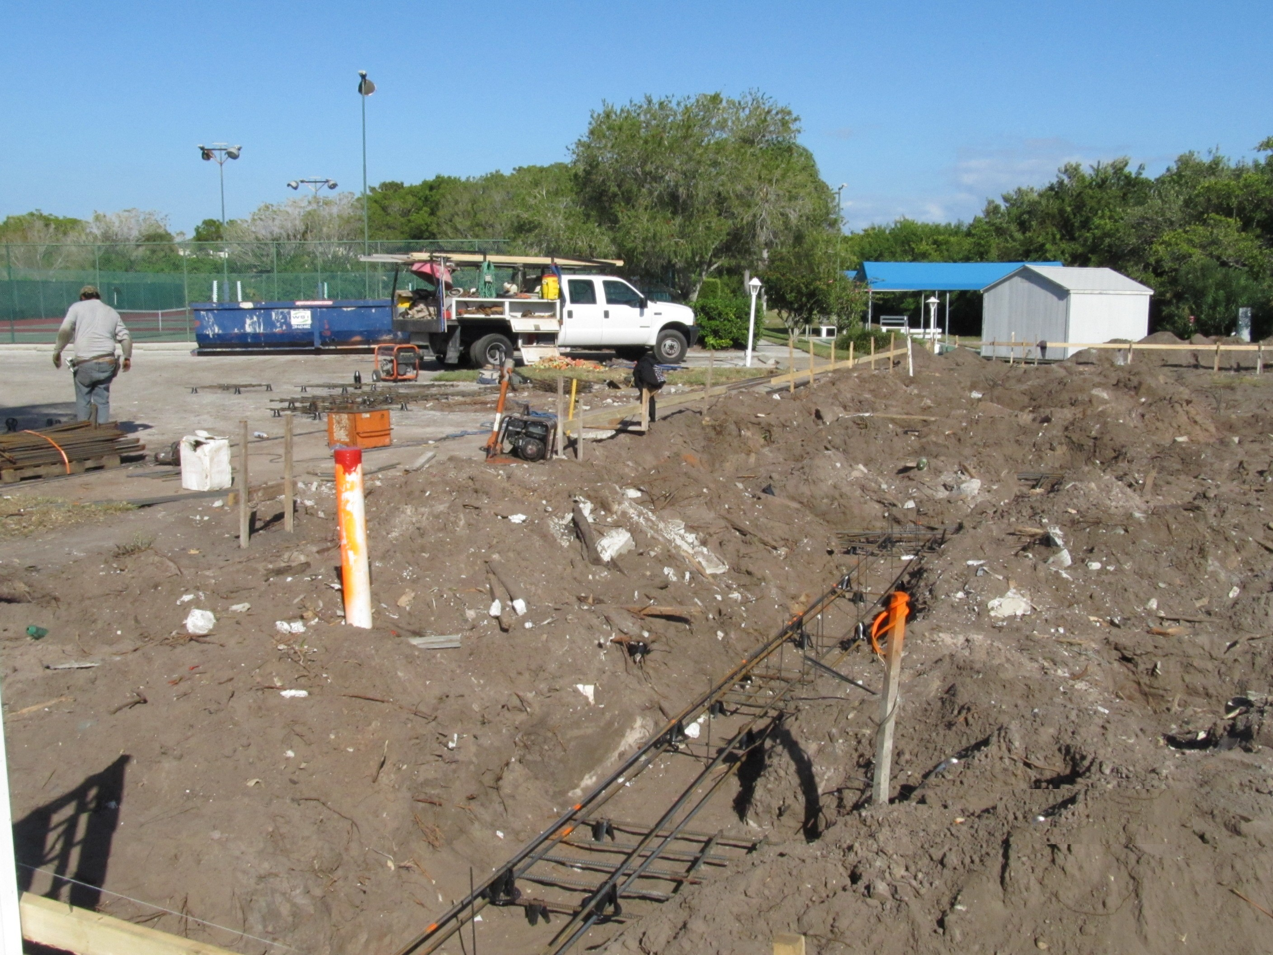
Foundation footings are dug and rebar installed in preparation for pouring the concrete

Slide 12
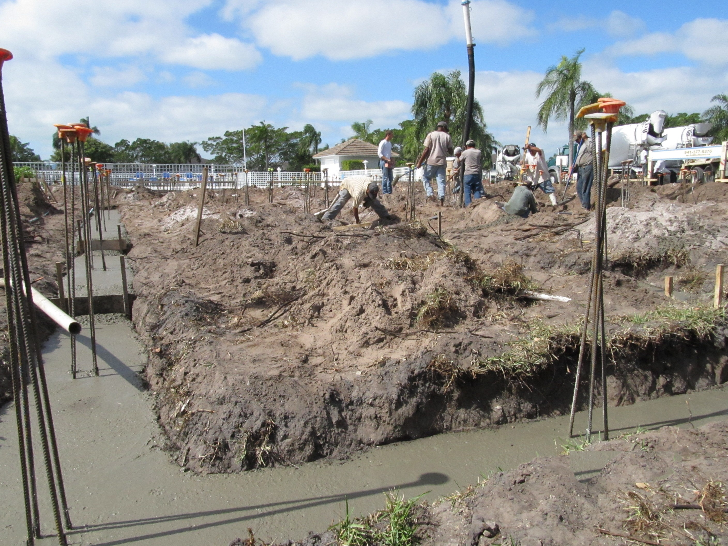
Concrete footings are poured

Slide 13
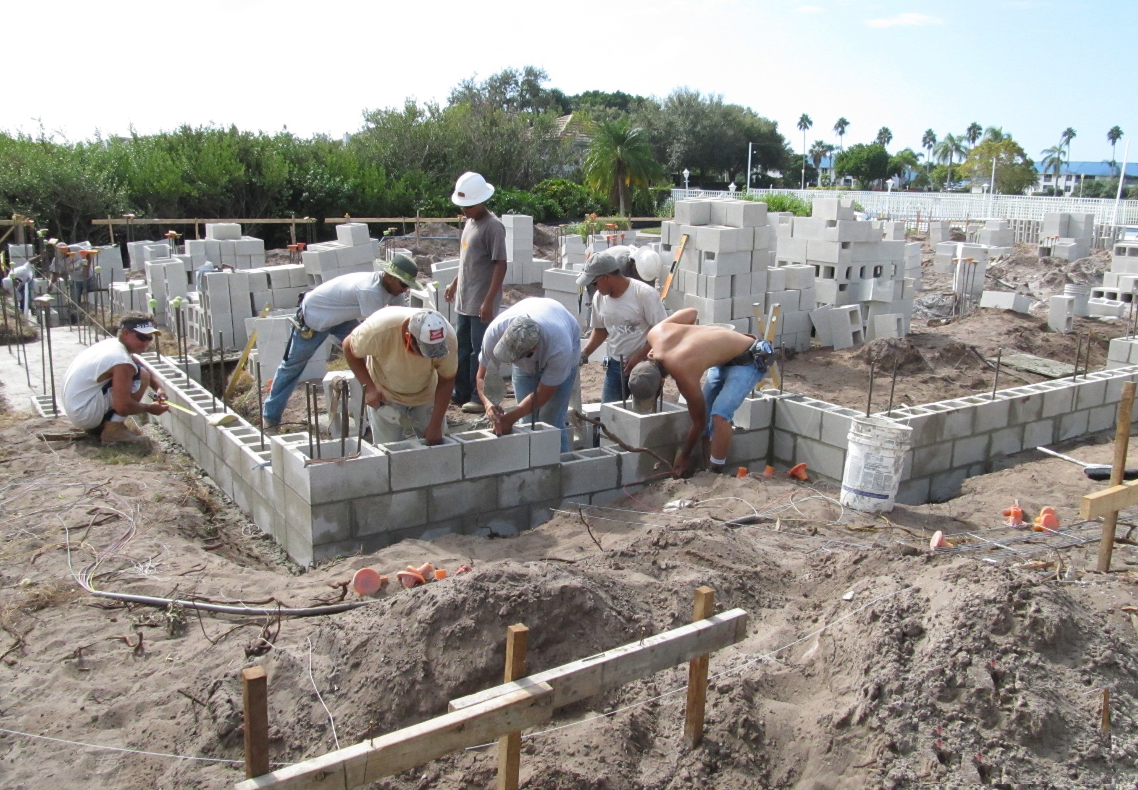
Concrete blocks are laid to created a foundation stem wall

Slide 14
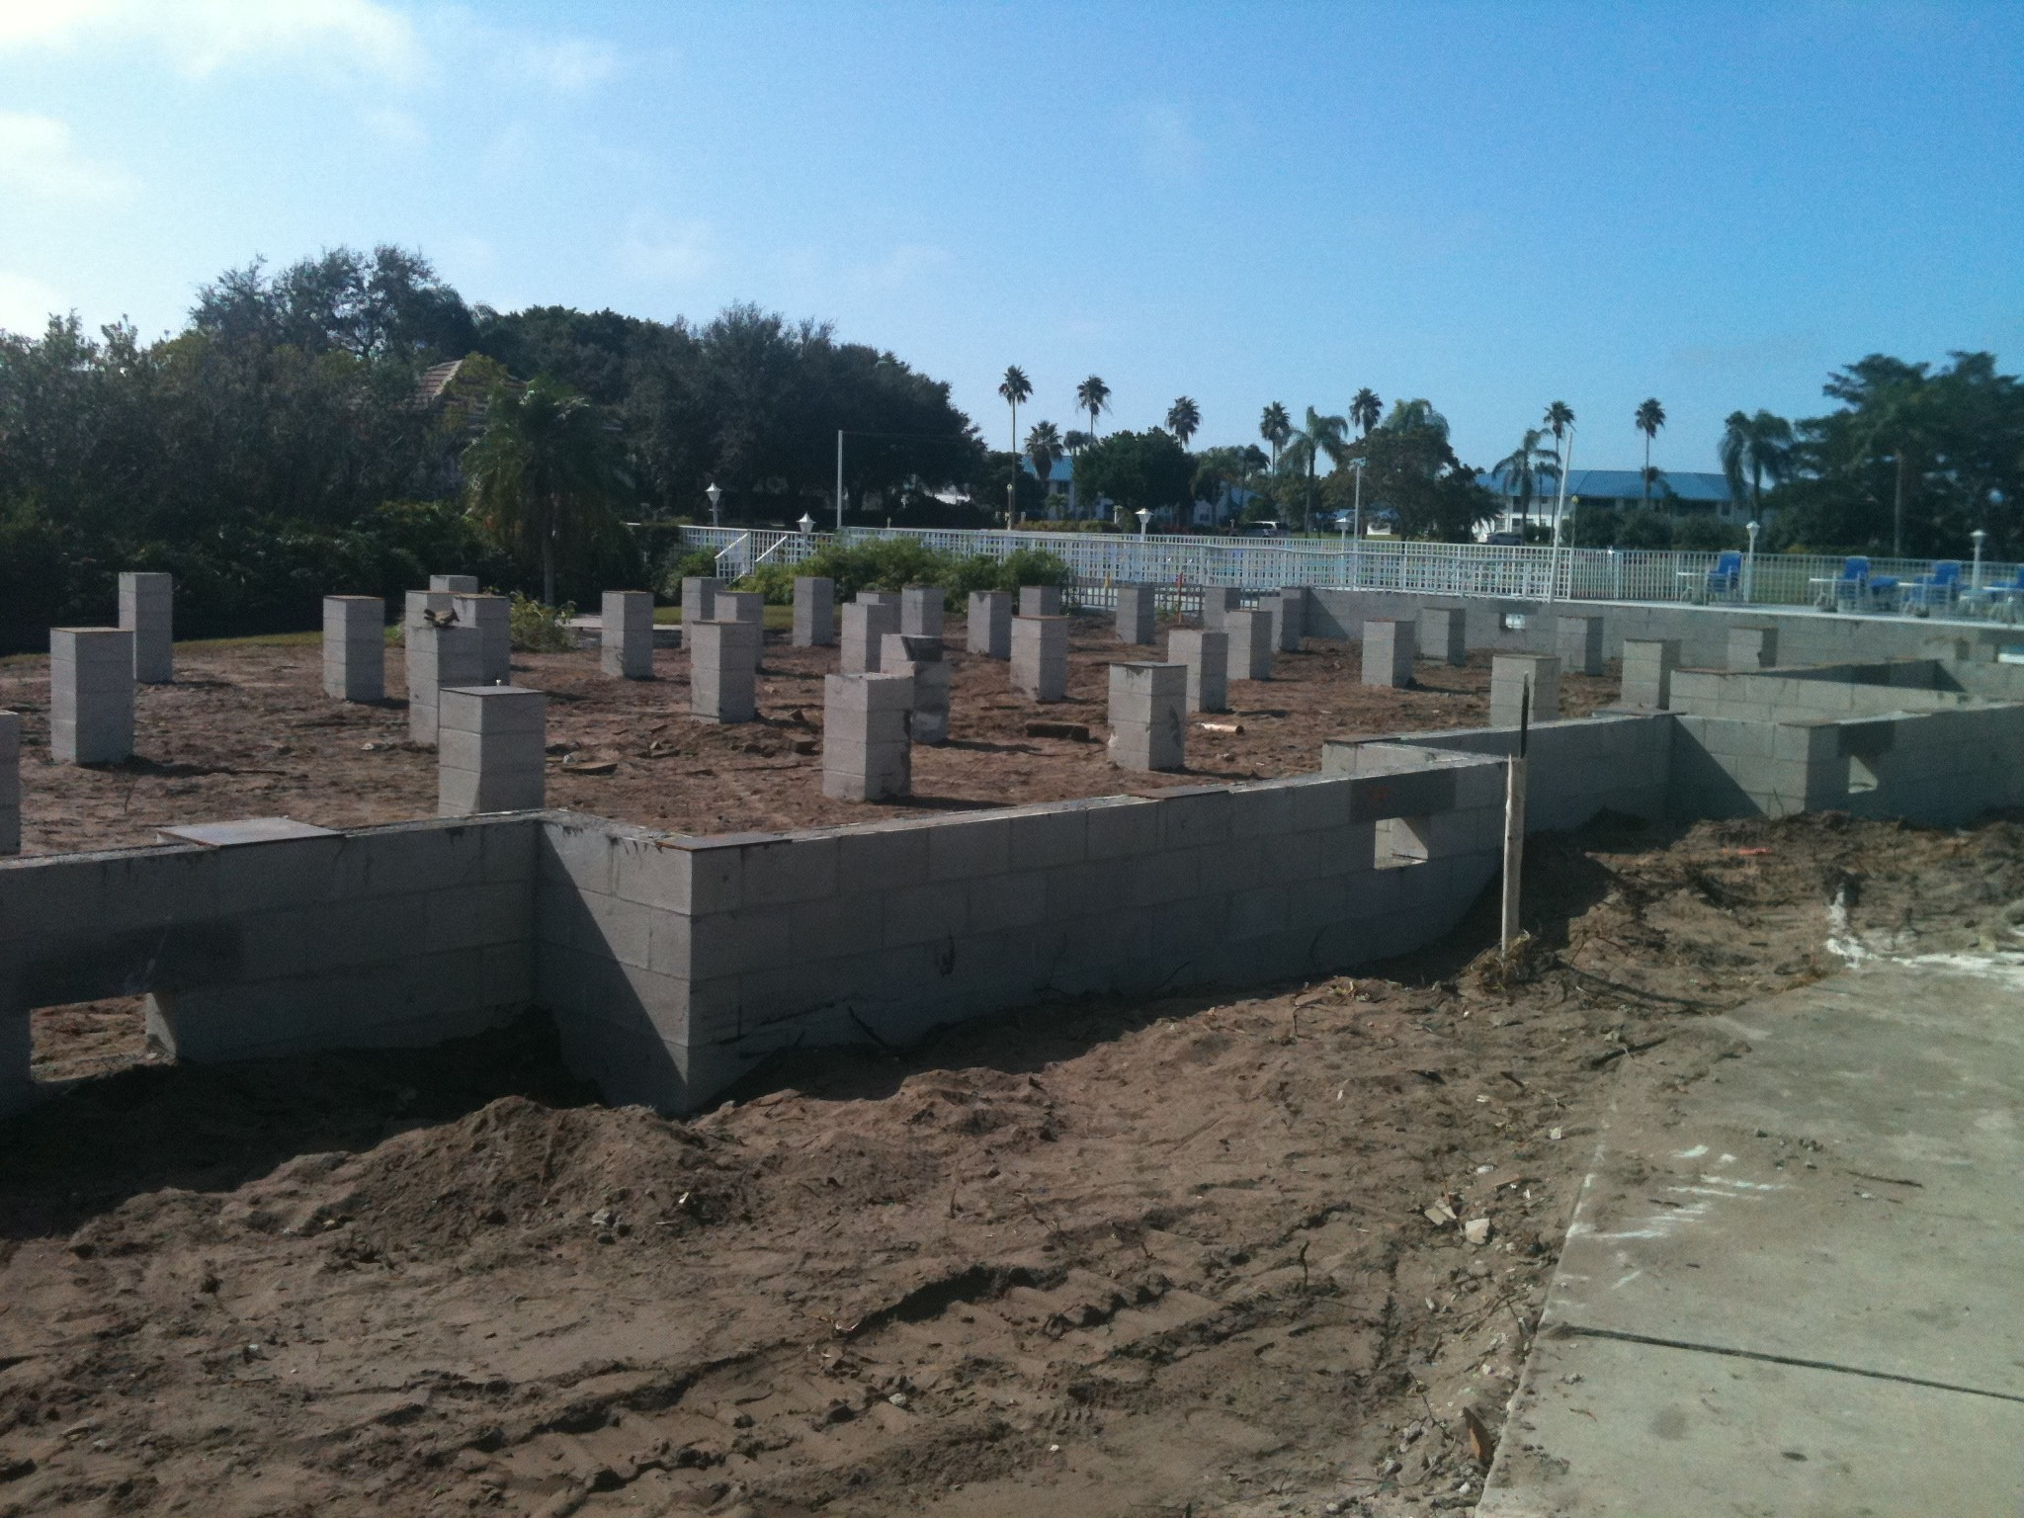
Finished foundation, height determined by flood zone, ready for installation of modules

Slide 15
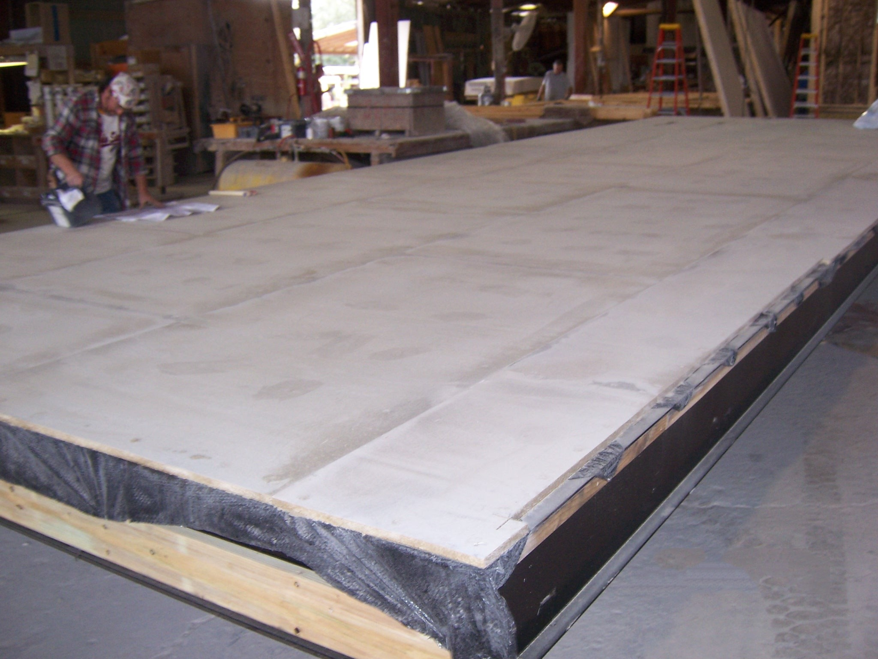
While site work is being done the factory is busy building the modules

Slide 16
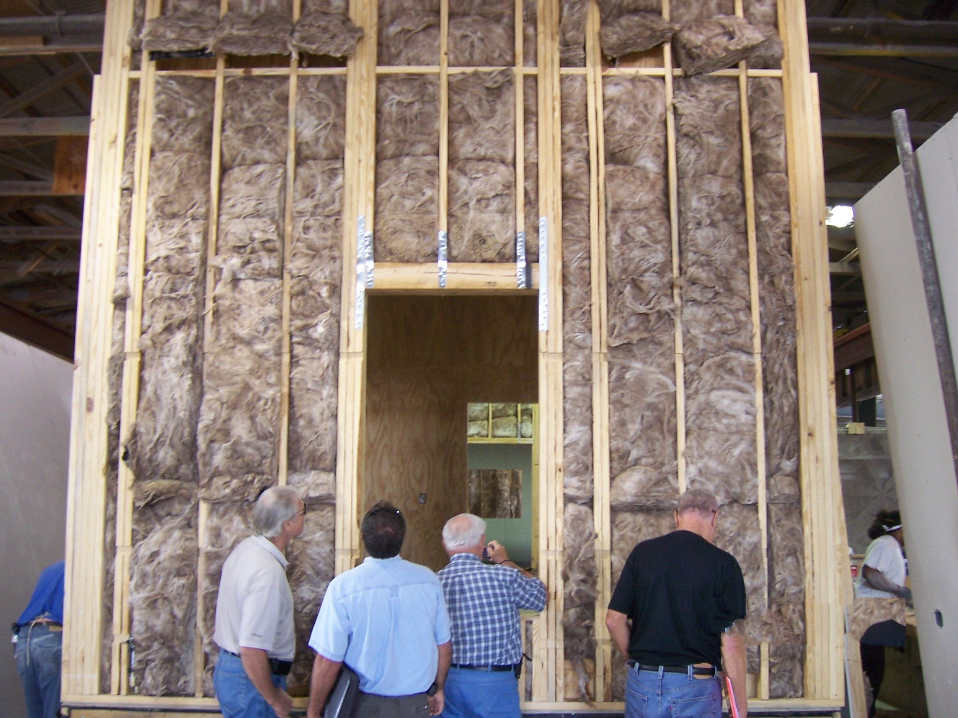

Slide 17
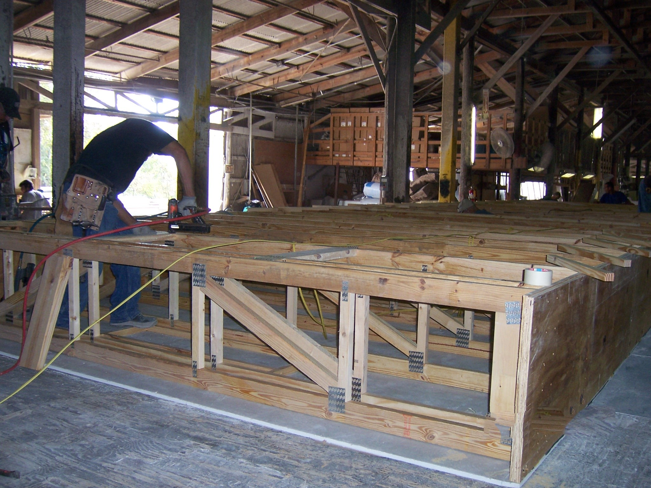

Slide 18
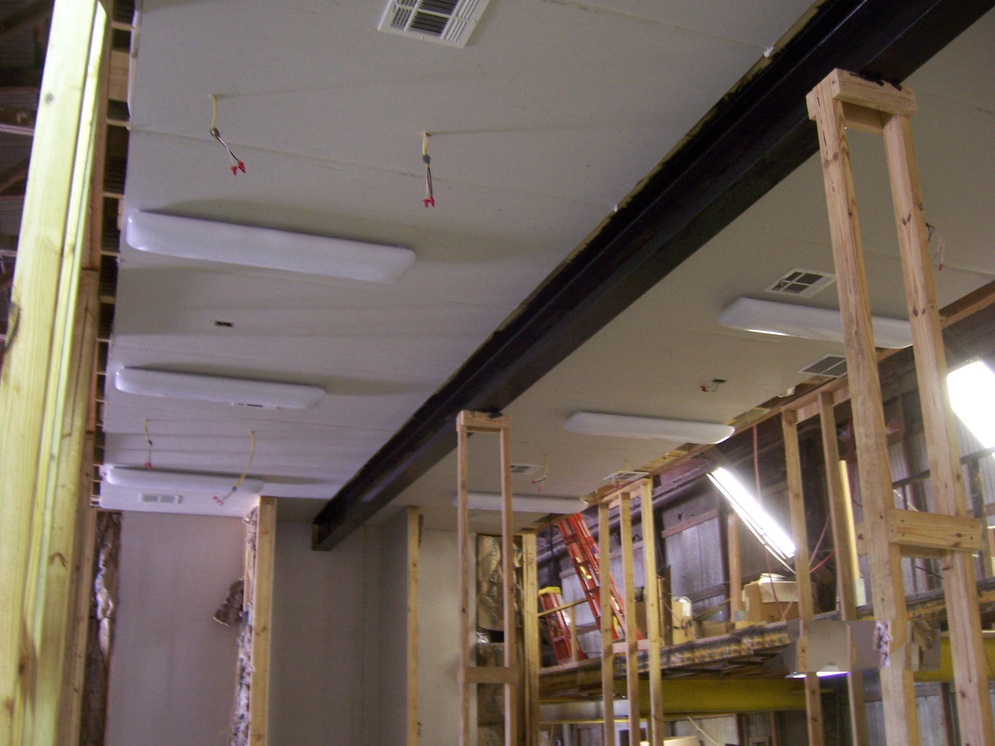

Slide 19
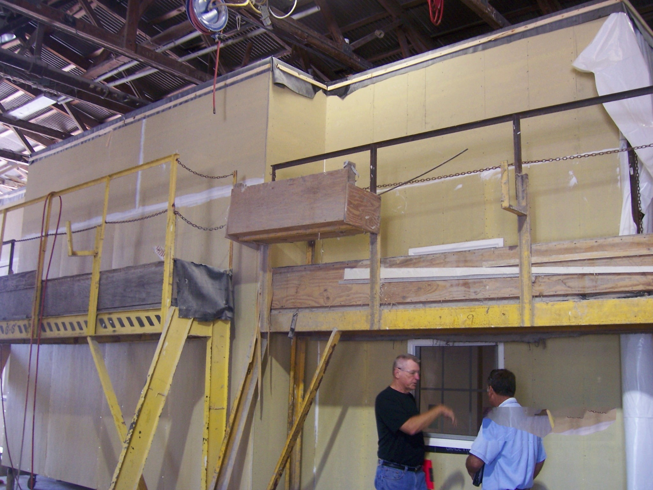

Slide 20
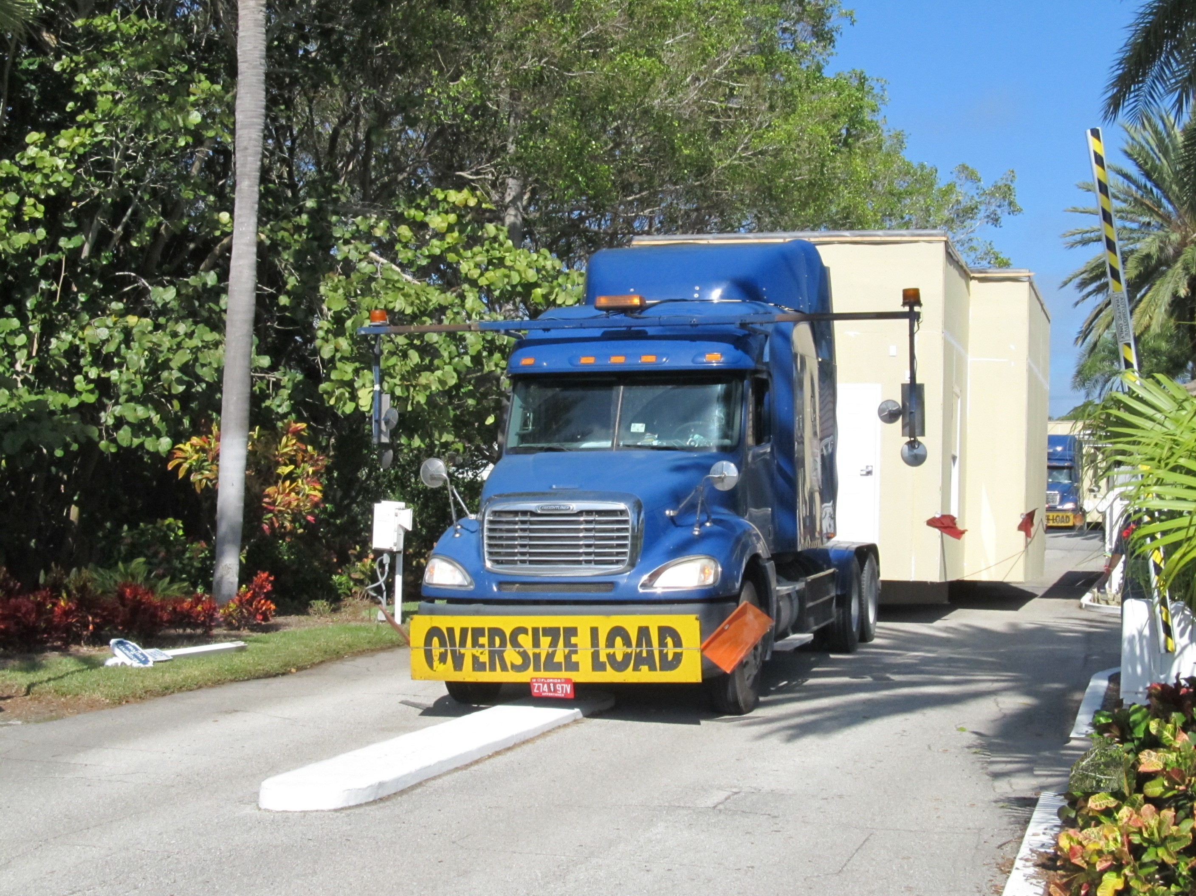
Site is ready and modules delivered

Slide 21
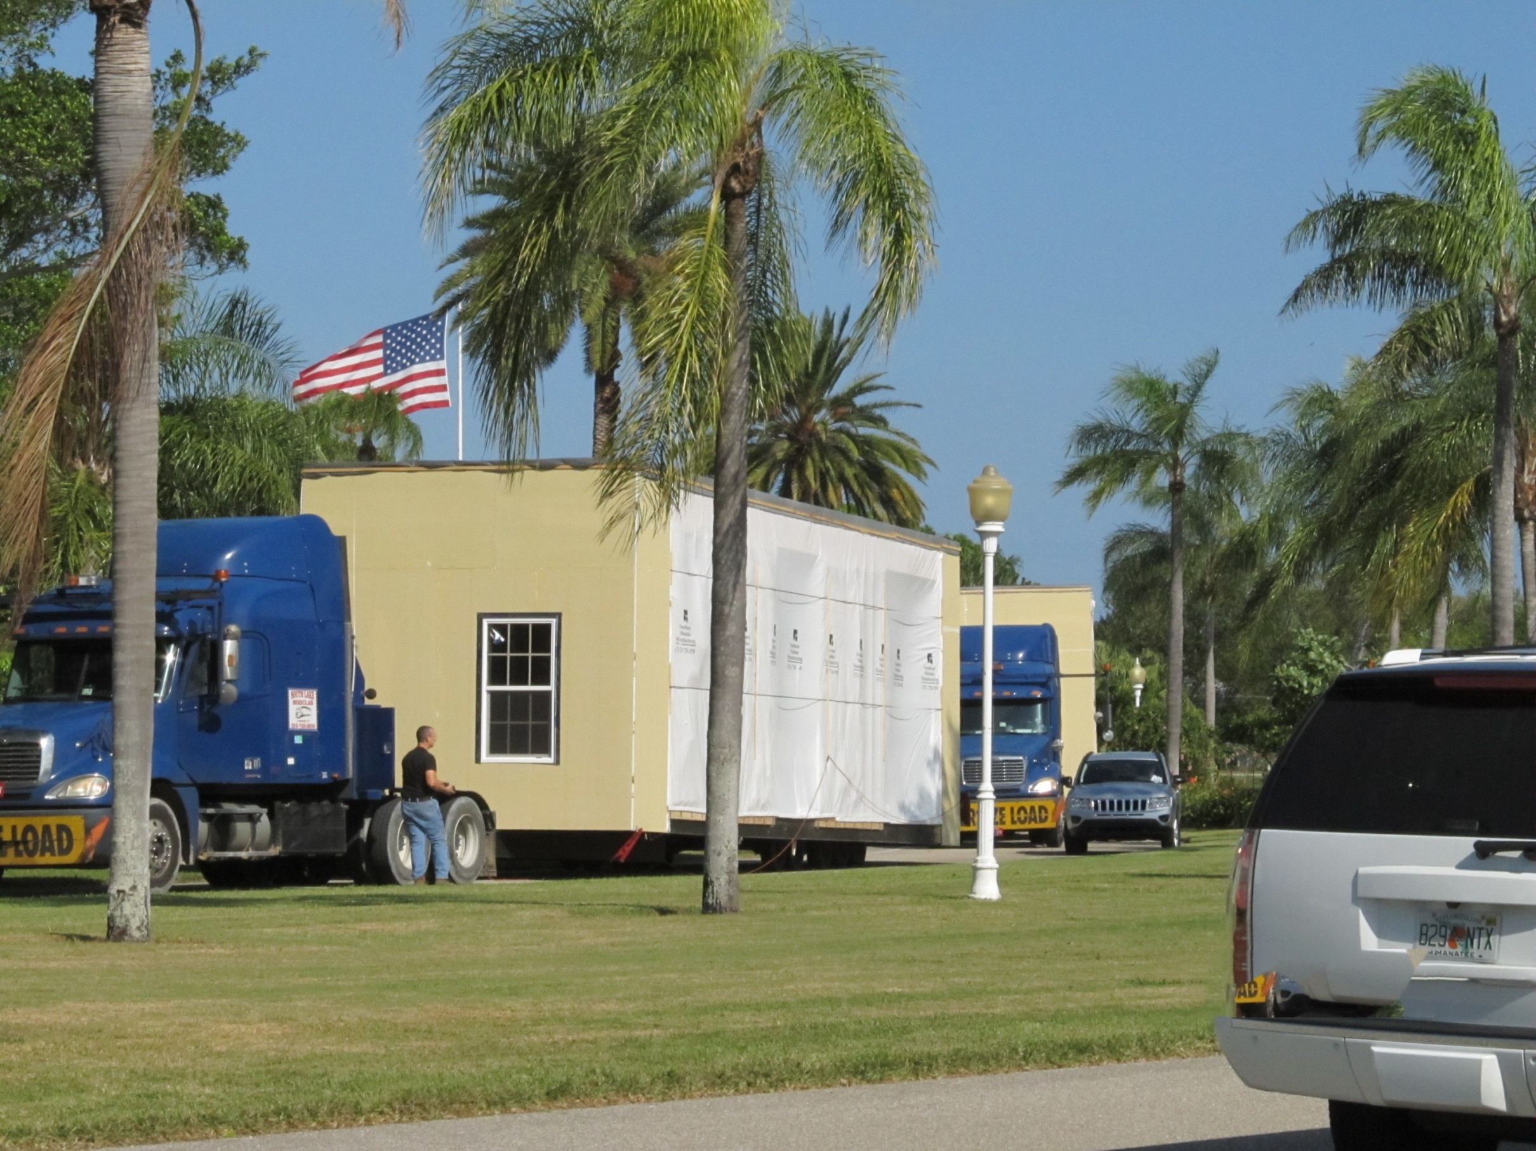

Slide 22
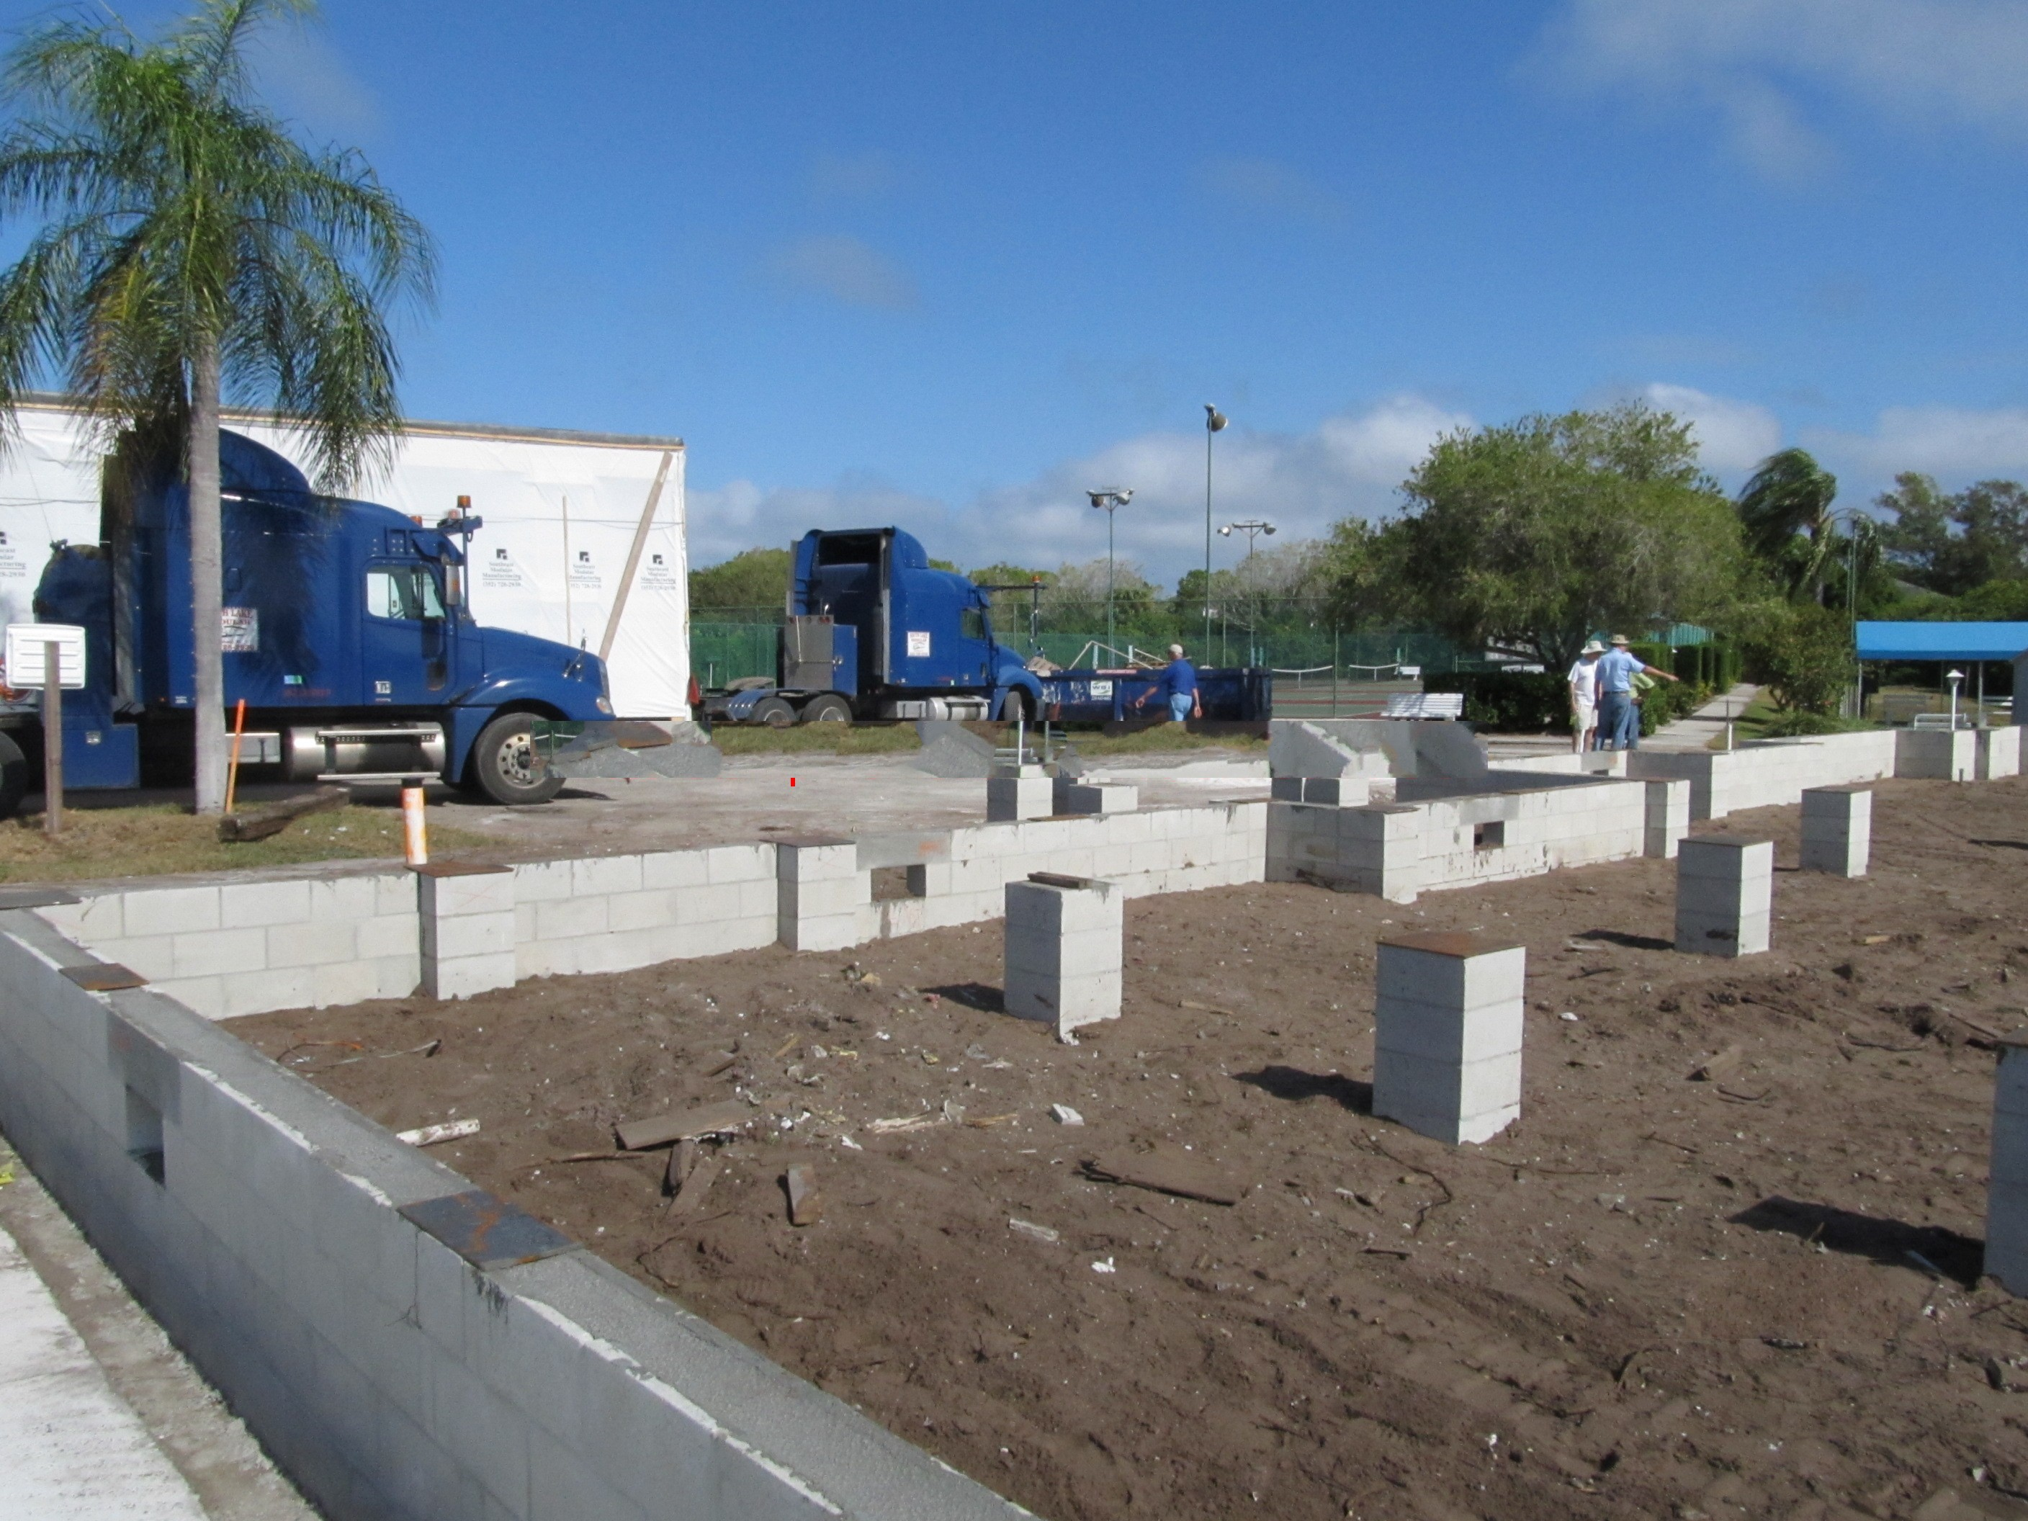

Slide 23
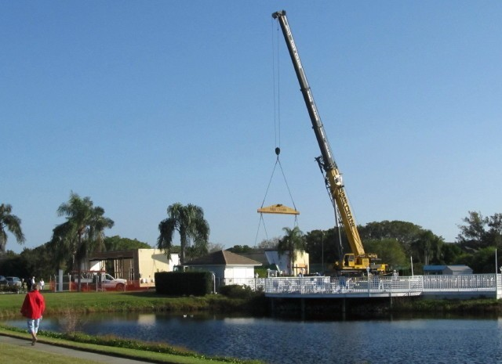
Crane is rigged and in position to place modules on foundation

Slide 24
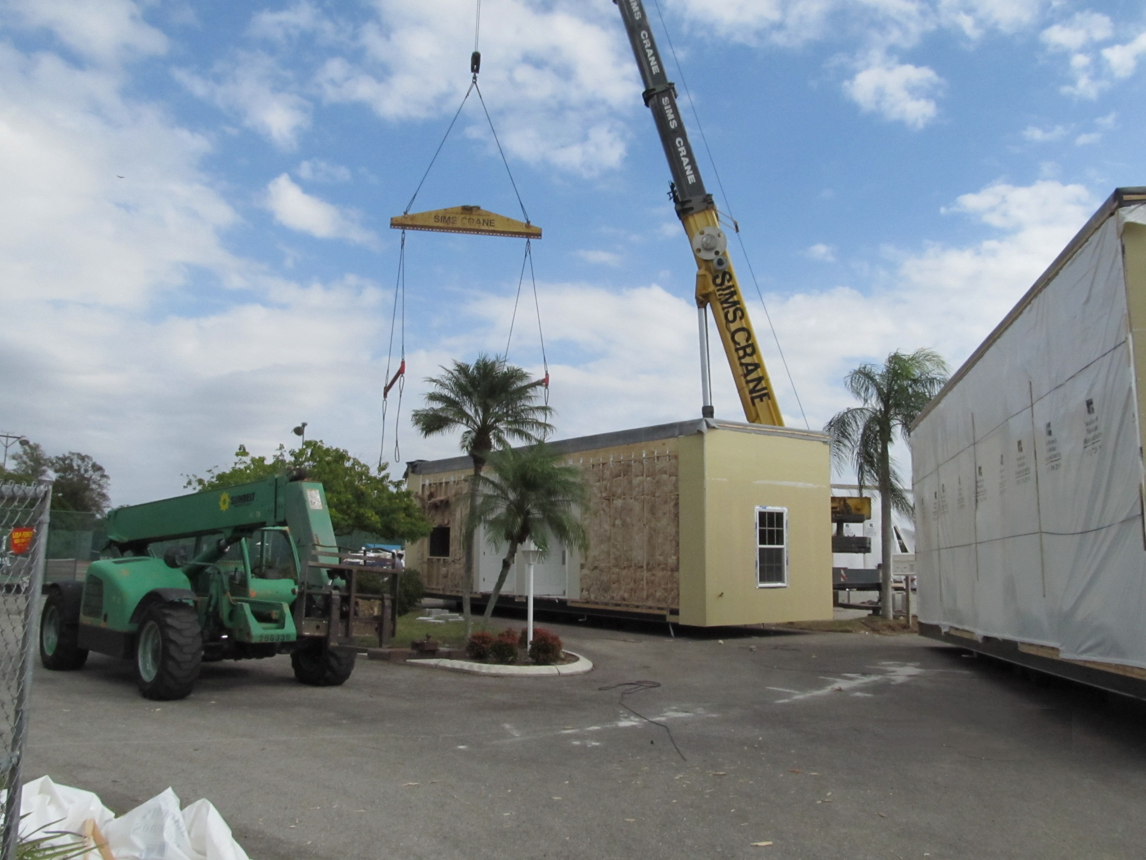
Rigging and straps placed around module

Slide 25
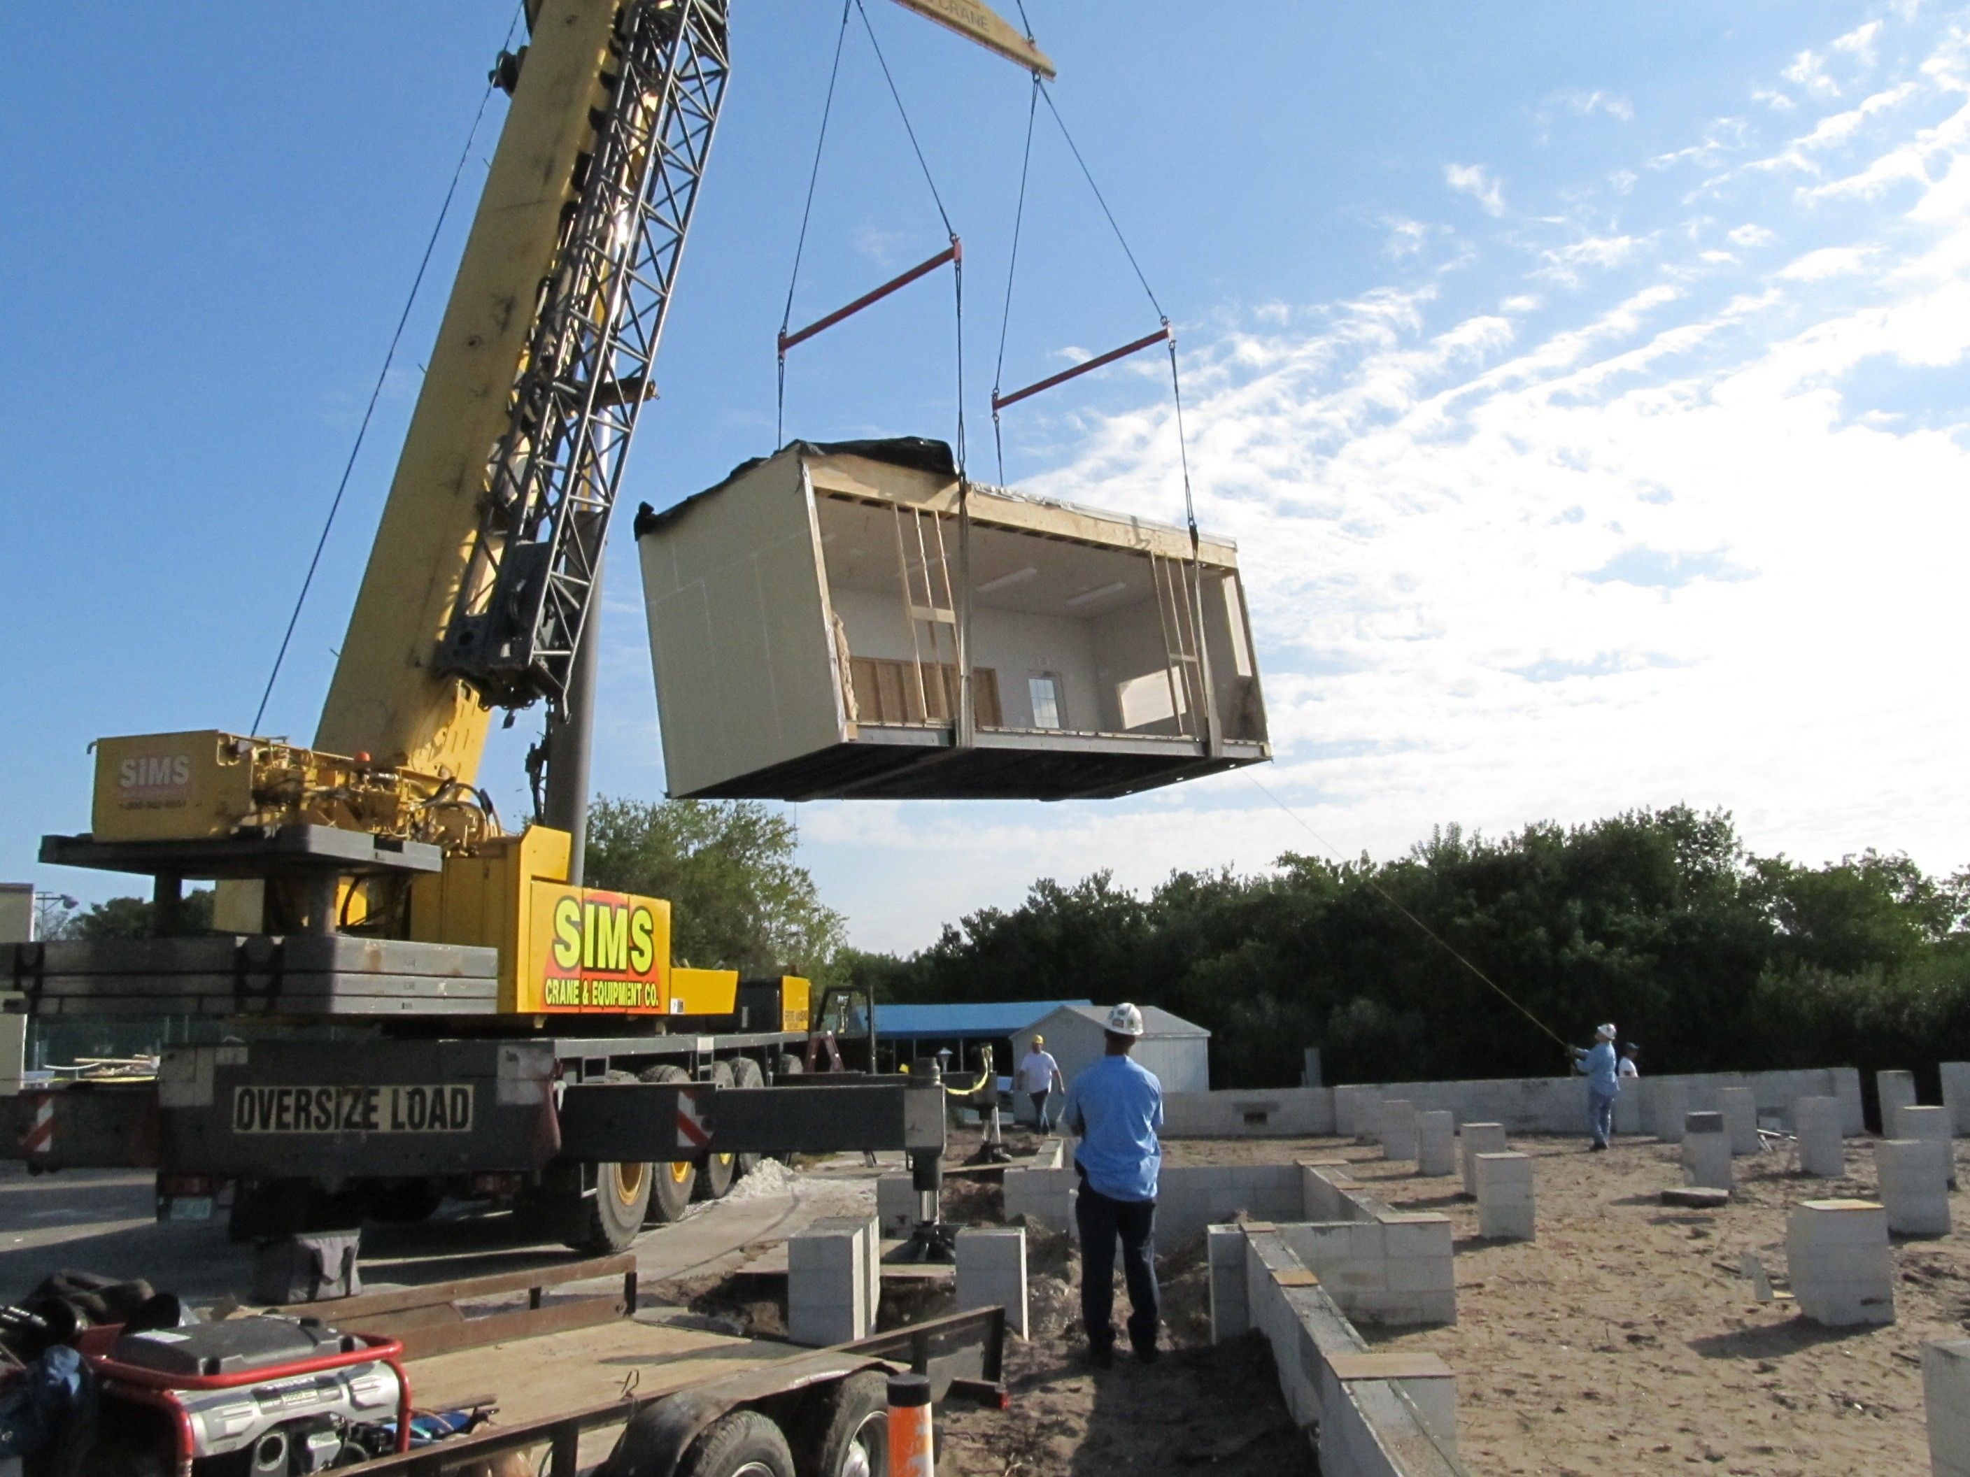
Module “flies” toward foundation

Slide 26
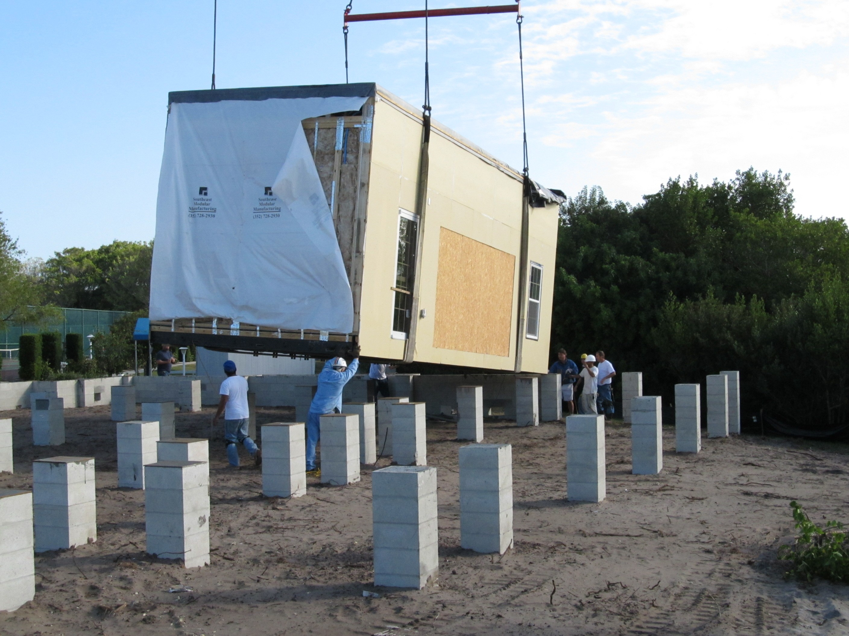

Slide 27
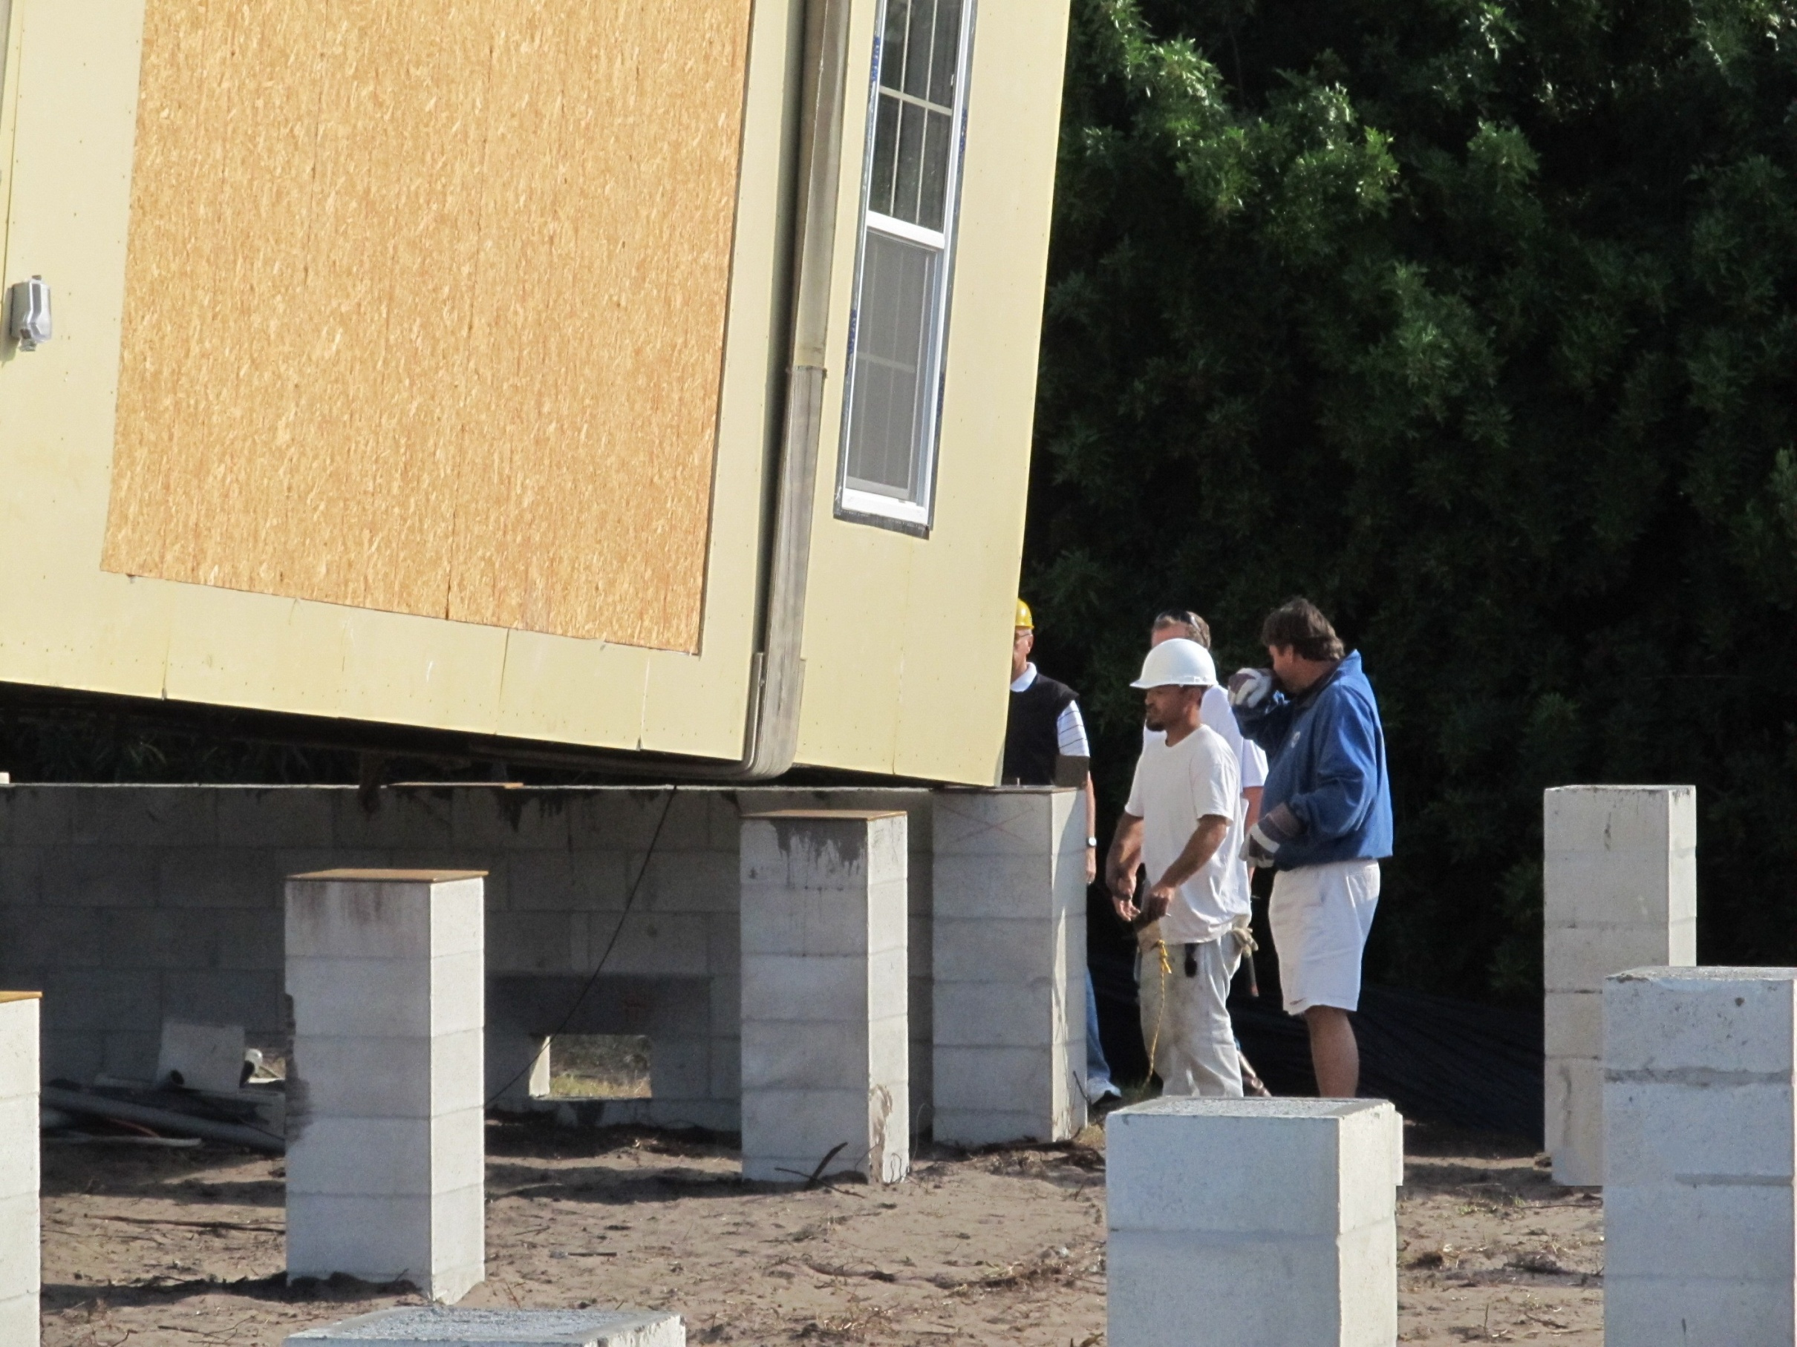
Touchdown

Slide 28
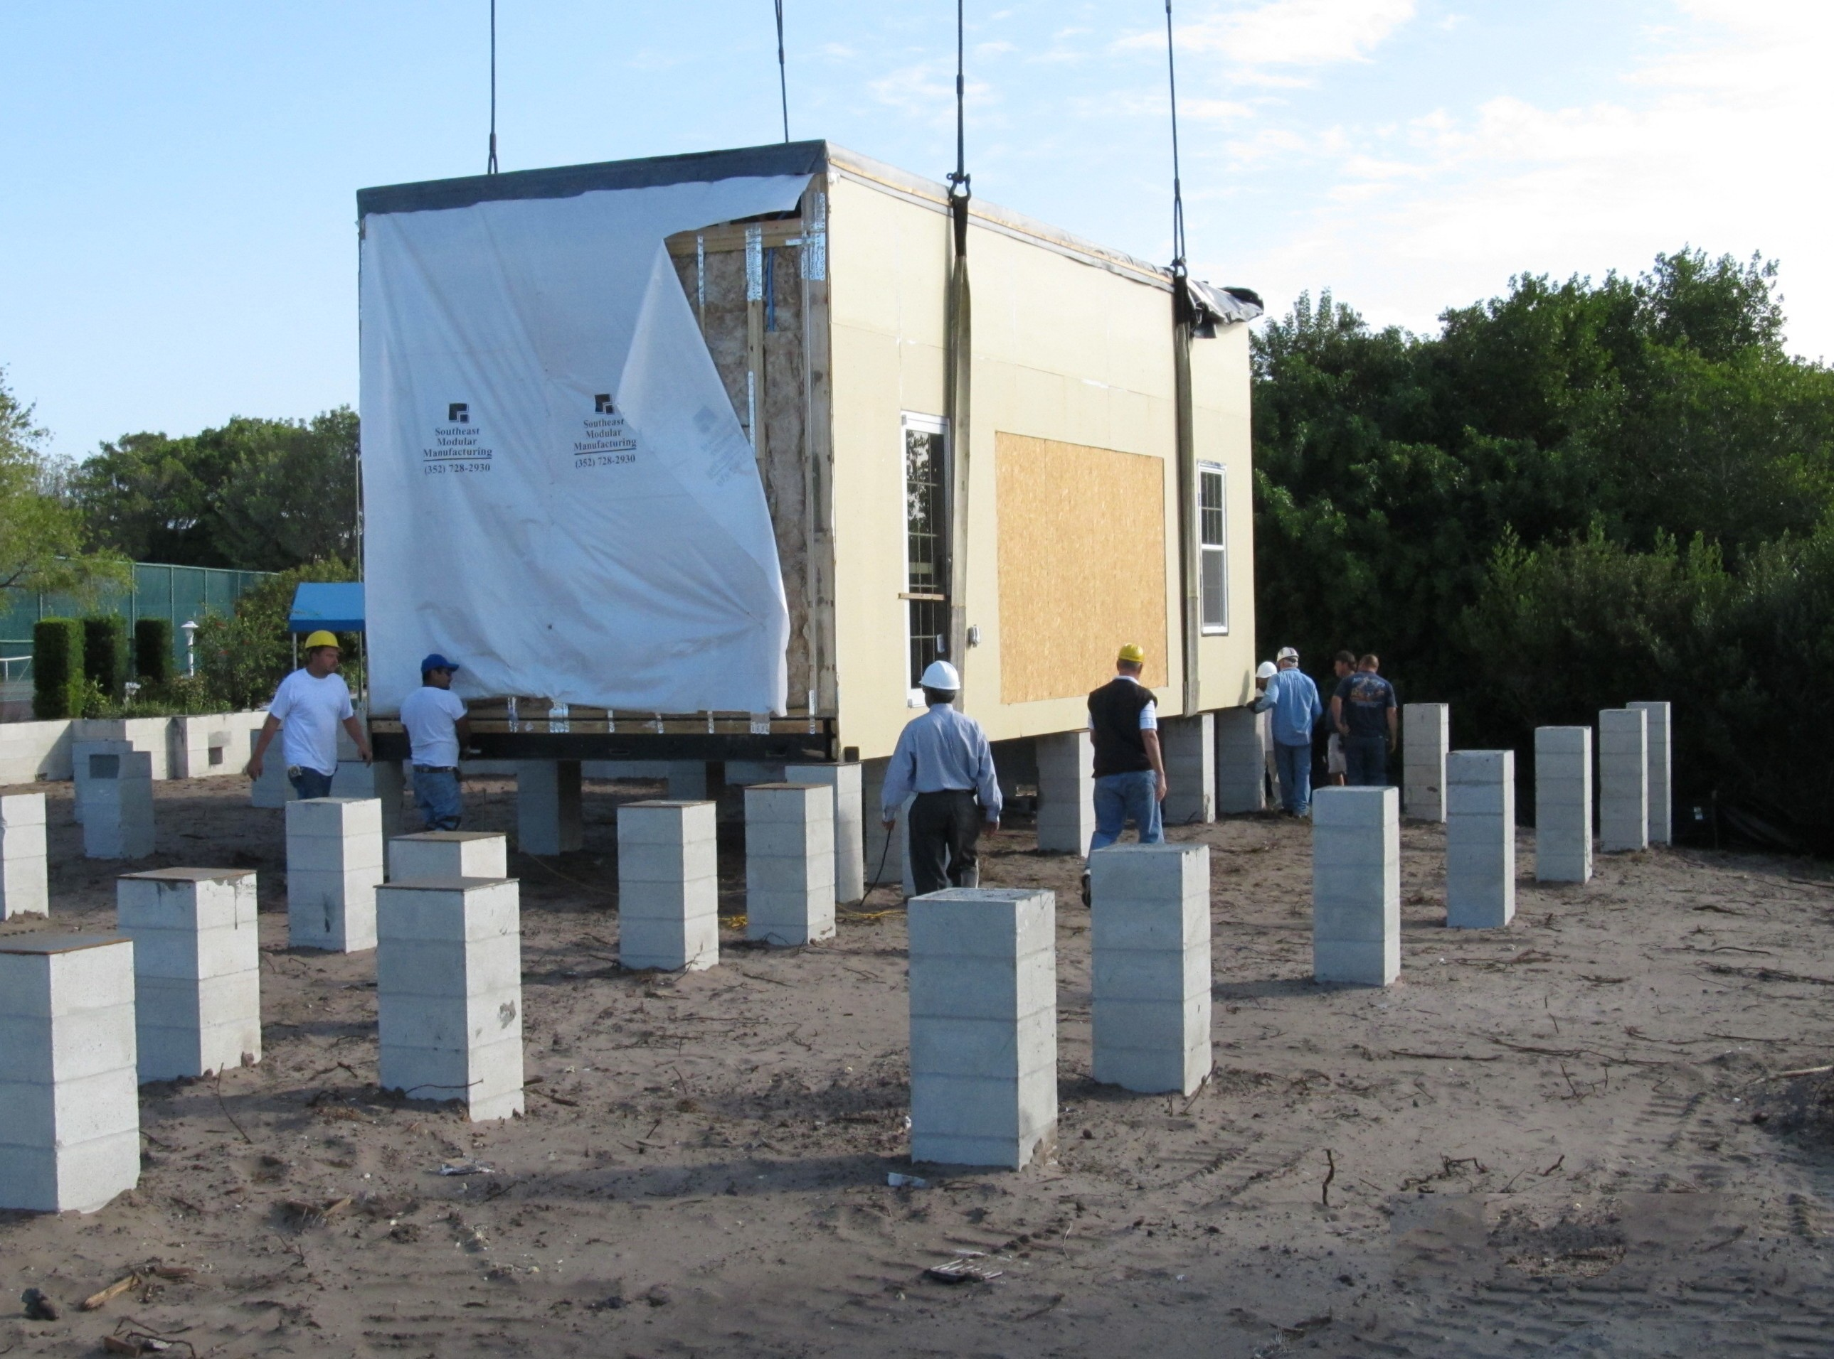
Module one lands on foundation
6 more to go!

Slide 29
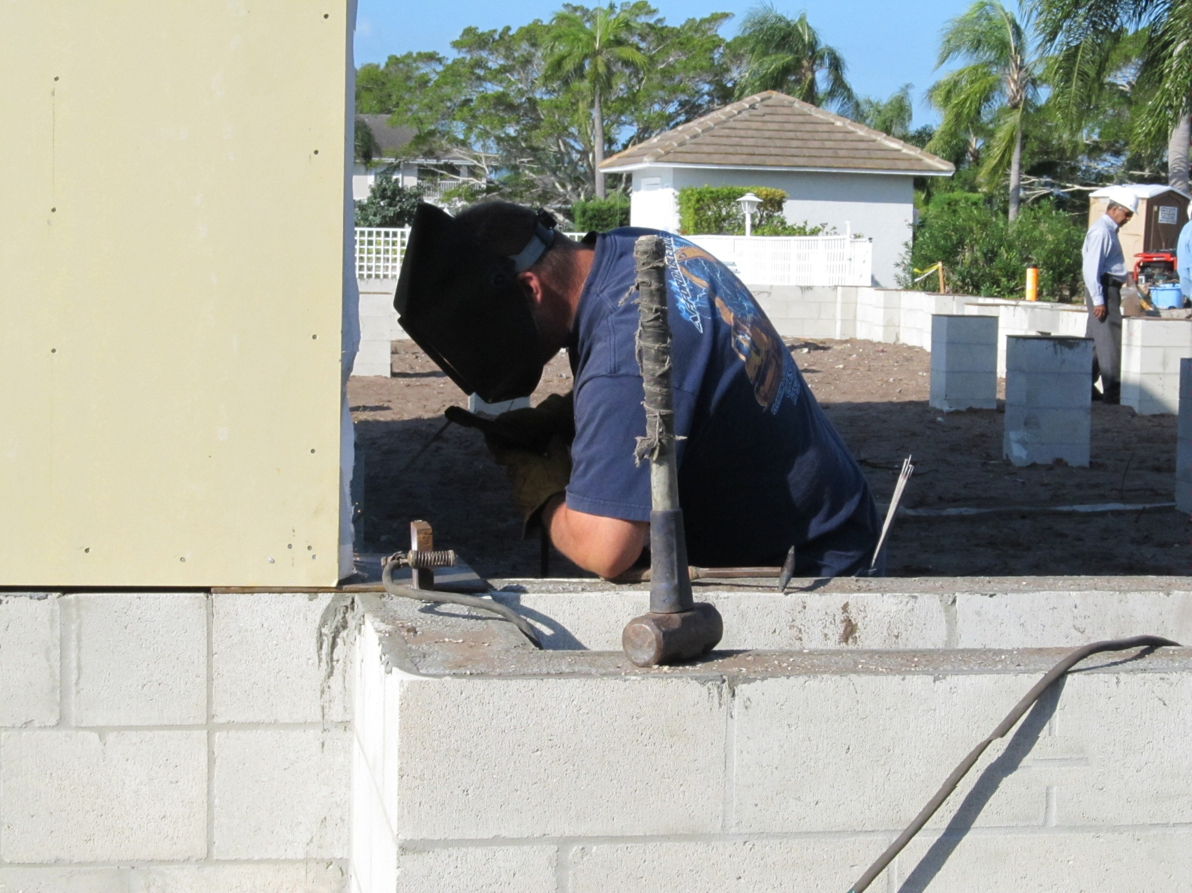
Once in place the module frame is welded to the foundation

Slide 30
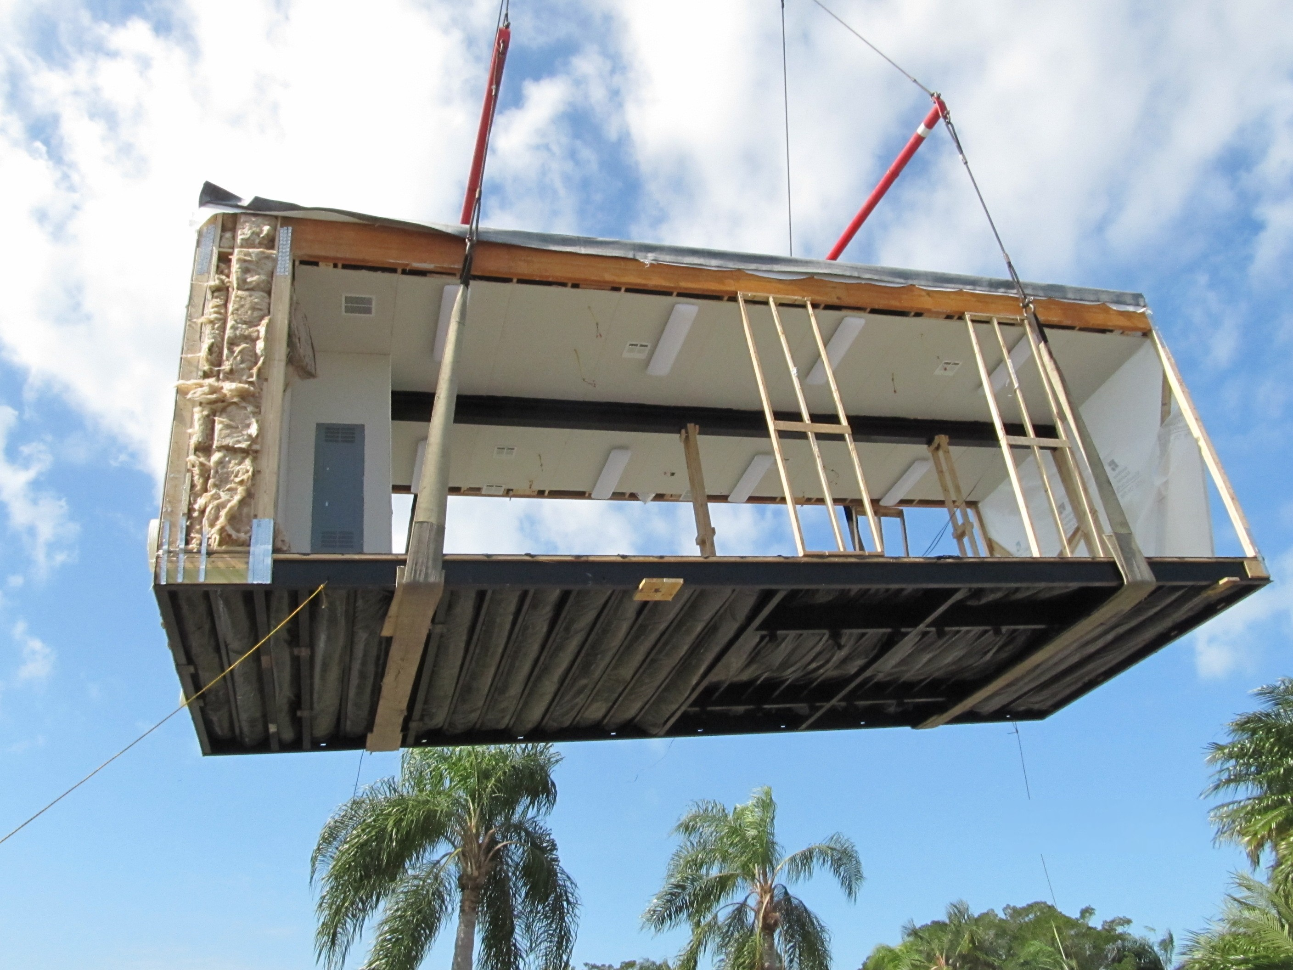
Second Module on the way

Slide 31
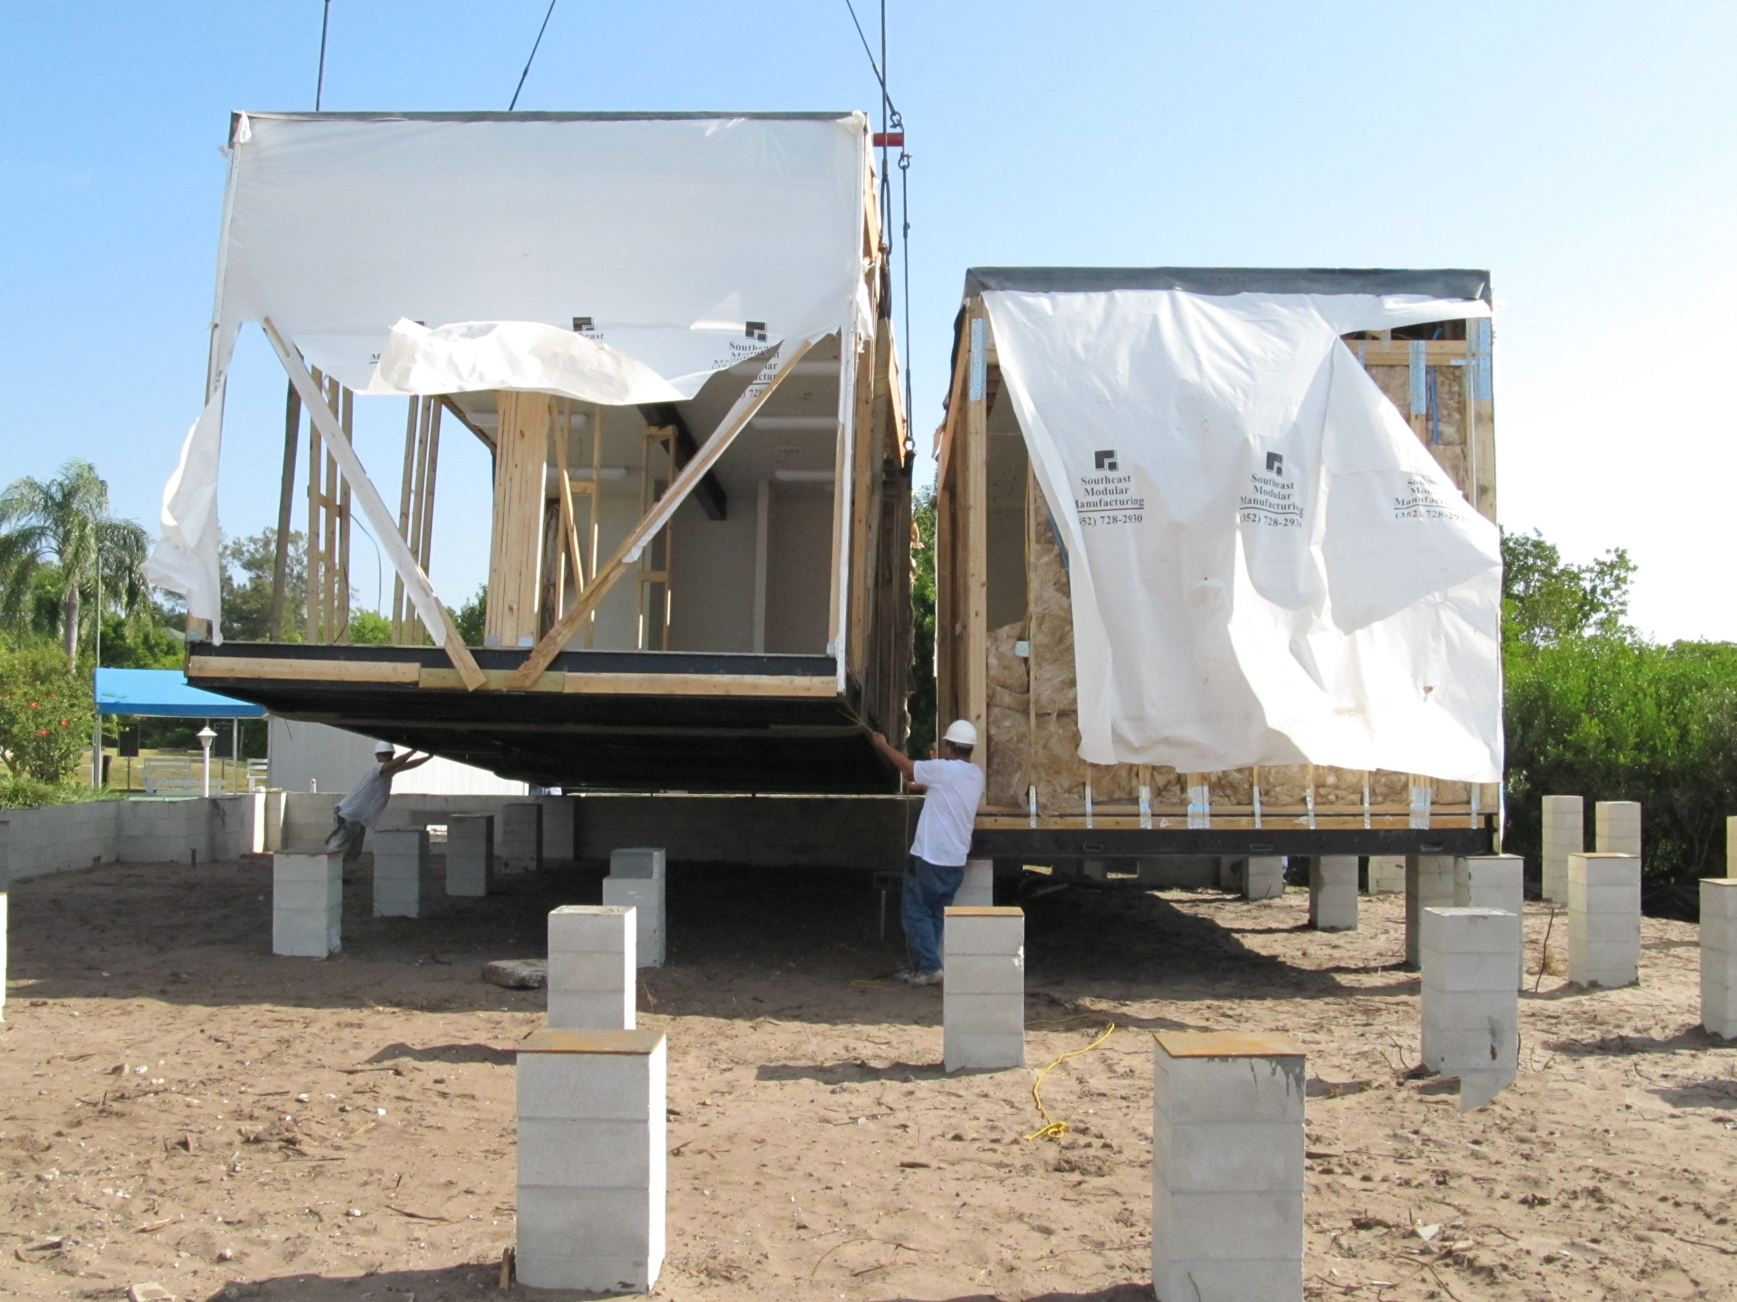
Second Module landing

Slide 32
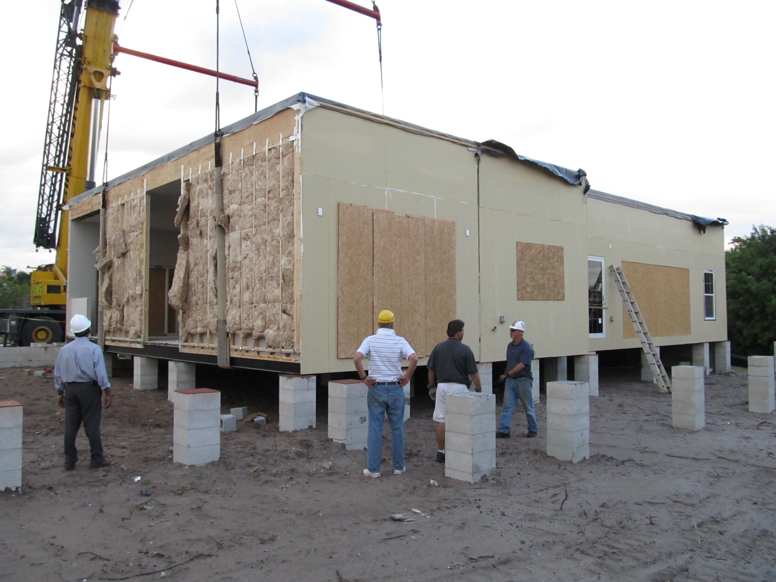
5 Modules in place

Slide 33
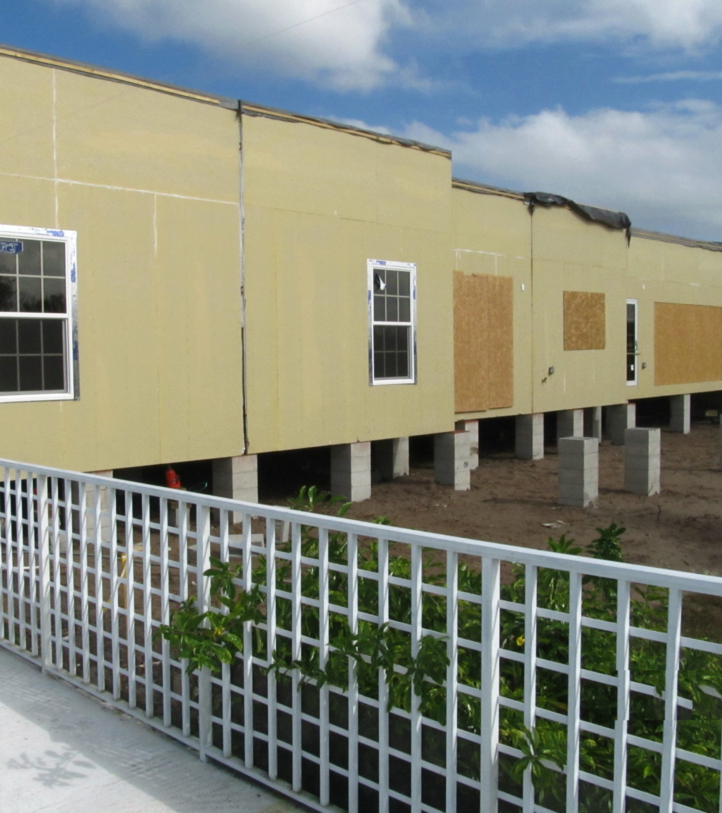
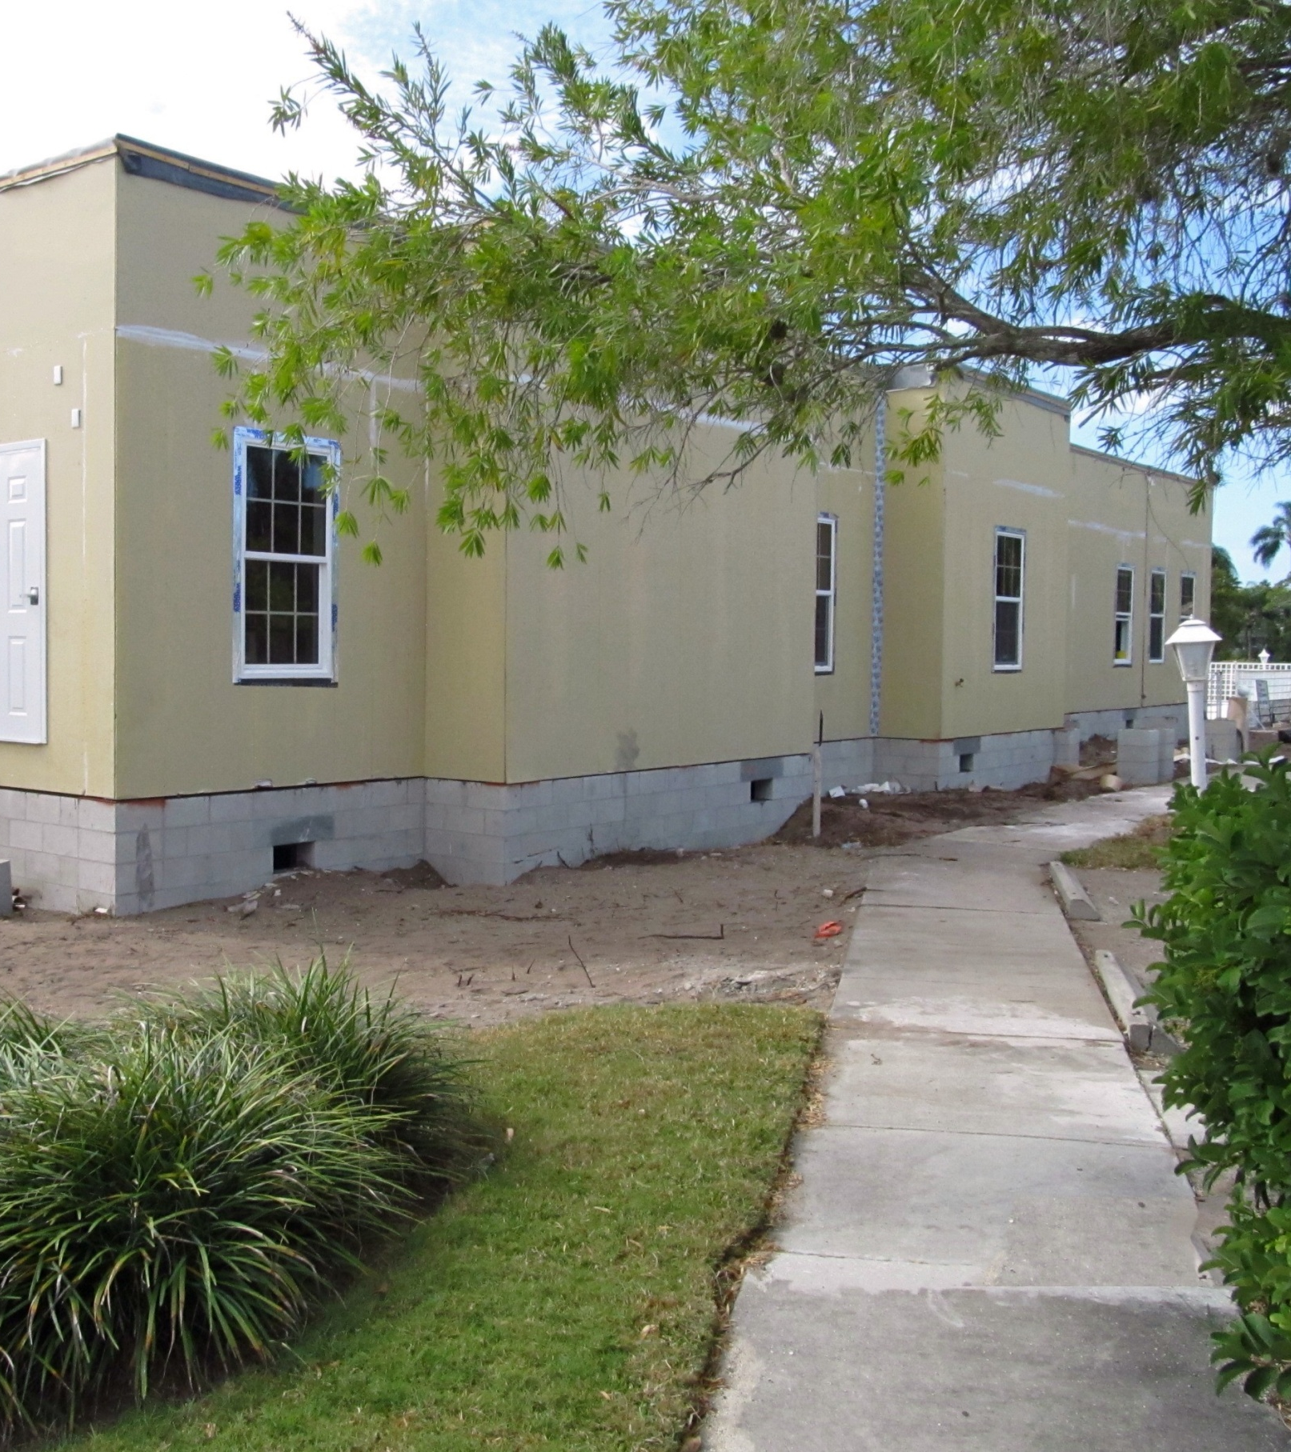
All 7 modules in place in just one Day!

Slide 34
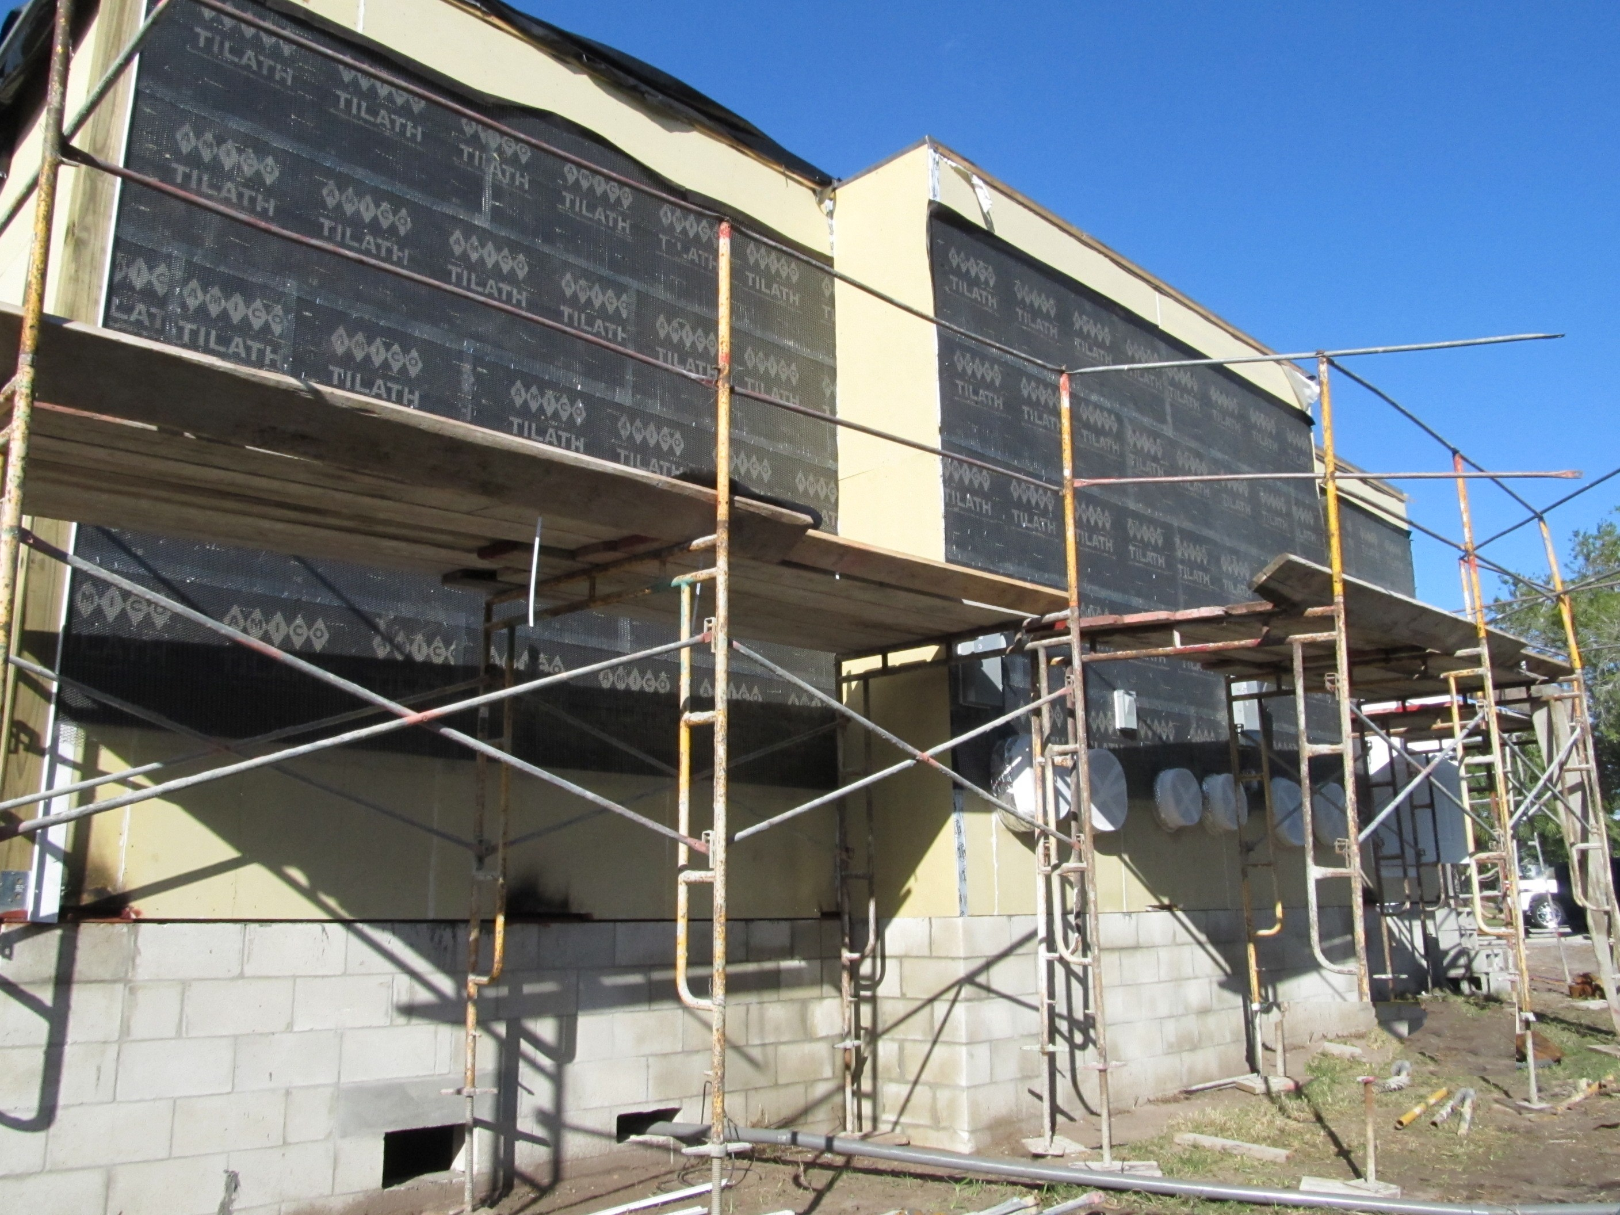
Lath going on in preparation for stucco finish

Slide 35
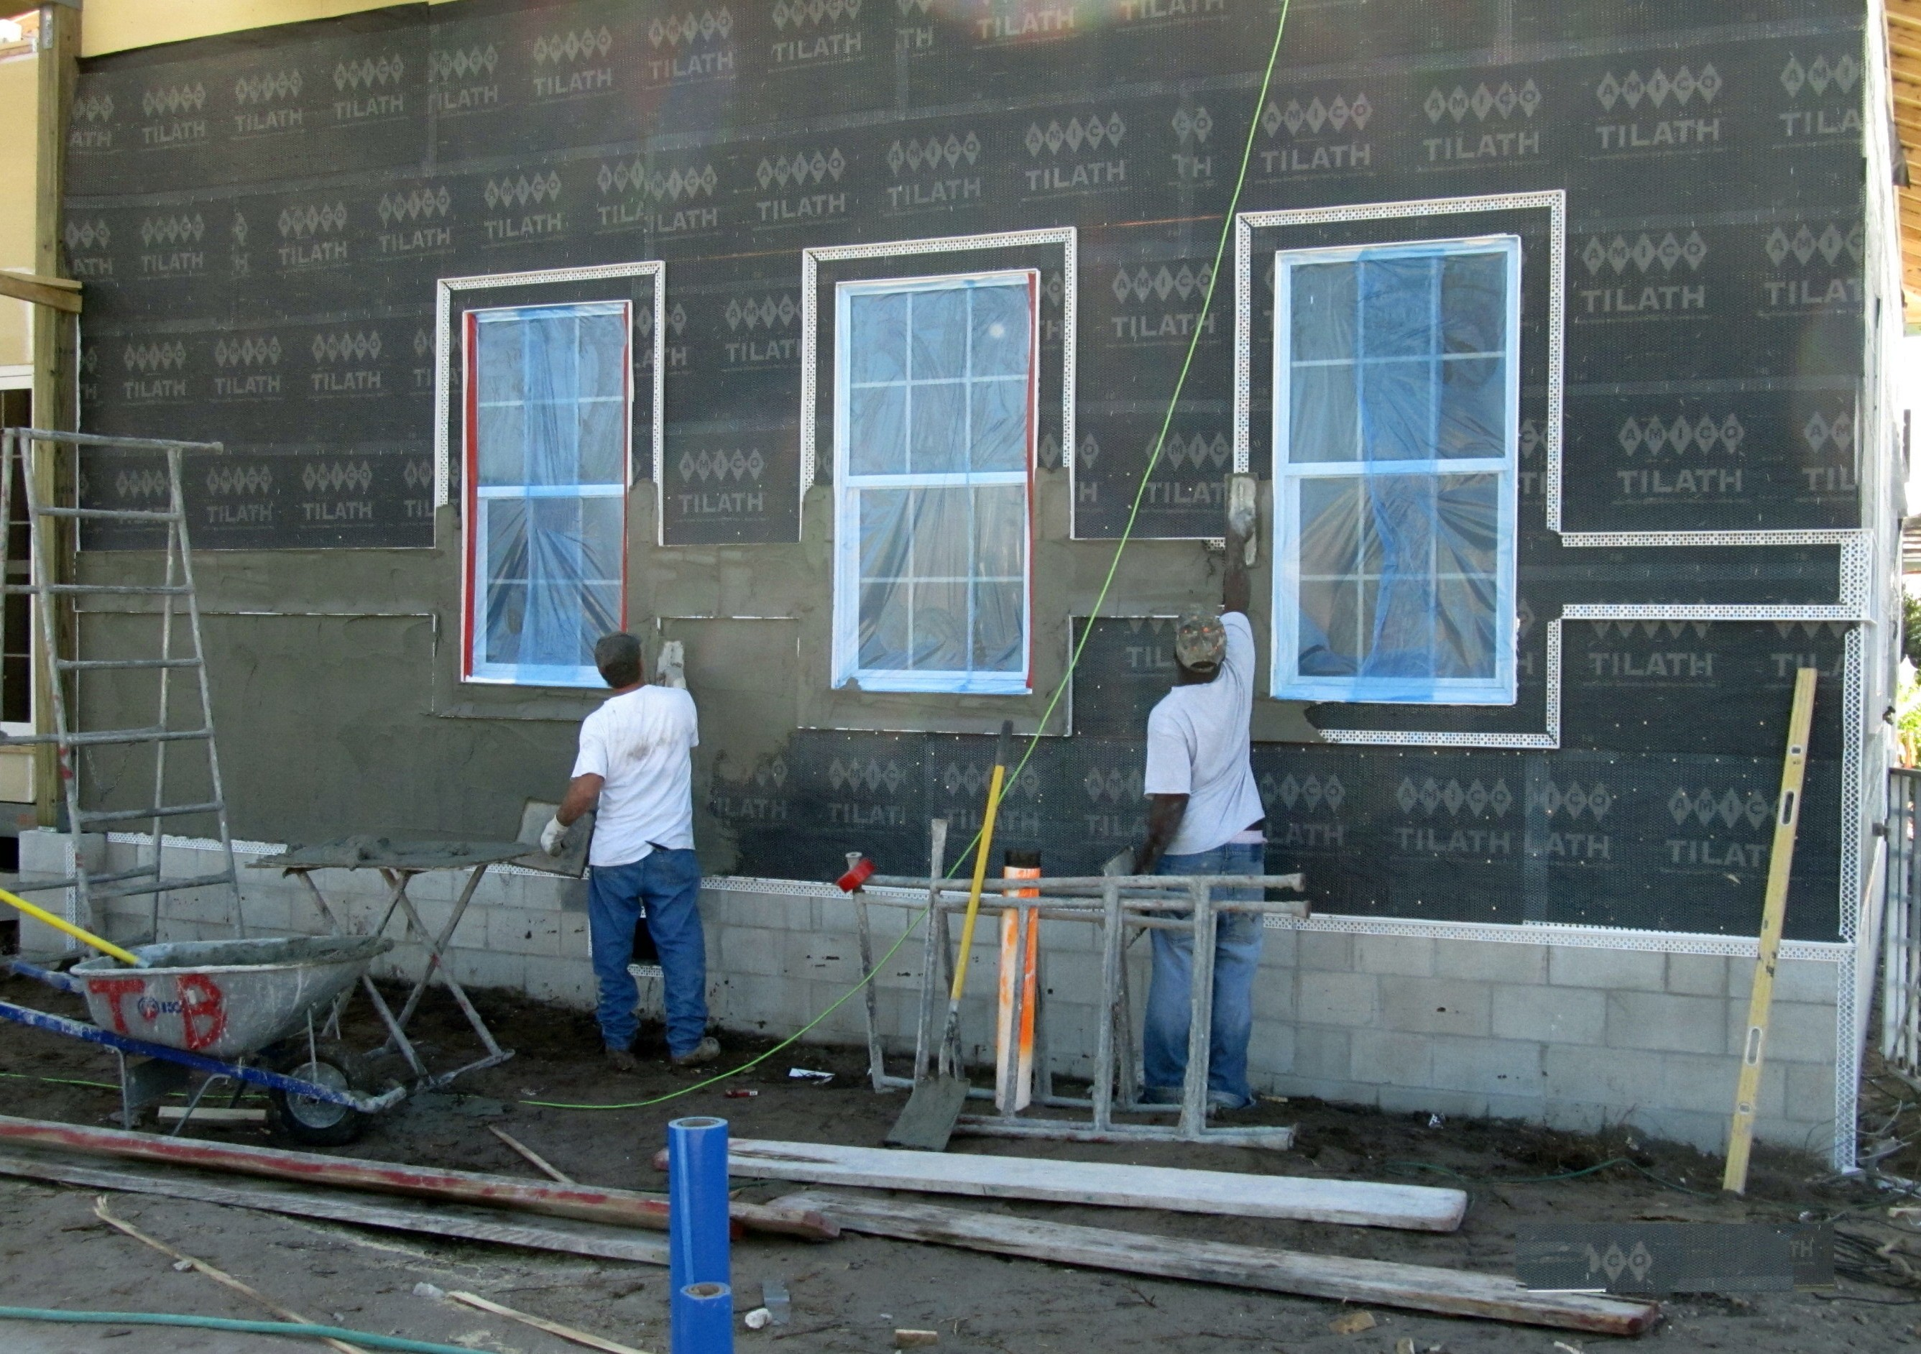

Slide 36
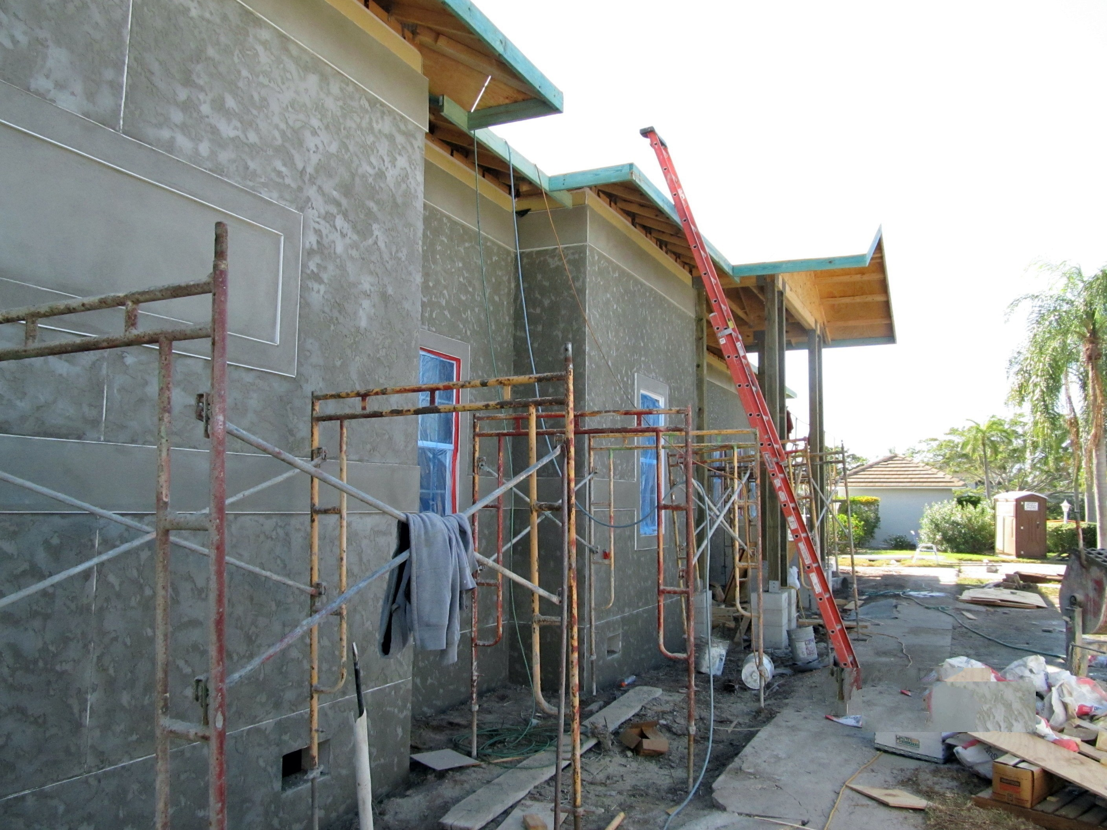
Finished Stucco

Slide 37
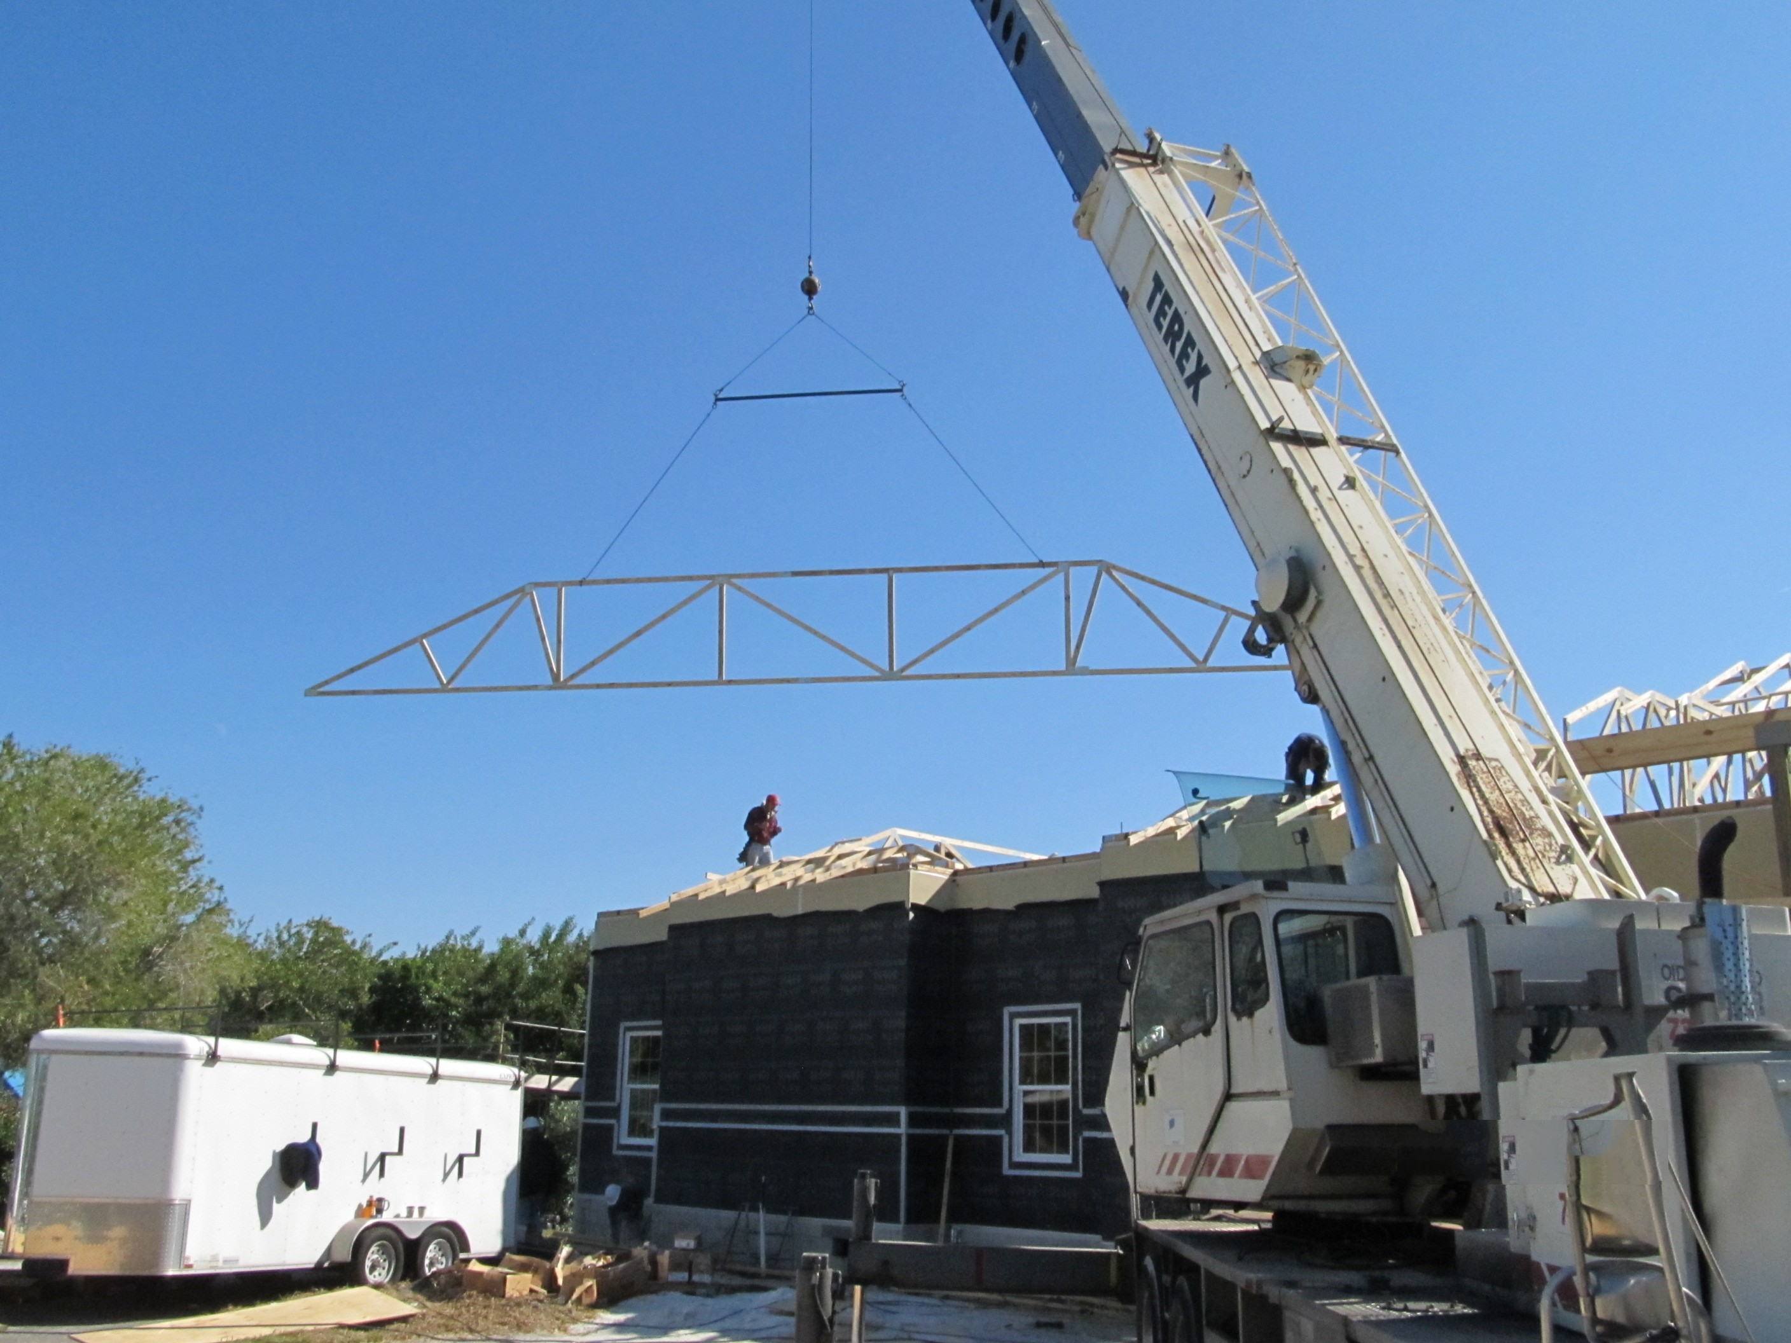
Roof trusses are flown into position

Slide 38
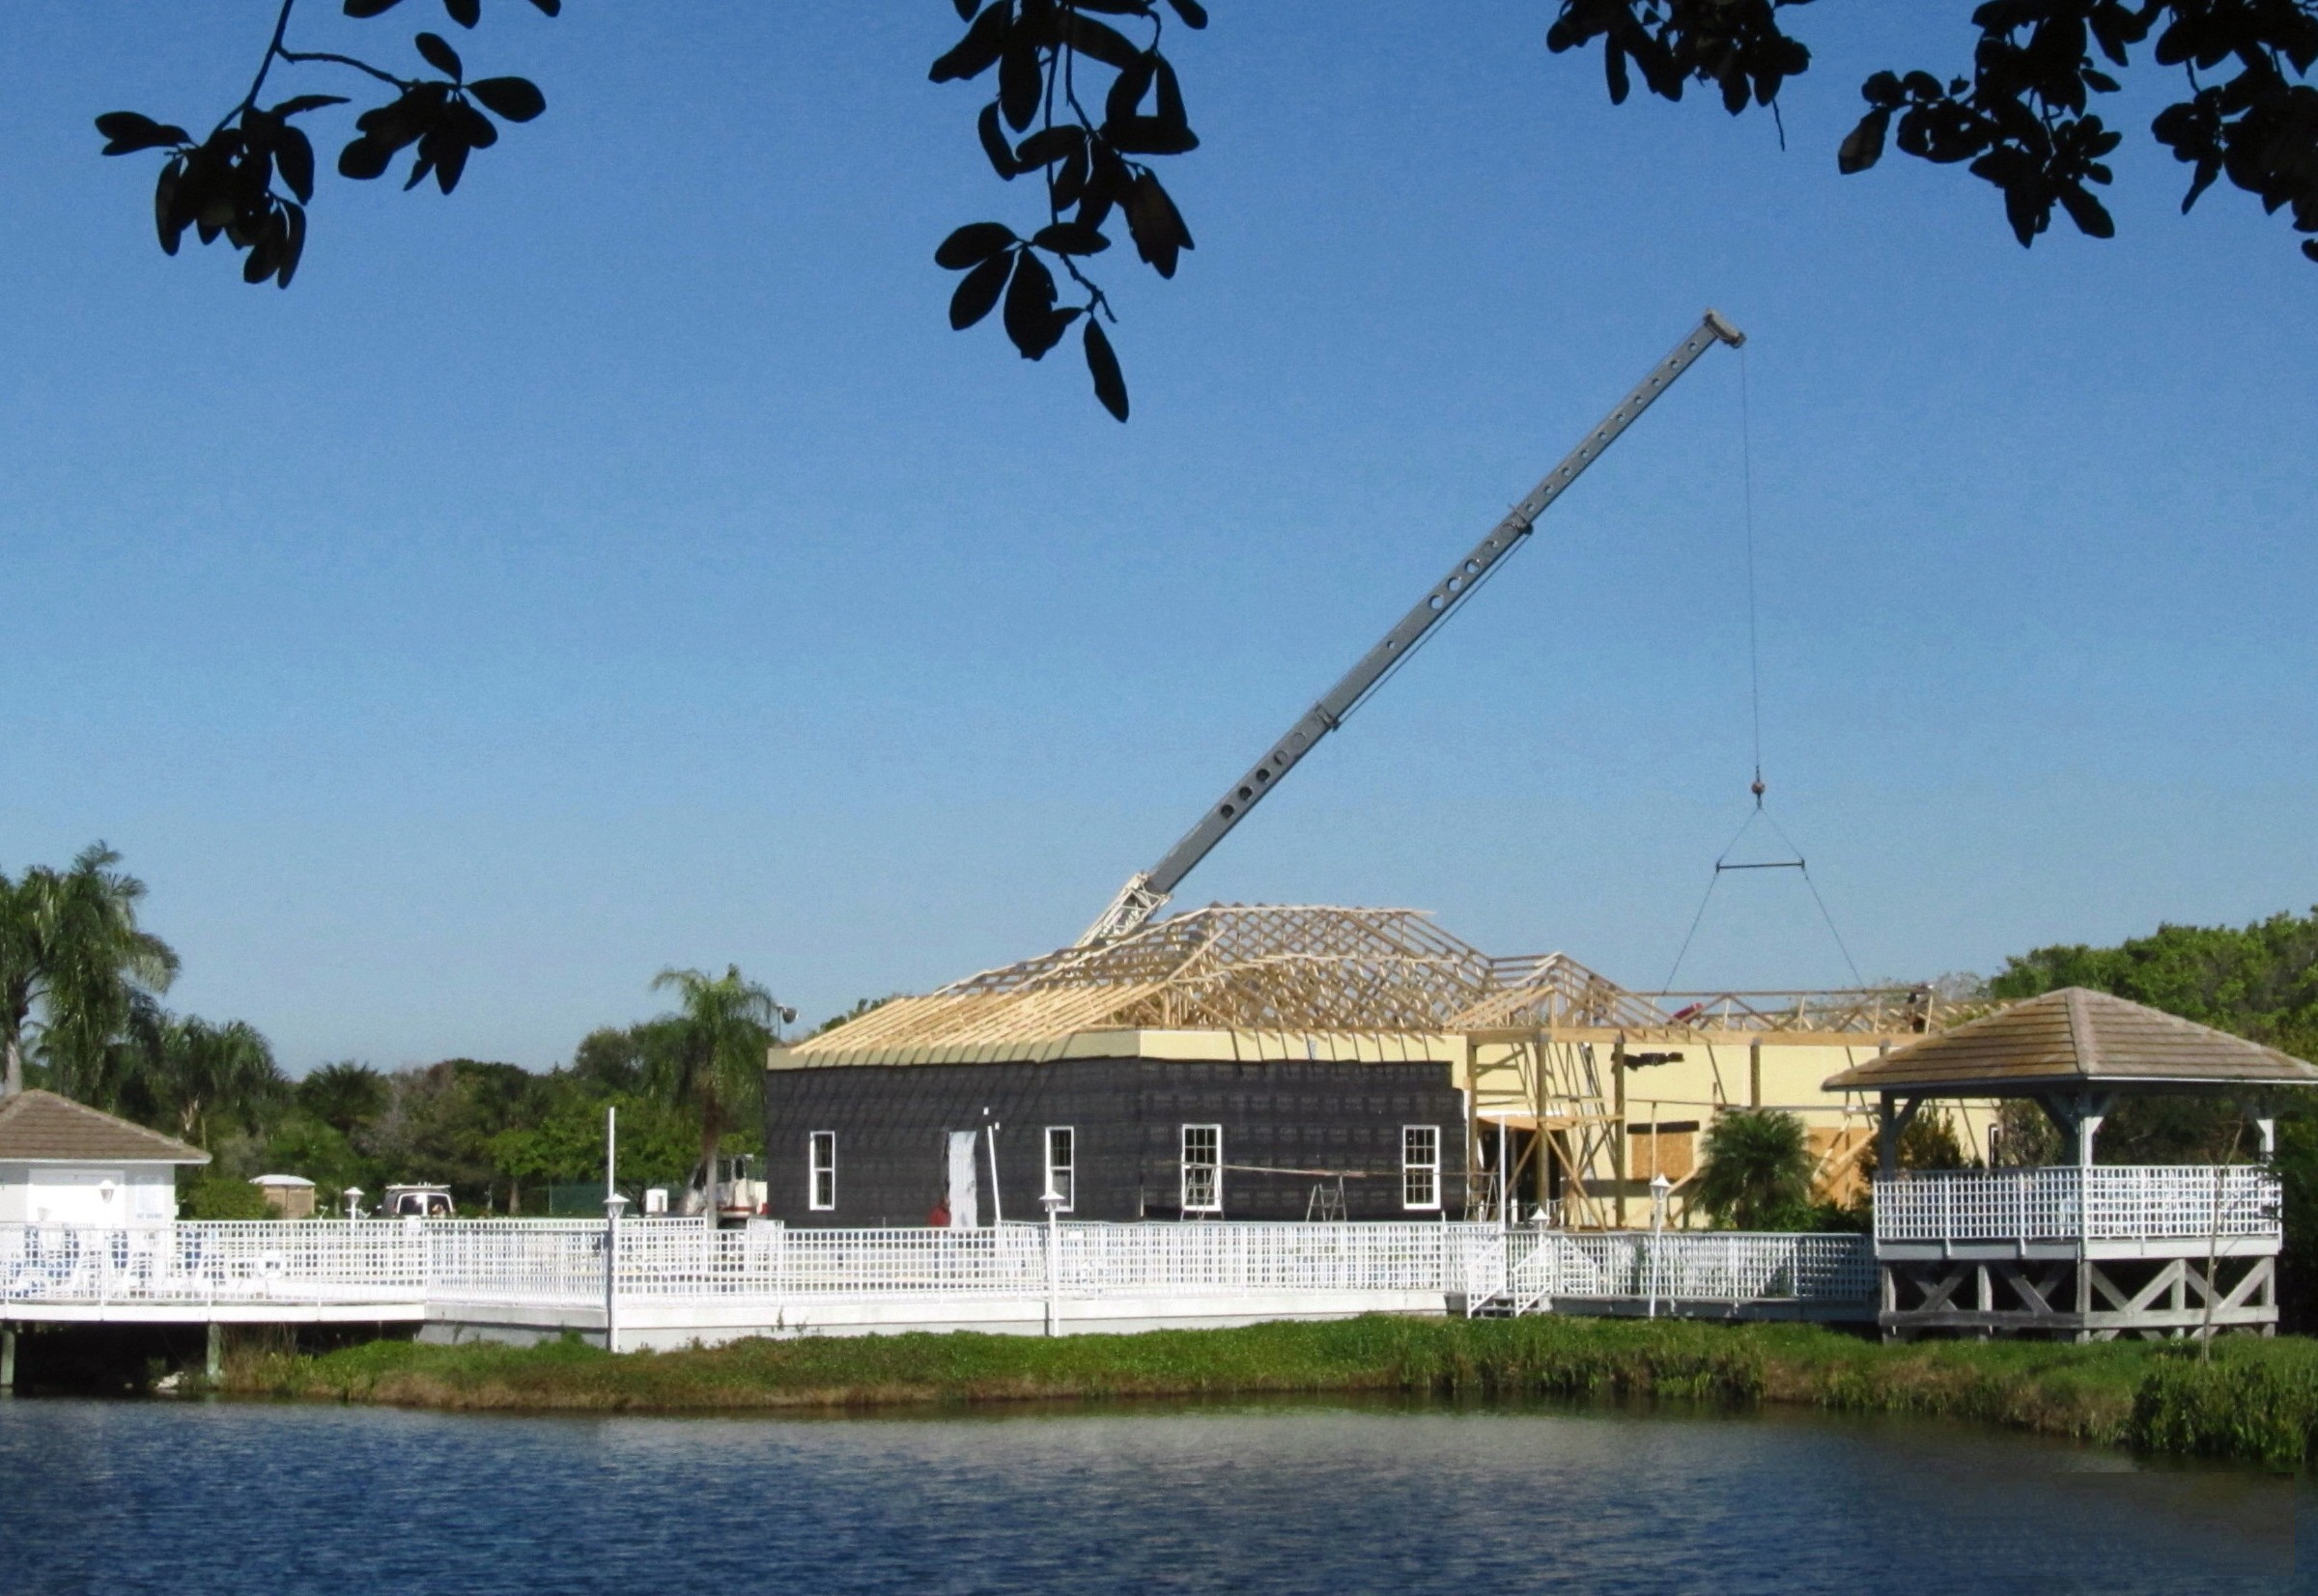

Slide 39
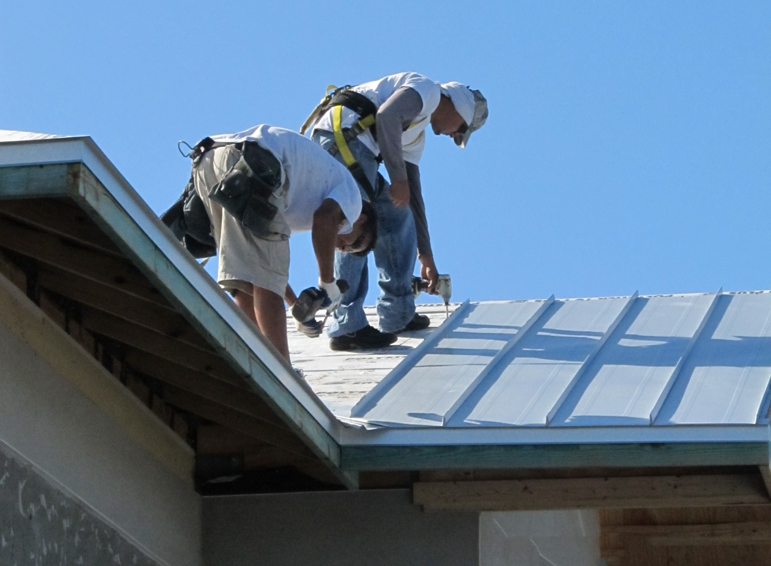
Metal Roof finish installed

Slide 40
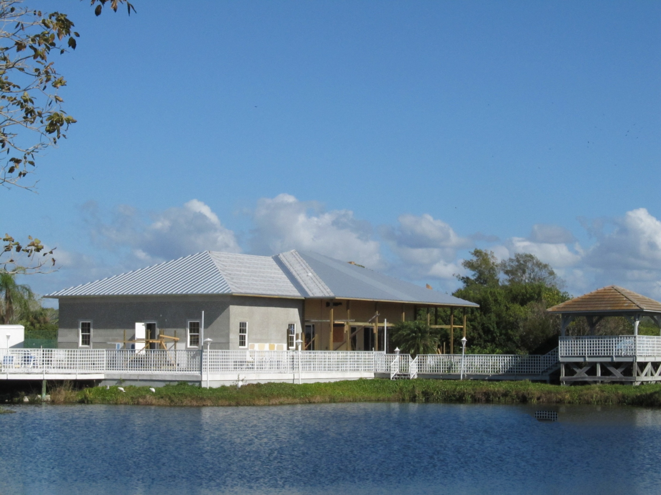
Roof is complete

Slide 41
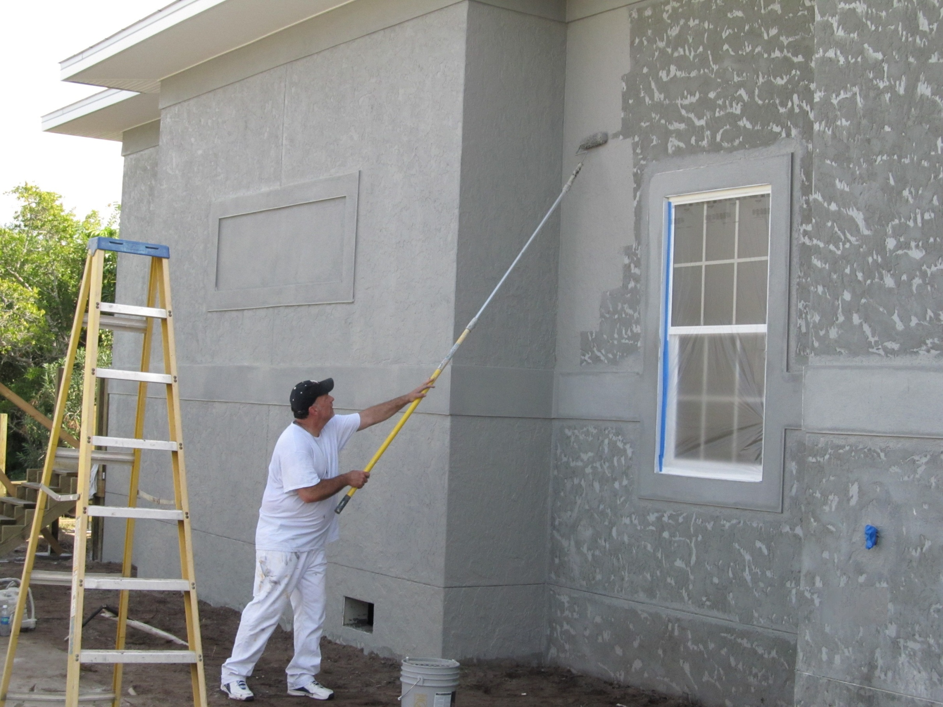
Paint goes on

Slide 42
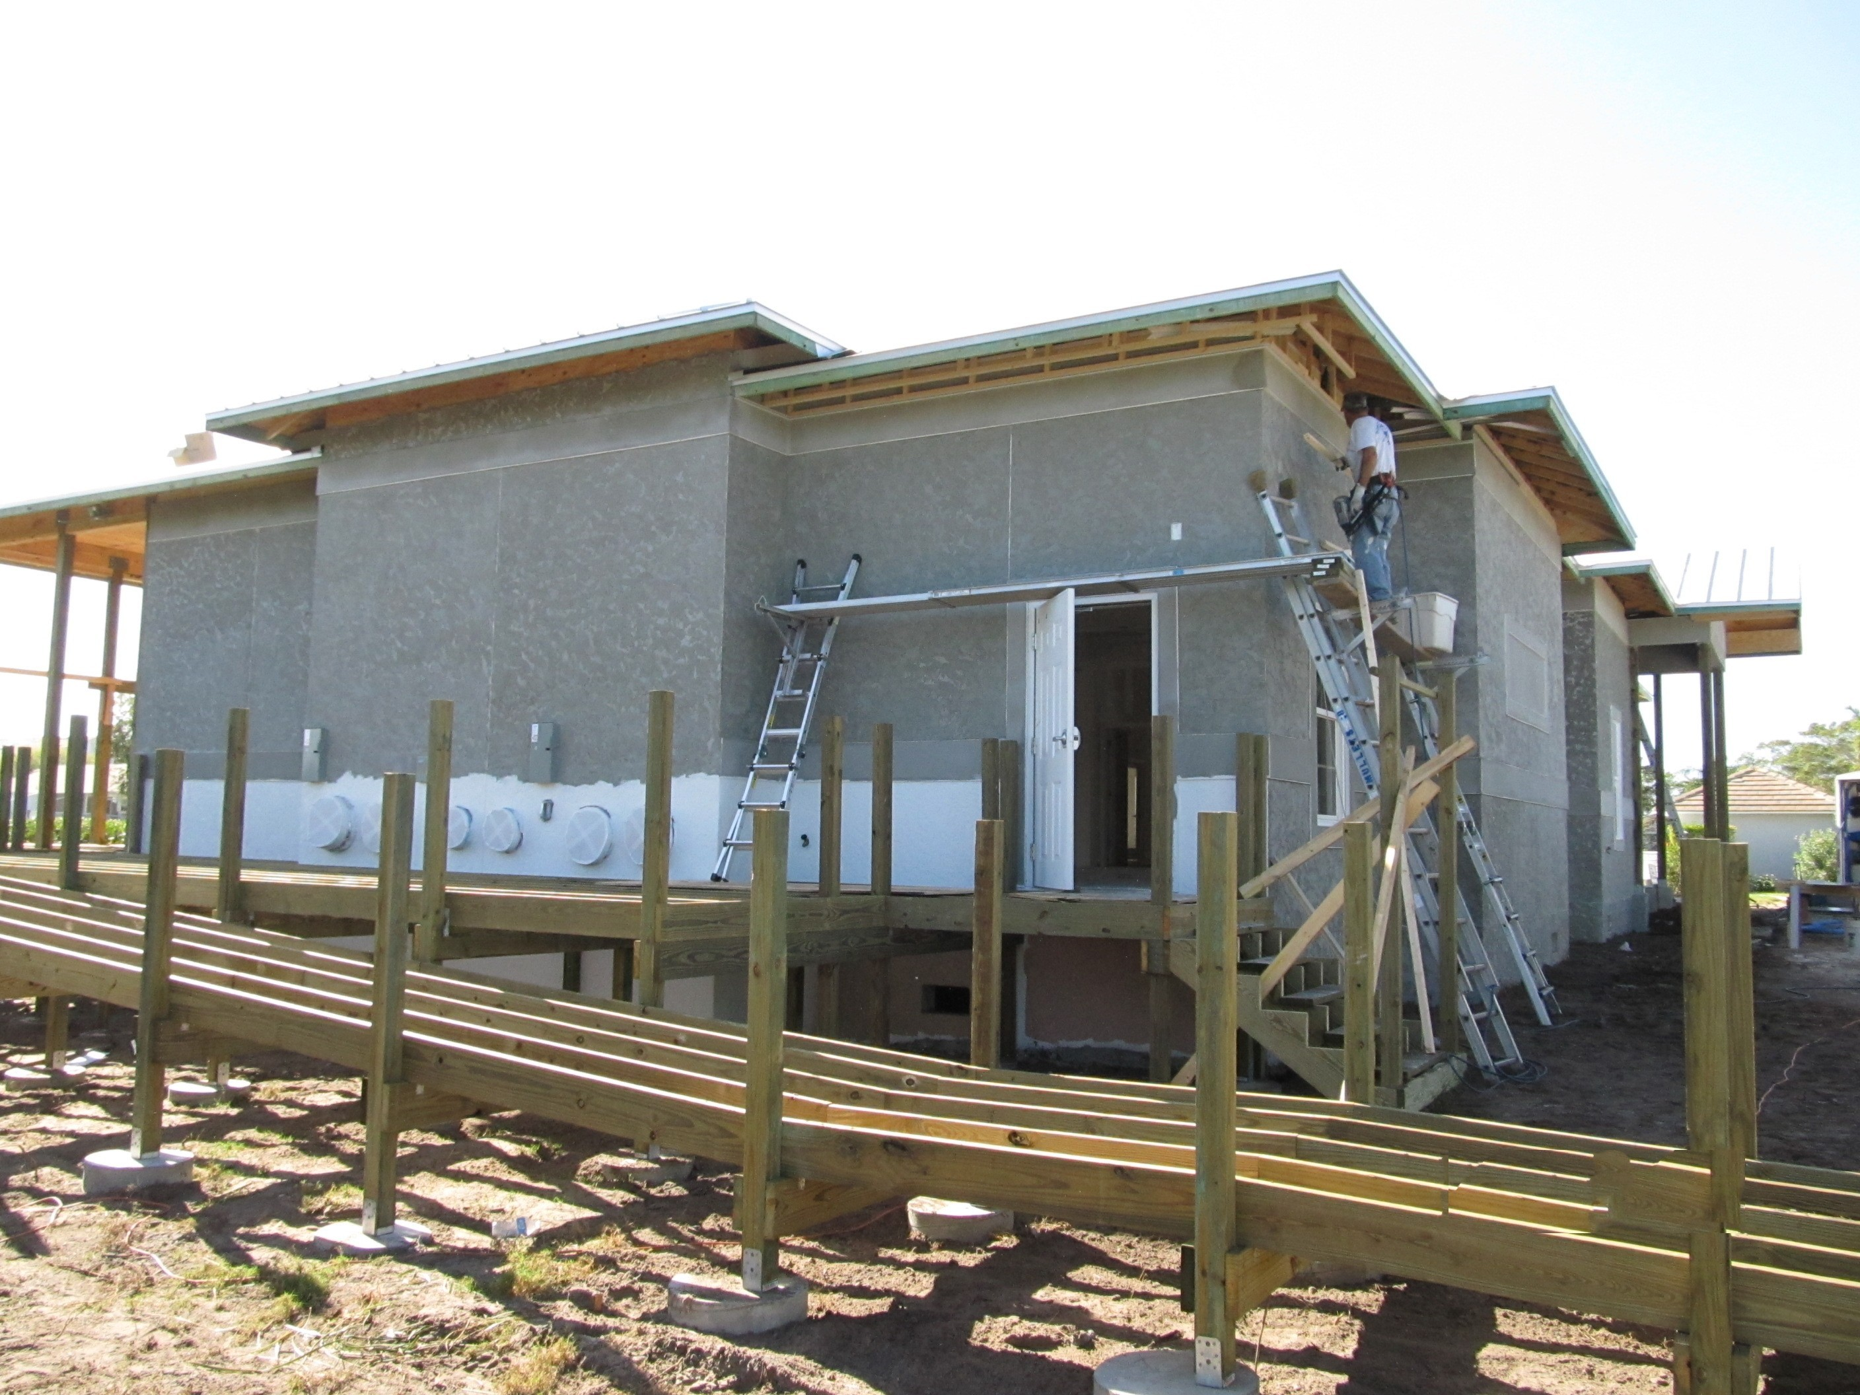
Construction of decks and ramp

Slide 43
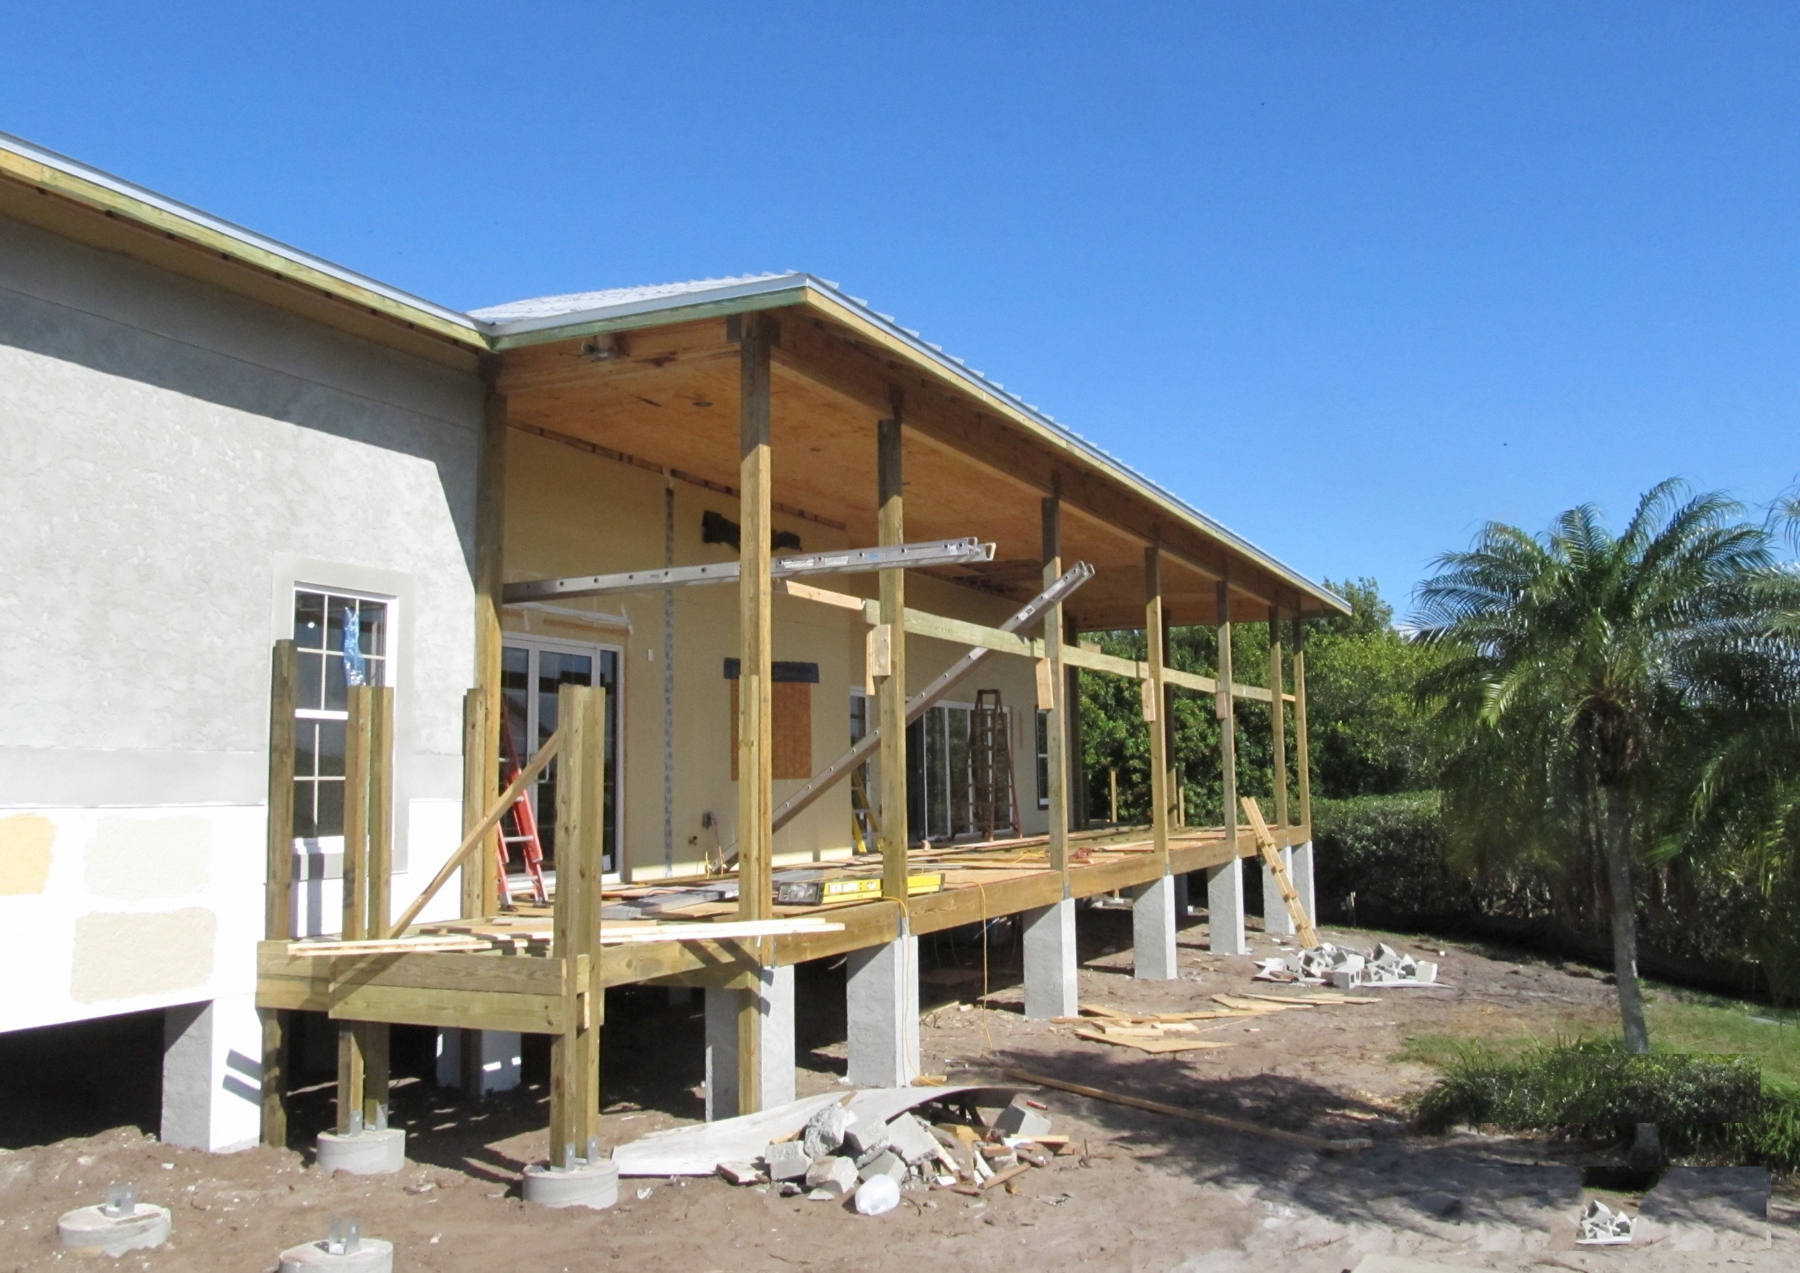

Slide 44
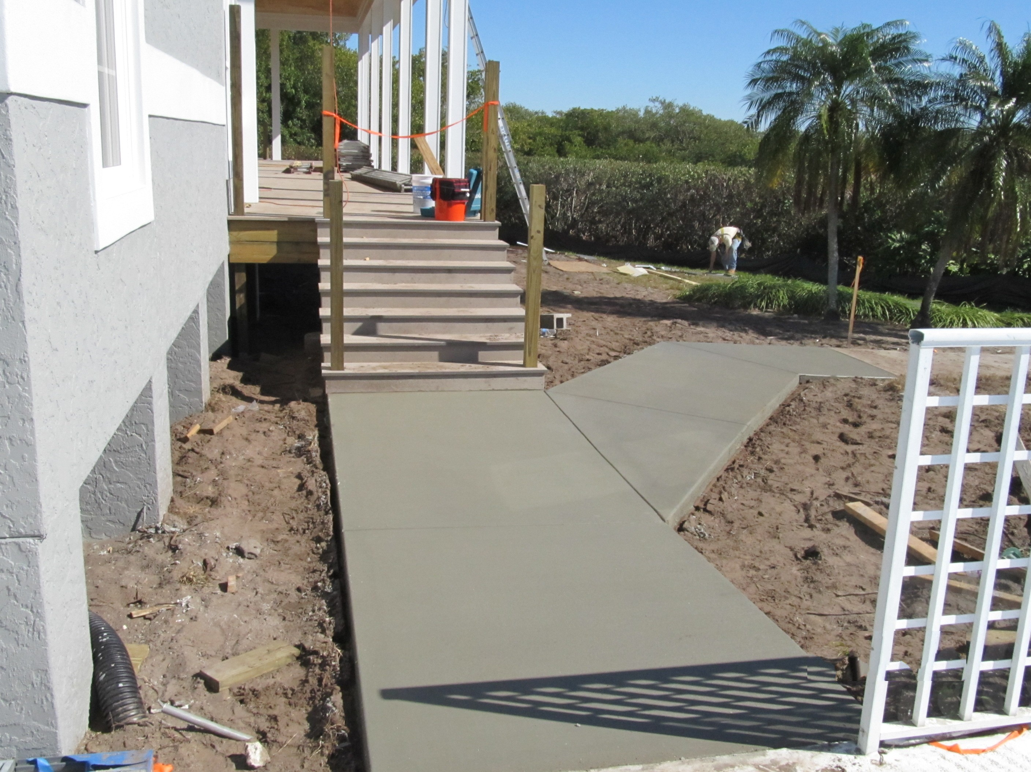
Sidewalks are poured

Slide 45
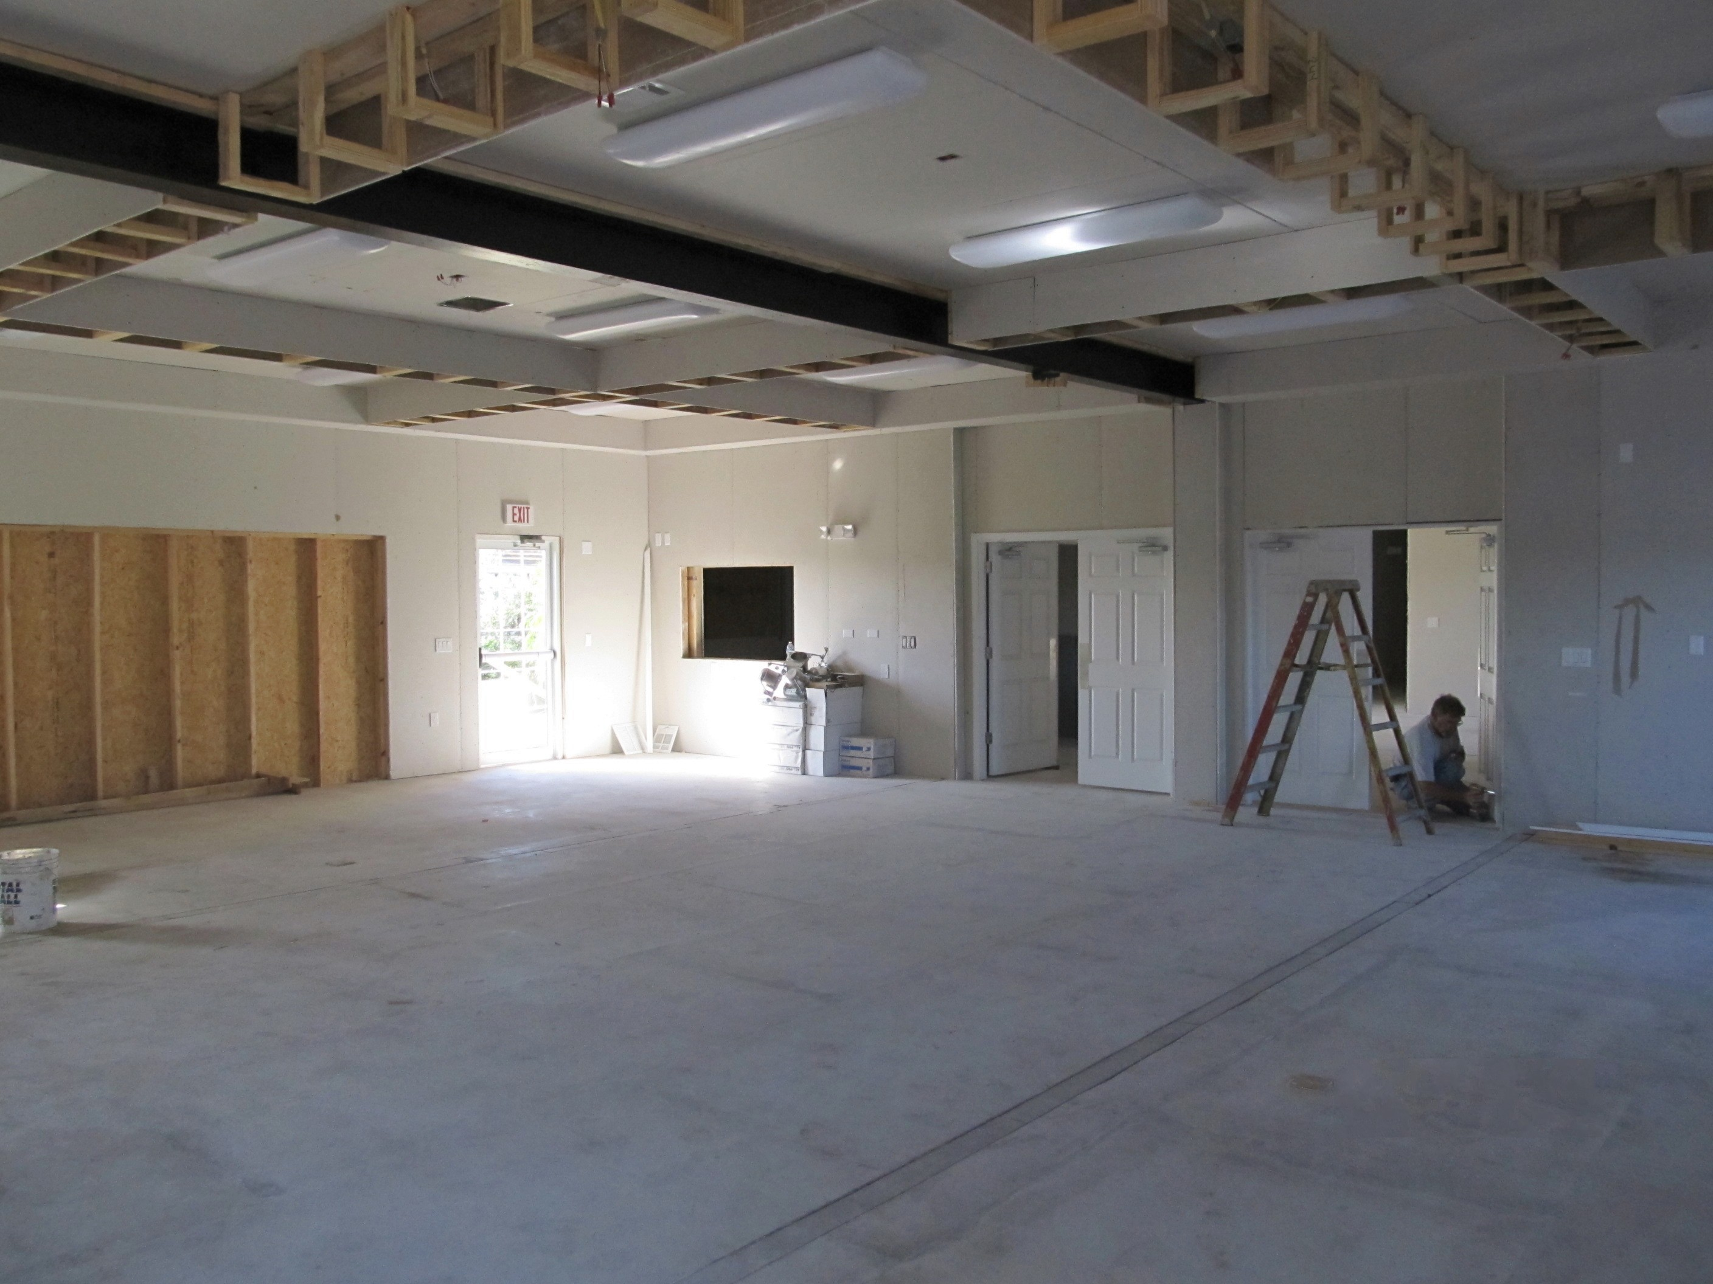
Interior of building received from factory

Slide 46
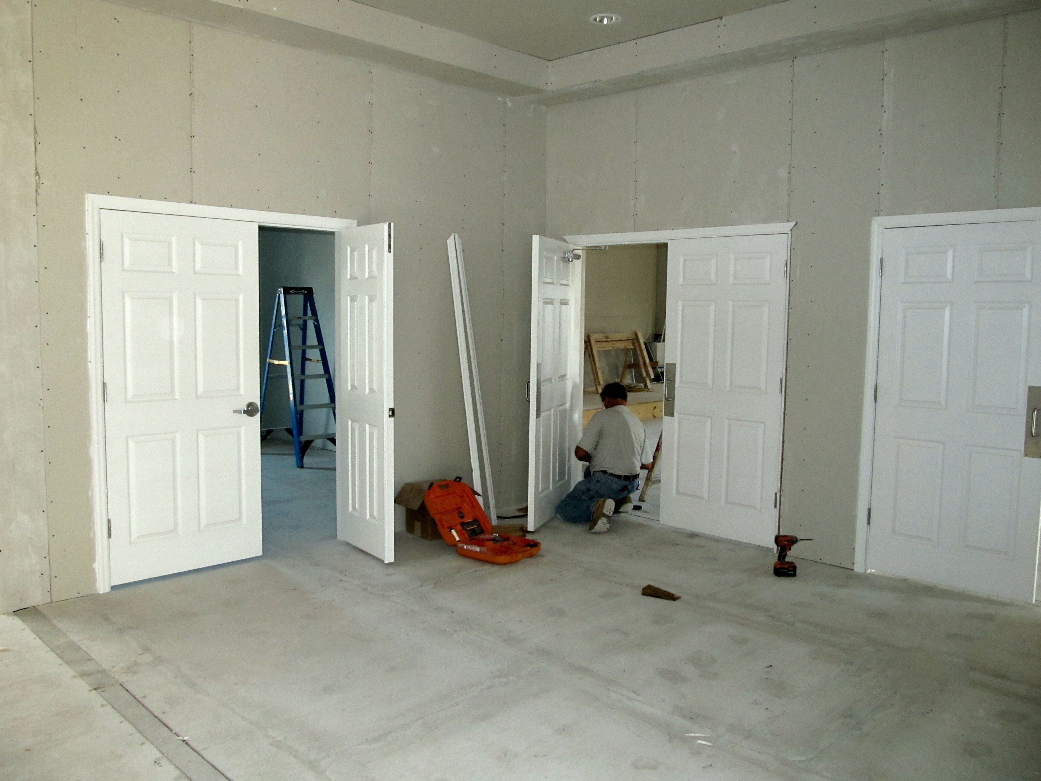

Slide 47
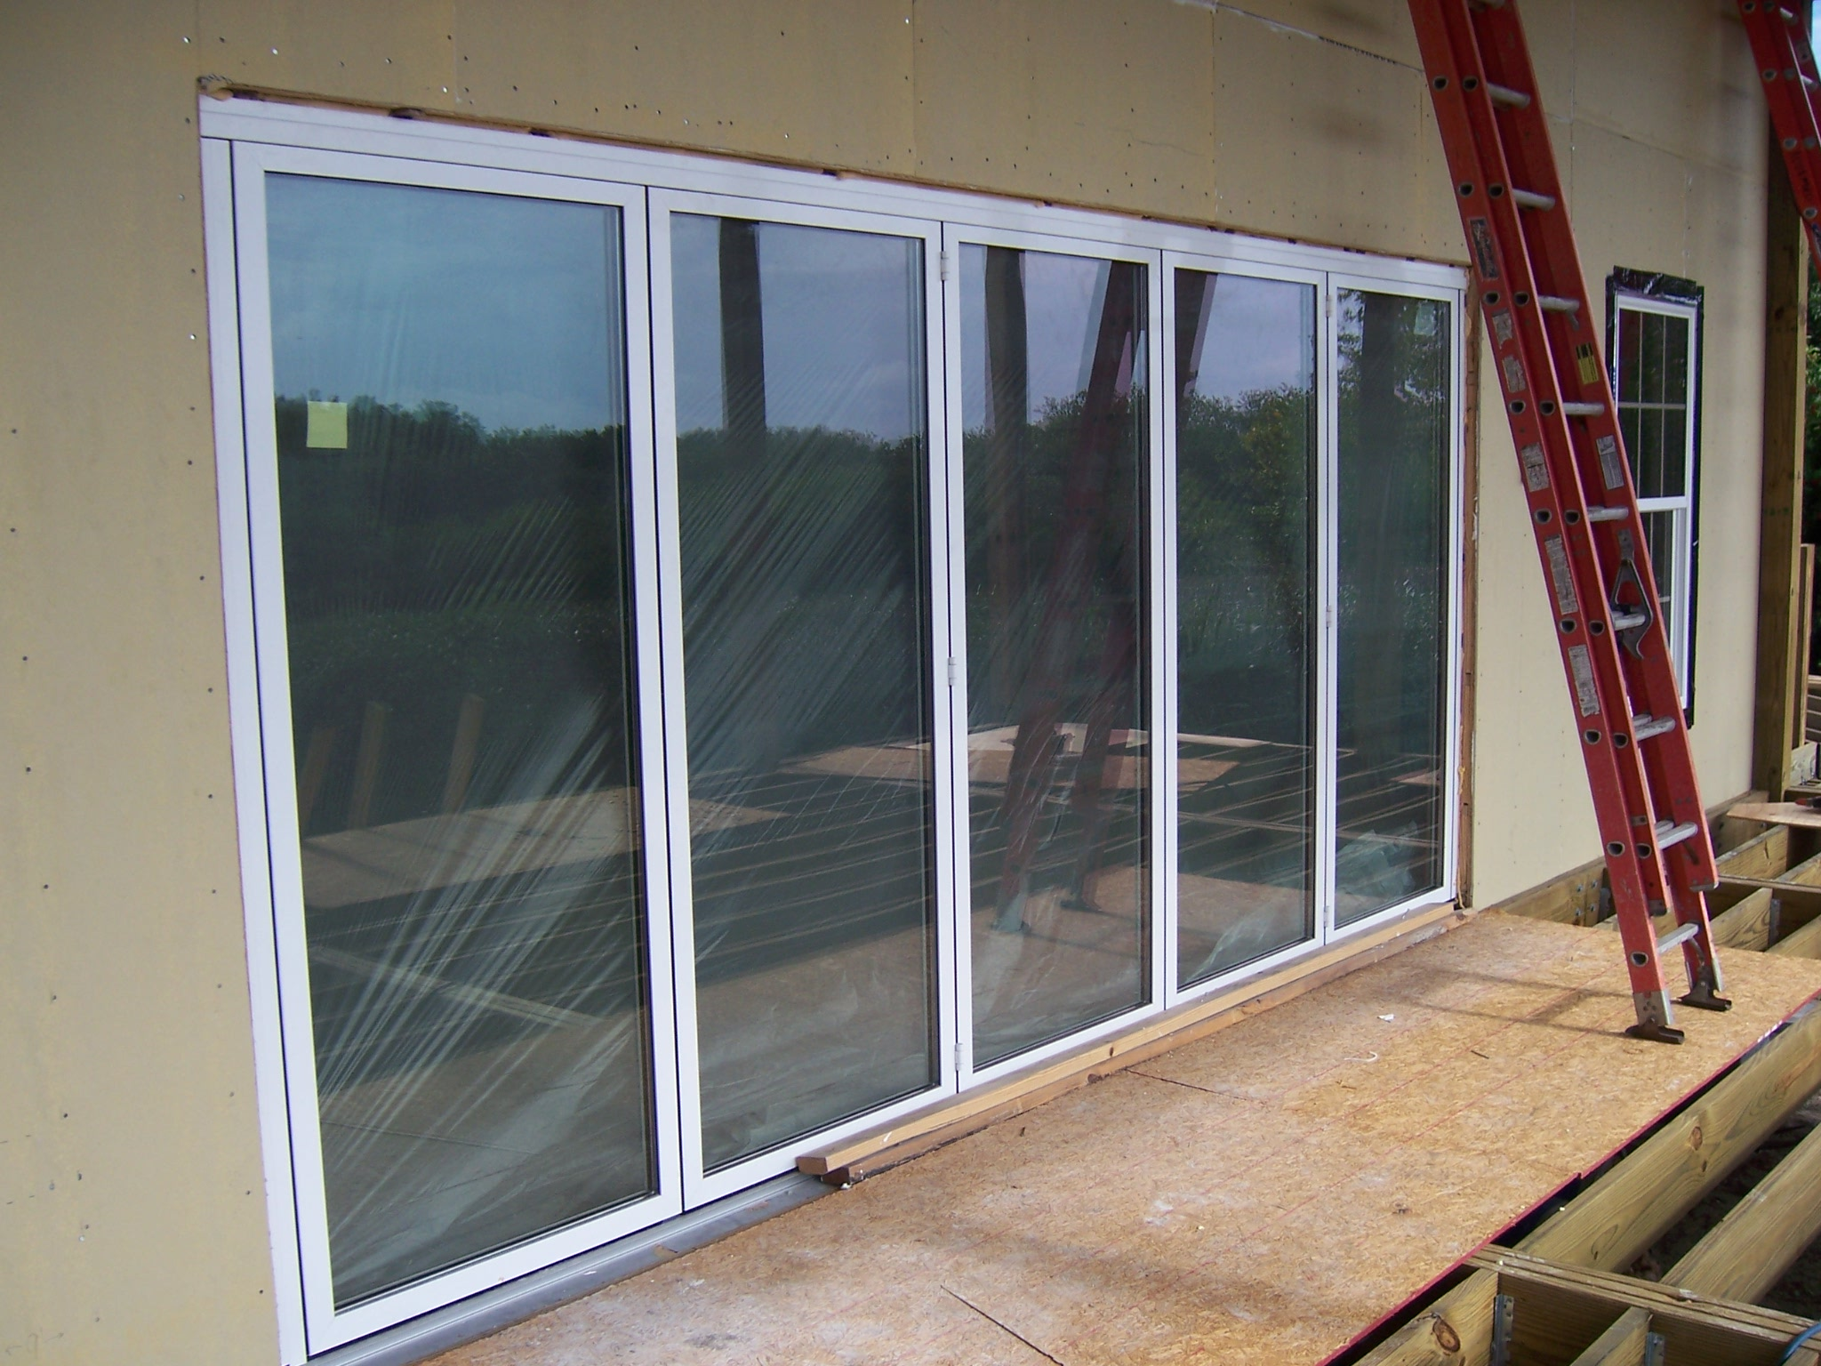
Folding Glass Wall installed

Slide 48
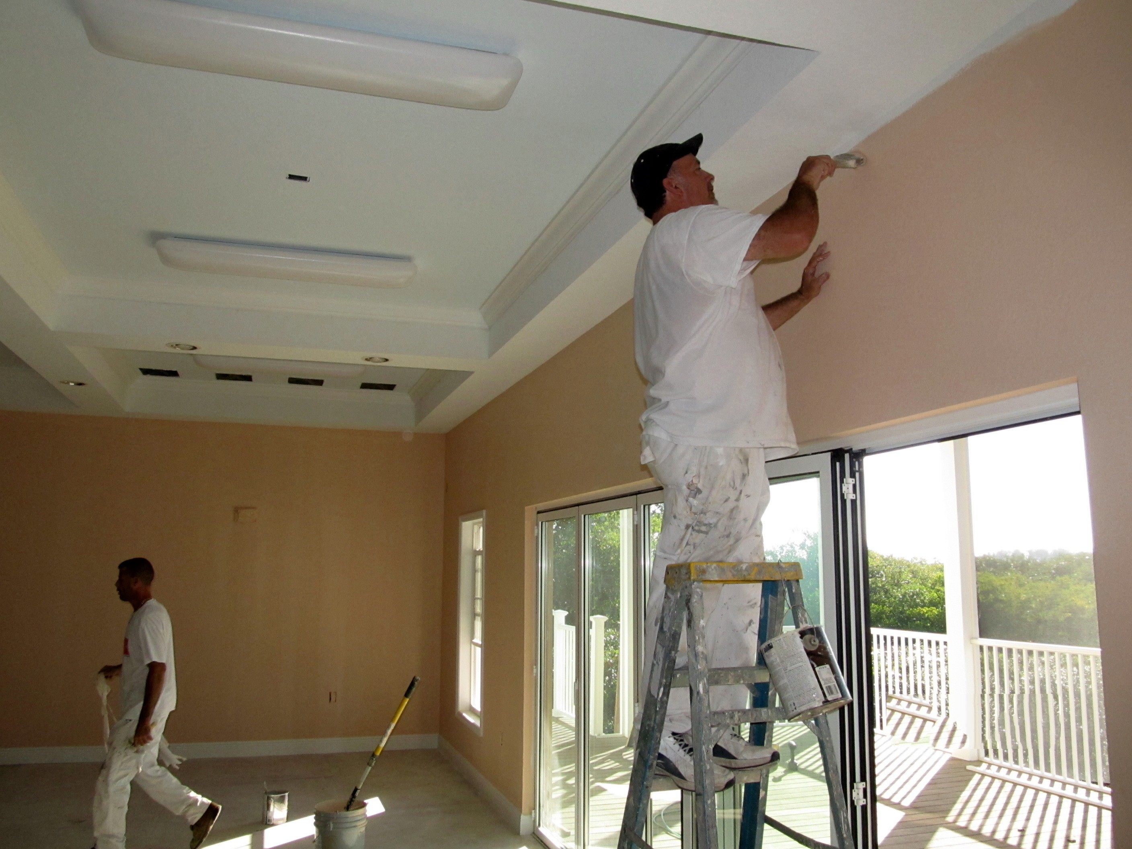
Drywall finished and painted

Slide 49
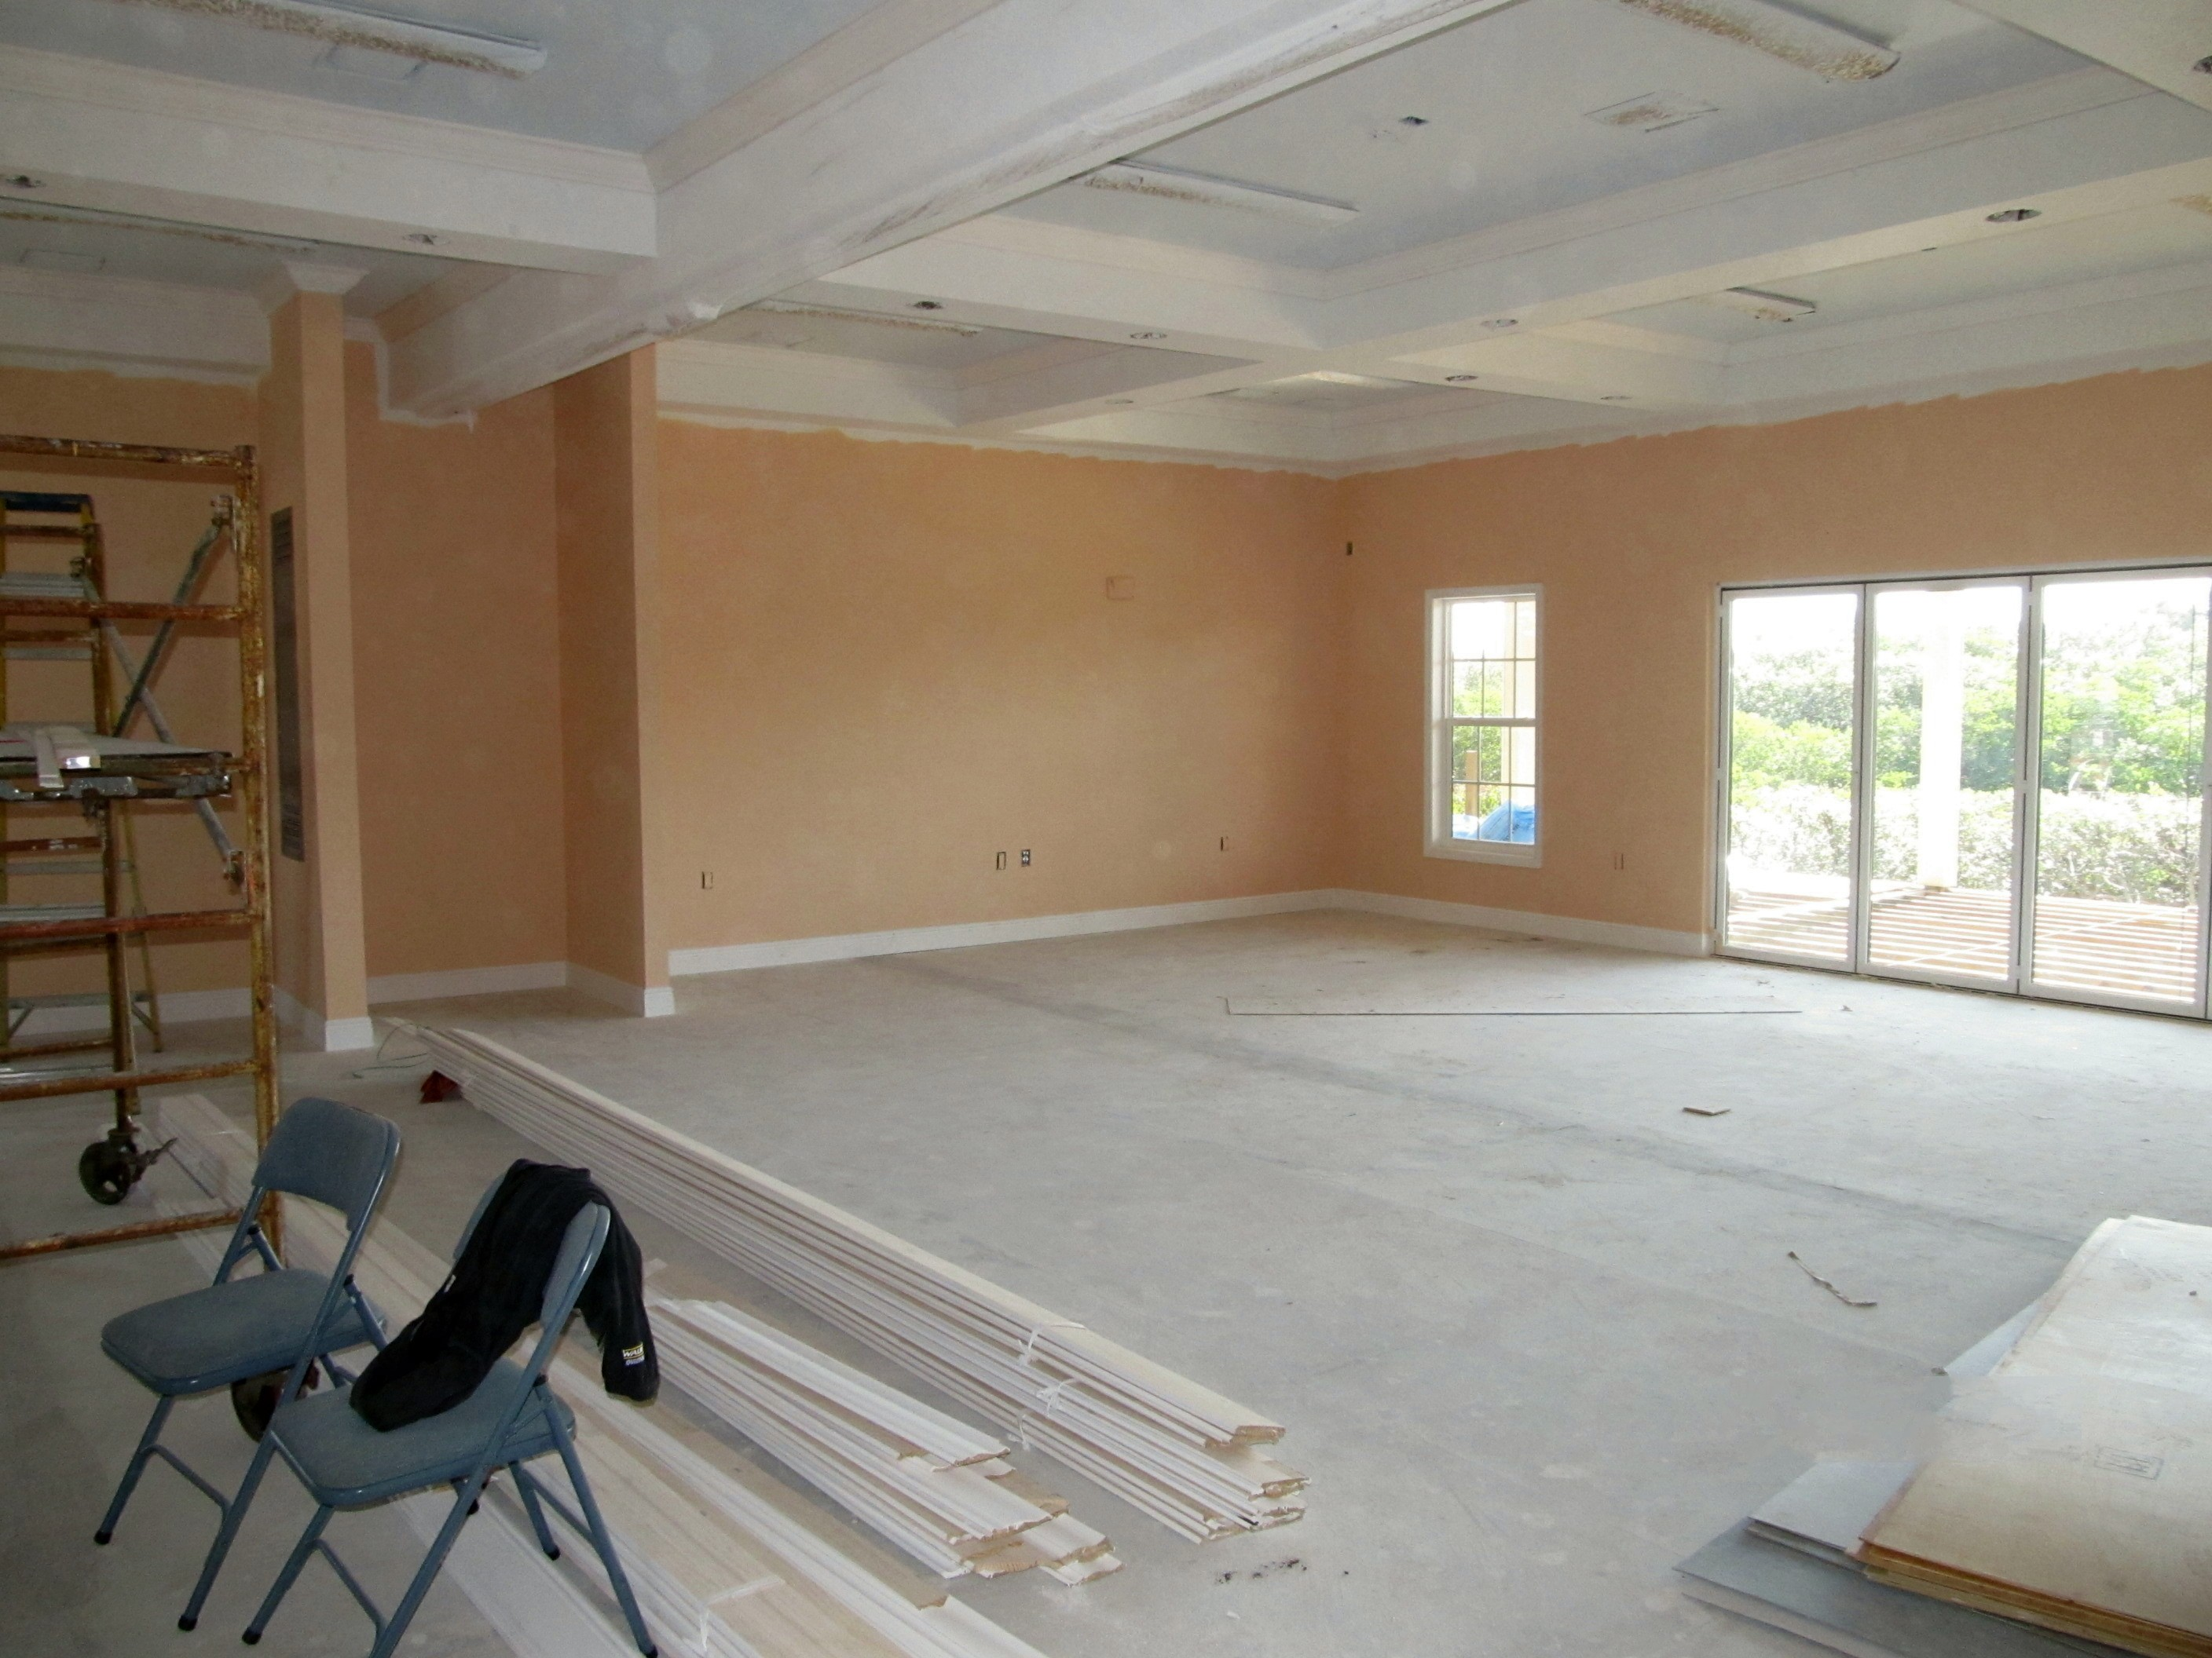

Slide 50
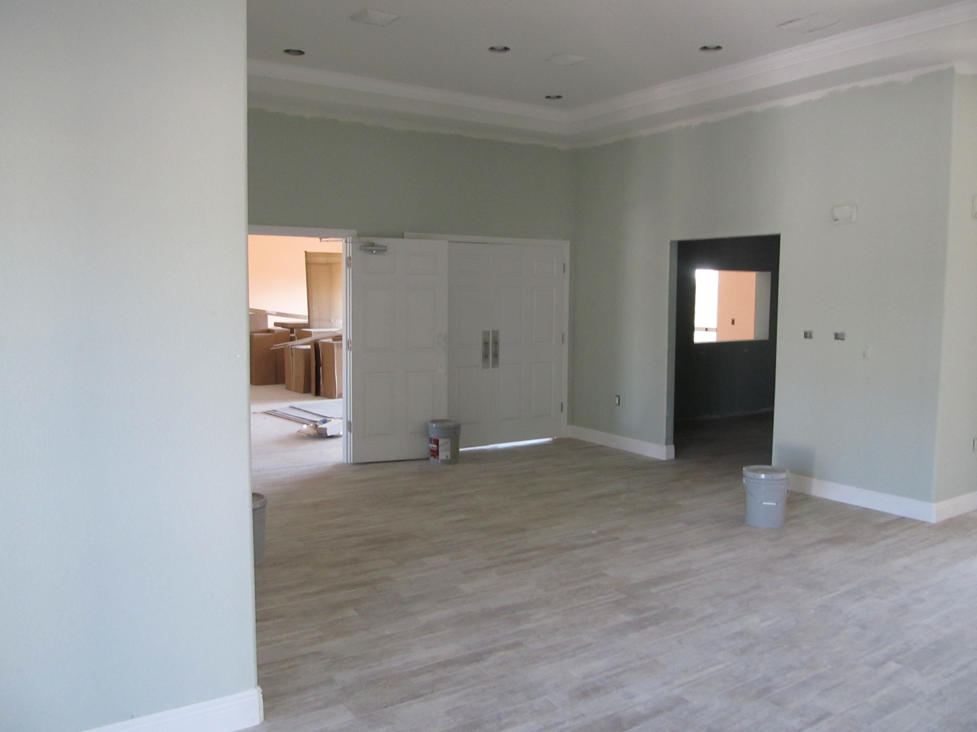
Ceramic Tiles installed

Slide 51


Slide 52

Kitchen cabinets installed

Slide 53


Slide 54

Electrical, Plumbing and Air Conditioning are completed

Slide 55


Slide 56


Slide 57

Finished Ceiling

Slide 58

Folding Room Partition

Slide 59

Women’s Restroom

Slide 60

Auditorium with stage

Slide 61

Screened Deck

Slide 62

Exercise Room

Slide 63

Landscaping and Parking Lot Complete

Slide 64

Project completed in just 3 months

Slide 65


Slide 66

Vision Building Systems, L.L.C.
For Information regarding your project call: 954-494-0737

